Slide 1
Practical and Secure Dynamic Searchable Encryption via Oblivious Access on Distributed Data Structure
Thang Hoang
EECS, Oregon State University
Corvallis, Oregon, 97331
hoangmin@eecs.oregonstate.edu
  Attila Altay Yavuz
  EECS, Oregon State University
  Corvallis, Oregon, 97331
  attila.yavuz@oregonstate.edu
Jorge Guajardo
Robert Bosch LLC – RTC
Pittsburgh, PA, 15222
Jorge.GuajardoMerchan@us.bosch.com

Slide 2













Privacy vs. Data Utilization Dilemma
Sensitive information
Client
(encrypted)
Storage on the cloud
Outsource data
Standard Encryption
(e.g., AES)
SEARCH?
ANALYZE?
  CAN’T SEARCH!
  CAN’T ANALYZE!
IMPACT

Slide 3





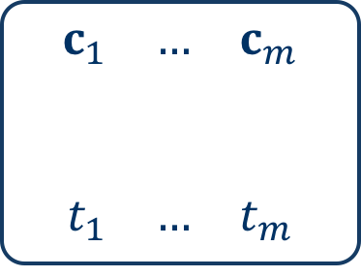
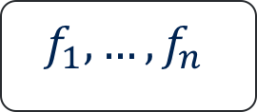

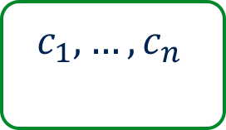
Dynamic Searchable Symmetric Encryption (DSSE)
Generic Framework
Client
Cloud
$$f_{1},…, f_{n}$$
Standard encryption
1. Extract keywords
Encrypted files
$$c_{1},…, c_{n}$$
$$w_{1},…, w_{m}$$
2. Generate trapdoors
Encrypted data structure
Create encrypted
data structure
$$\begin{matrix}c_{1} & … & c_{m}\end{matrix}$$
$$\begin{matrix}t_{1} & … & t_{m}\end{matrix}$$
$$t_{1},…, t_{m}$$
(searchable representation)

Slide 4


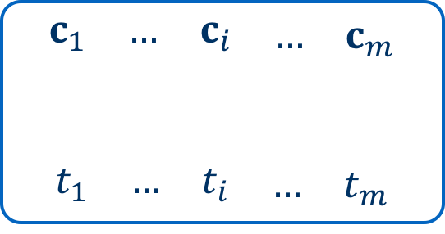




Dynamic Searchable Symmetric Encryption
Keyword Search Example
Client
Cloud
$$(f_{1},…, f_{n^{′}})$$
search keyword $w_{i}$
Standard encryption
Encrypted files
$$c_{i}=(c_{1},…,c_{n^{′}})$$
$$(c_{1},…,c_{n})$$
1. Generate token
Encrypted data structure
$$\begin{matrix}\begin{matrix}c_{1} & … & c_{i}\end{matrix} & … & c_{m}\end{matrix}$$
$$\begin{matrix}\begin{matrix}t_{1} & … & t_{i}\end{matrix} & … & t_{m}\end{matrix}$$
$$t_{i}$$

Slide 5
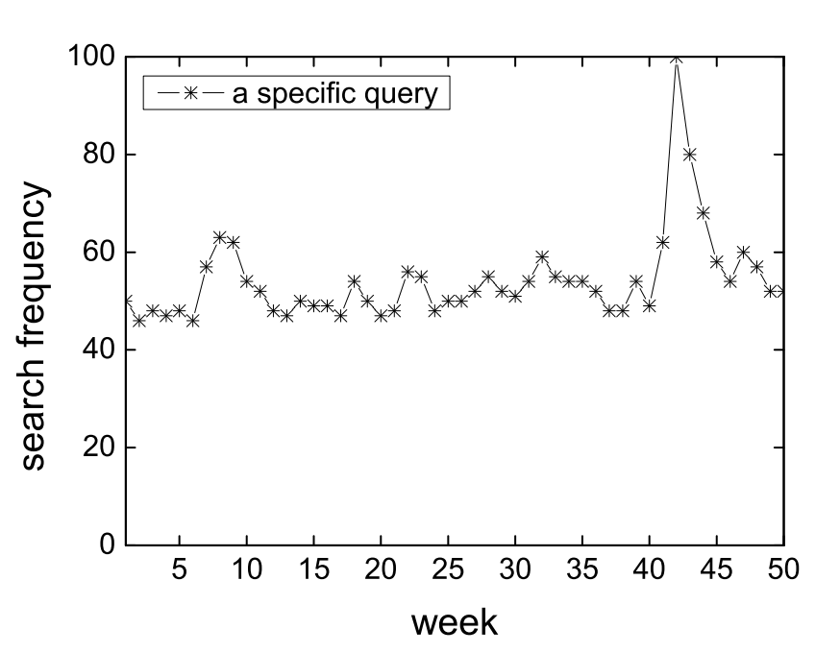
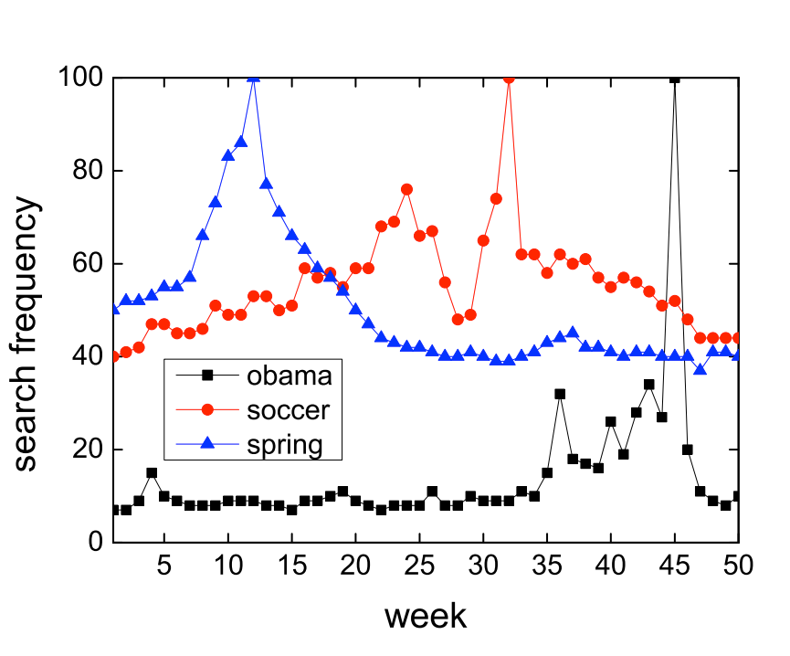







Dynamic Searchable Symmetric Encryption
Security Issue
All DSSE schemes leaks access patterns due to the deterministic relation between a token and its encrypted result.
Server’s observation
search $w_{i}$
data structure access pattern
file access pattern
$w_{i}$’s result
update $f_{k}$
search $w_{i}$
$w_{i}$’s result (${id}_{i}$)
statistical analysis attacks (e.g., Liu et al.)
update $f_{k}$
Client
Server
(e.g., query recovery, histogram analysis, plain text recovery)

Slide 6
Dynamic Searchable Symmetric Encryption
Security Issue
Solution: Oblivious Random Access Memory (ORAM)
  Practicality issue: ORAM’s communication/ bandwidth overhead
file access pattern
data structure access pattern
Server’s observation
Oblivious Random Access Machine (ORAM)
Considerably acceptable
solution so far
!?
Research gap:
ODS does not operate well on secure DSs
protected file access pattern
protected data structure access pattern

Slide 7
A more efficient and yet secure protocol to obliviously access data structure in DSSE?

Slide 8
Distributed Oblivious Data Structure DSSE
System Model
Semi-honest server is a common assumption
Multi-server setting is also a common assumption
Non-colluding servers can be achieved in practice with different companies
(e.g., Google vs. Microsoft vs. Amazon vs. Dropbox vs. etc.)

Slide 9
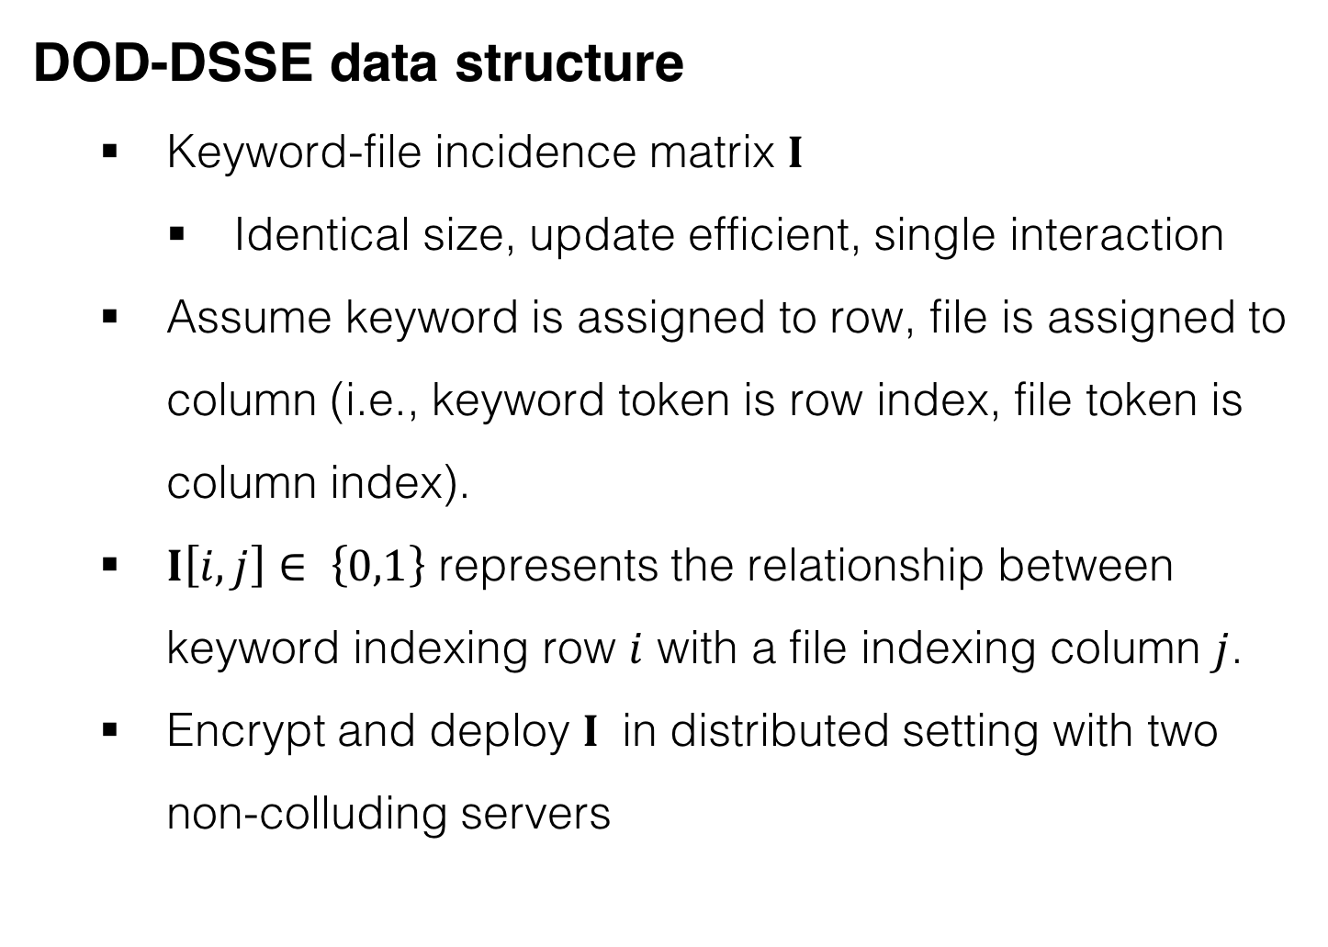
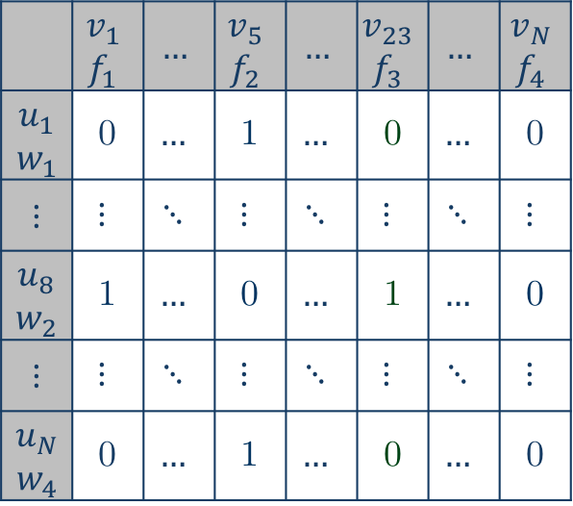
Distributed Oblivious Data Structure DSSE
Main idea
DOD-DSSE data structure
  Keyword-file incidence matrix $I$
    Identical size, update efficient, single interaction
  Assume keyword is assigned to row, file is assigned to column (i.e., keyword token is row index, file token is column index).
  $I\left[i,j\right]∈ \left\{0,1\right\}$ represents the relationship between keyword indexing row $i$ with a file indexing column $j$.
  Encrypt and deploy $I$ in distributed setting with two non-colluding servers
 | $$v_{1}$$ $$f_{1}$$ | $$…$$ | $$v_{5}$$ $$f_{2}$$ | $$…$$ | $$v_{23}$$ $$f_{3}$$ | $$…$$ | $$v_{N}$$ $$f_{4}$$
$$u_{1}$$ $$w_{1}$$ | 0 | $$…$$ | 1 | $$…$$ | 0 | $$…$$ | 0
$$⋮$$ | $$⋮$$ | $$⋱$$ | $$⋮$$ | $$⋱$$ | $$⋮$$ | $$⋱$$ | $$⋮$$
$$u_{8}$$ $$w_{2}$$ | 1 | $$…$$ | 0 | $$…$$ | 1 | $$…$$ | 0
$$⋮$$ | $$⋮$$ | $$⋱$$ | $$⋮$$ | $$⋱$$ | $$⋮$$ | $$⋱$$ | $$⋮$$
$$u_{N}$$ $$w_{4}$$ | 0 | $$…$$ | 1 | $$…$$ | 0 | $$…$$ | 0
Figure 1. Example of DOD-DSSE data structure

Slide 10




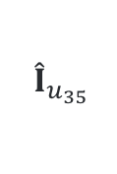
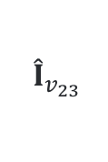
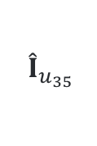

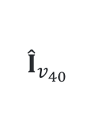
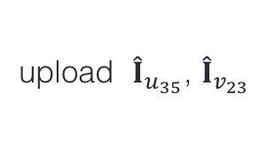
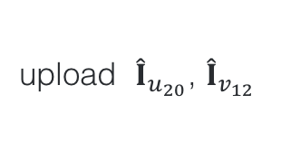
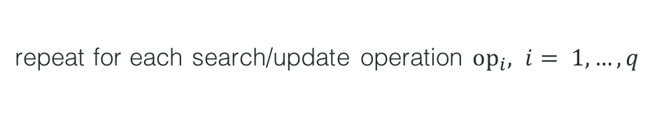
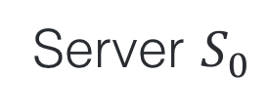
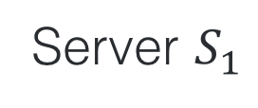







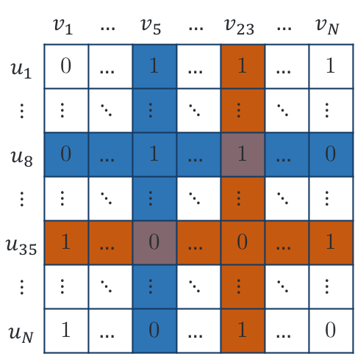
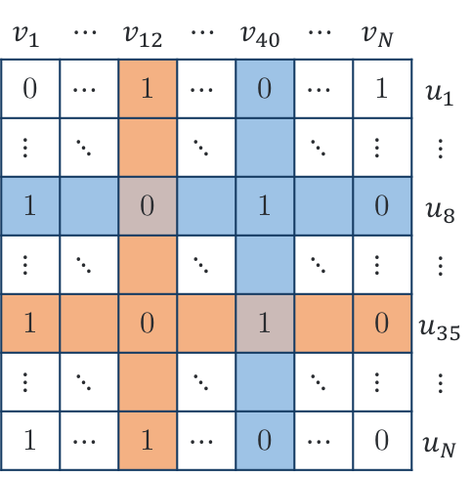
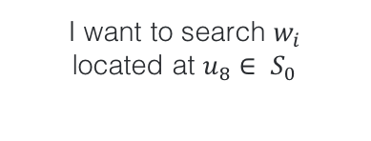



Distributed Oblivious Data Structure DSSE
Main idea
“Fetch – re-encrypt – swap” strategy
I want to search $w_{i}$
located at $u_{8}∈ S_{0}$
Server $S_{0}$
Server $S_{1}$
Client
Encrypted data structure $I^{(0)}$
Encrypted data structure $I^{(1)}$
request row $u_{8}$, column $v_{5}$
request row $u_{10}$, column $v_{40}$
 | $$v_{1}$$ | $$…$$ | $$v_{5}$$ | $$…$$ | $$v_{23}$$ | $$…$$ | $$v_{N}$$
$$u_{1}$$ | 0 | $$…$$ | 1 | $$…$$ | 1 | $$…$$ | 1
$$⋮$$ | $$⋮$$ | $$⋱$$ | $$⋮$$ | $$⋱$$ | $$⋮$$ | $$⋱$$ | $$⋮$$
$$u_{8}$$ | 0 | $$…$$ | 1 | $$…$$ | 1 | $$…$$ | 0
$$⋮$$ | $$⋮$$ | $$⋱$$ | $$⋮$$ | $$⋱$$ | $$⋮$$ | $$⋱$$ | $$⋮$$
$$u_{35}$$ | 1 | $$…$$ | 0 | $$…$$ | 0 | $$…$$ | 1
$$⋮$$ | $$⋮$$ | $$⋱$$ | $$⋮$$ | $$⋱$$ | $$⋮$$ | $$⋱$$ | $$⋮$$
$$u_{N}$$ | 1 | $$…$$ | 0 | $$…$$ | 1 | $$…$$ | 0
$$v_{1}$$ | $$⋯$$ | $$v_{12}$$ | $$⋯$$ | $$v_{40}$$ | $$⋯$$ | $$v_{N}$$
0 | $$⋯$$ | 1 | $$⋯$$ | 0 | $$⋯$$ | 1 | $$u_{1}$$
$$⋮$$ | $$⋱$$ |  | $$⋱$$ |  | $$⋱$$ | $$⋮$$ | $$⋮$$
1 |  | 0 |  | 1 |  | 0 | $$u_{8}$$
$$⋮$$ | $$⋱$$ |  | $$⋱$$ |  | $$⋱$$ | $$⋮$$ | $$⋮$$
1 |  | 0 |  | 1 |  | 0 | $$u_{35}$$
$$⋮$$ | $$⋱$$ |  | $$⋱$$ |  | $$⋱$$ | $$⋮$$ | $$⋮$$
1 | $$⋯$$ | 1 | $$⋯$$ | 0 | $$⋯$$ | 0 | $$u_{N}$$
fetch row $I_{u_{8}}$, column $I_{v_{5}}$
fetch row $I_{u_{10}}$, column $I_{v_{40}}$
(1)
(2)
(1)
Decrypt
$$I_{u_{8}}$$
(${I′}_{u_{8}}$, ${I′}_{v_{5}}$)
(3)
(${I′}_{u_{10}}$, ${I′}_{v_{40}}$)
$$I_{u_{8}}$$
search result
Re-encrypt
$${ \hat{I}}_{u_{35}}$$
(${\hat{I}}_{u_{8}}$, ${\hat{I}}_{v_{5}}$)
(4)
(${ \hat{I}}_{u_{10}}$, ${\hat{I}}_{v_{40}}$)
$${ \hat{I}}_{u_{35}}$$
Assign new address
(${\hat{I}}_{u_{20}}$, ${\hat{I}}_{v_{12}}$)
swap
(${ \hat{I}}_{u_{35}}$, ${\hat{I}}_{v_{23}}$)
$$I_{v_{5}}$$
$${ \hat{I}}_{v_{23}}$$
(6)
(5)
(6)
$$I_{v_{12}}$$
$${ \hat{I}}_{v_{40}}$$
upload ${ \hat{I}}_{u_{35}}$, ${\hat{I}}_{v_{23}}$
upload ${ \hat{I}}_{u_{20}}$, ${\hat{I}}_{v_{12}}$
repeat for each search/update operation ${op}_{i}, i= 1,…, q$

Slide 11

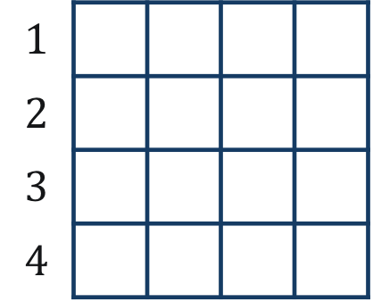
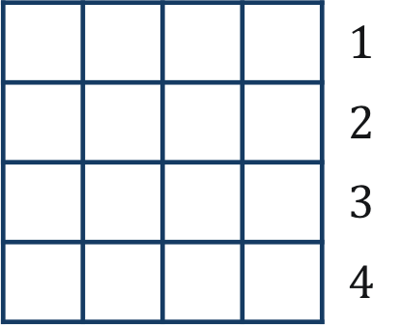

Distributed Oblivious Data Structure DSSE
Main idea
Limitation:
  Two non-colluding server setting
  One-time repetition of an un-linkable query (insignificant info leaked)
    Example: search the same keyword 4 times
1st
$$1$$
$$2$$
$$3$$
$$4$$
 |  |  |  | $$1$$
 |  |  |  | $$2$$
 |  |  |  | $$3$$
 |  |  |  | $$4$$
$S_{0}$’s observation
$S_{1}$’s observation
1
4

Slide 12
Distributed Oblivious Data Structure DSSE
Main idea
Limitation:
  Two non-colluding server setting
  One-time repetition of an un-linkable query (insignificant info leaked)
    Example: search the same keyword 4 times
2nd
$$1$$
$$2$$
$$3$$
$$4$$
 |  |  |  | $$1$$
 |  |  |  | $$2$$
 |  |  |  | $$3$$
 |  |  |  | $$4$$
$S_{0}$’s observation
$S_{1}$’s observation
1
3
4
4
one-time repetition

Slide 13
Distributed Oblivious Data Structure DSSE
Main idea
Limitation:
  Two non-colluding server setting
  One-time repetition of an un-linkable query (insignificant info leaked)
    Example: search the same keyword 4 times
3rd
$$1$$
$$2$$
$$3$$
$$4$$
 |  |  |  | $$1$$
 |  |  |  | $$2$$
 |  |  |  | $$3$$
 |  |  |  | $$4$$
$S_{0}$’s observation
$S_{1}$’s observation
1
3
3
4
4
2
one-time repetition
unlinkable

Slide 14
Distributed Oblivious Data Structure DSSE
Main idea
Limitation:
  Two non-colluding server setting
  One-time repetition of an un-linkable query (insignificant info leaked)
    Example: search the same keyword 4 times
4th
$$1$$
$$2$$
$$3$$
$$4$$
 |  |  |  | $$1$$
 |  |  |  | $$2$$
 |  |  |  | $$3$$
 |  |  |  | $$4$$
$S_{0}$’s observation
$S_{1}$’s observation
1
3
3
2
4
4
2
2
unlinkable
one-time repetition

Slide 15
Distributed Oblivious Data Structure DSSE
Is it just simply swapping searchable representation data between two servers?

Slide 16
Distributed Oblivious Data Structure DSSE
Challenges
Consistency (correctness) issue
Linkability (security) issue
Performance optimization issue

Slide 17
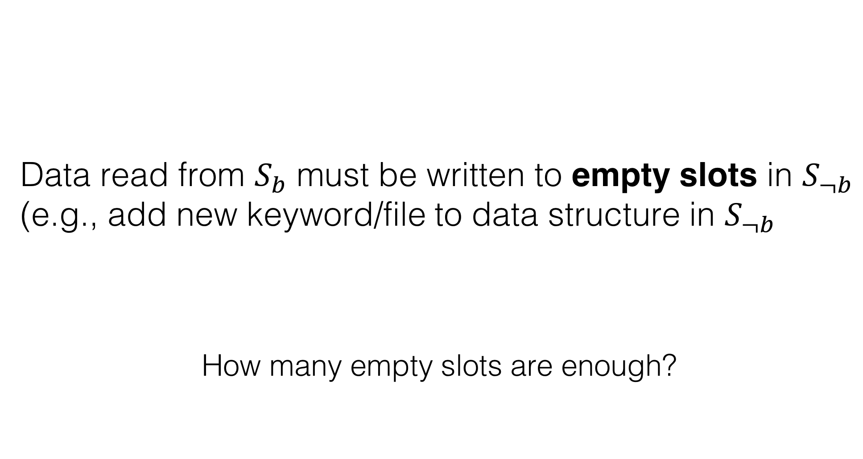
Distributed Oblivious Data Structure DSSE
Consistency Issue
Data read from $S_{b}$ must be written to empty slots in $S_{¬b}$ (e.g., add new keyword/file to data structure in $S_{¬b}$
How many empty slots are enough?

Slide 18


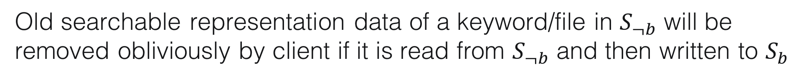
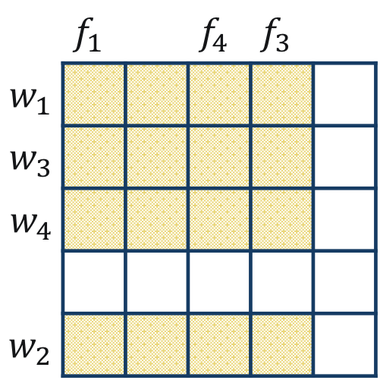
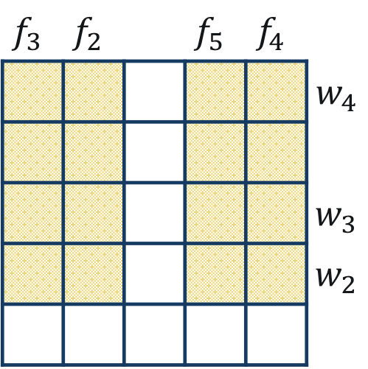






Distributed Oblivious Data Structure DSSE
Consistency Issue
Old searchable representation data of a keyword/file in $S_{¬b}$ will be removed obliviously by client if it is read from $S_{¬b}$ and then written to $S_{b}$
$$I^{(0)}$$
$$I_{f_{2}}^{(1)}$$
$$I^{(1)}$$
 | $$f_{1}$$ |  | $$f_{4}$$ | $$f_{3}$$
$$w_{1}$$
$$w_{3}$$
$$w_{4}$$
$$w_{2}$$
Client
Local
Processing
$$f_{3}$$ | $$f_{2}$$ |  | $$f_{5}$$ | $$f_{4}$$
 |  |  |  |  | $$w_{4}$$
 |  |  |  |  | $$w_{3}$$
 |  |  |  |  | $$w_{2}$$
$$f_{2}$$
$$I_{w_{1}}^{(0)}$$
$$w_{1}$$
$${\hat{I}}_{w_{1}}^{(1)}$$
$${\hat{I}}_{f_{2}}^{(0)}$$

Slide 19
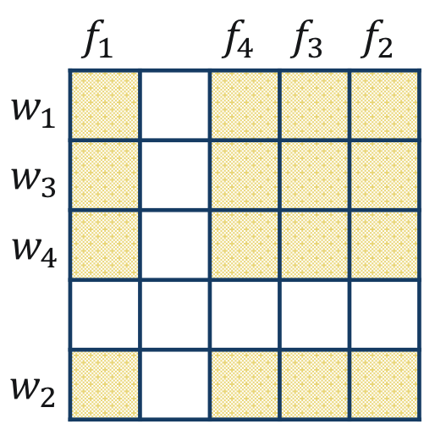
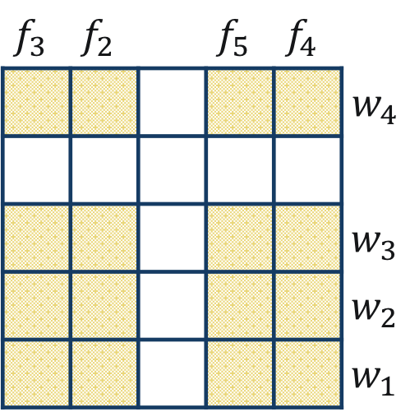
Distributed Oblivious Data Structure DSSE
Consistency Issue
Old searchable representation data of a keyword/file in $S_{¬b}$ will be removed obliviously by client if it is read from $S_{¬b}$ and then written to $S_{b}$
$$I^{(0)}$$
$$I_{f_{2}}^{(1)}$$
$$I^{(1)}$$
 | $$f_{1}$$ |  | $$f_{4}$$ | $$f_{3}$$ | $$f_{2}$$
$$w_{1}$$
$$w_{3}$$
$$w_{4}$$
$$w_{2}$$
Client
Local
Processing
$$f_{3}$$ | $$f_{2}$$ |  | $$f_{5}$$ | $$f_{4}$$
 |  |  |  |  | $$w_{4}$$
 |  |  |  |  | $$w_{3}$$
 |  |  |  |  | $$w_{2}$$
 |  |  |  |  | $$w_{1}$$
$$I_{w_{1}}^{(0)}$$
$${\hat{I}}_{w_{1}}^{(1)}$$
$${\hat{I}}_{f_{2}}^{(0)}$$
Is one empty slot per dimension enough?

Slide 20






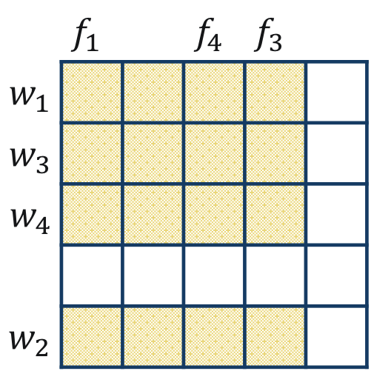
Distributed Oblivious Data Structure DSSE
Security Issue
$$I^{(0)}$$
$$I^{(1)}$$
 | $$f_{1}$$ |  | $$f_{4}$$ | $$f_{3}$$
$$w_{1}$$
$$w_{3}$$
$$w_{4}$$
$$w_{2}$$
Client
Local
Processing
$$f_{3}$$ | $$f_{2}$$ |  | $$f_{5}$$ | $$f_{4}$$
 |  |  |  |  | $$w_{4}$$
 |  |  |  |  | $$w_{3}$$
 |  |  |  |  | $$w_{2}$$
$$f_{2}$$
$$I_{w_{1}}^{(0)}$$
$$w_{1}$$
$${\hat{I}}_{w_{1}}^{(1)}$$

Slide 21
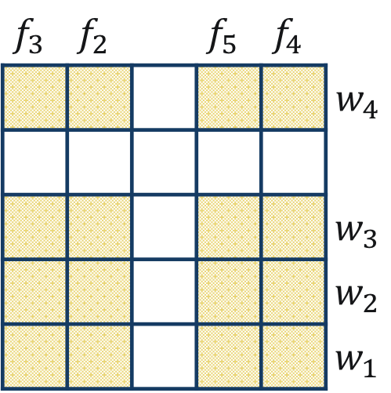
Distributed Oblivious Data Structure DSSE
Security Issue
$$I^{(0)}$$
$$I^{(1)}$$
 | $$f_{1}$$ |  | $$f_{4}$$ | $$f_{3}$$
$$w_{1}$$
$$w_{3}$$
$$w_{4}$$
$$w_{2}$$
Client
Local
Processing
$$f_{3}$$ | $$f_{2}$$ |  | $$f_{5}$$ | $$f_{4}$$
 |  |  |  |  | $$w_{4}$$
 |  |  |  |  | $$w_{3}$$
 |  |  |  |  | $$w_{2}$$
 |  |  |  |  | $$w_{1}$$
$$f_{2}$$
$$I_{w_{1}}^{(0)}$$
$${\hat{I}}_{w_{1}}^{(1)}$$

Slide 22




Distributed Oblivious Data Structure DSSE
Security Issue
$$I^{(0)}$$
$$I^{(1)}$$
 | $$f_{1}$$ |  | $$f_{4}$$ | $$f_{3}$$
$$w_{1}$$
$$w_{3}$$
$$w_{4}$$
$$w_{2}$$
Client
Local
Processing
$$f_{3}$$ | $$f_{2}$$ |  | $$f_{5}$$ | $$f_{4}$$
 |  |  |  |  | $$w_{4}$$
 |  |  |  |  | $$w_{3}$$
 |  |  |  |  | $$w_{2}$$
 |  |  |  |  | $$w_{1}$$
$$f_{2}$$
$$I_{w_{3}}^{(0)}$$
$${\hat{I}}_{w_{3}}^{(1)}$$
Linkable access pattern

Slide 23
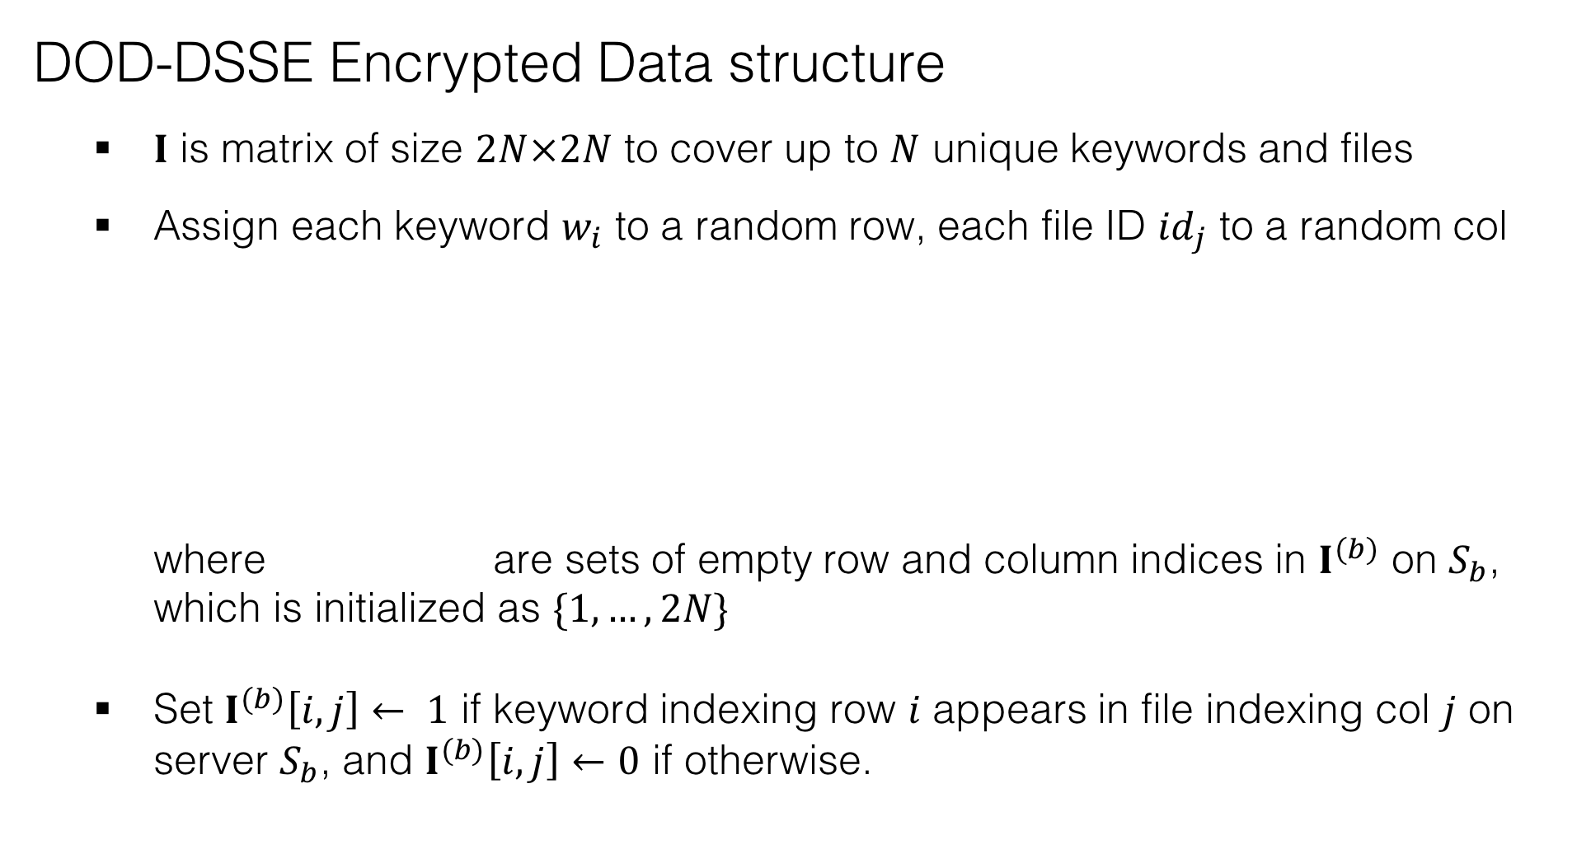
Distributed Oblivious Data Structure DSSE
Basic Construction
DOD-DSSE Encrypted Data structure
  $I$ is matrix of size $2N×2N$ to cover up to $N$ unique keywords and files
  Assign each keyword $w_{i}$ to a random row, each file ID ${id}_{j}$ to a random col
    where are sets of empty row and column indices in $I^{(b)}$ on $S_{b}$, which is initialized as $\{1,…,2N\}$
  Set $I^{(b)}\left[i,j\right]← 1$ if keyword indexing row $i$ appears in file indexing col $j$ on server $S_{b}$, and $I^{(b)}\left[i,j\right]←0$ if otherwise.

Slide 24
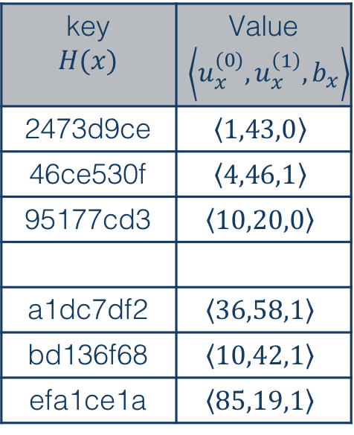


Distributed Oblivious Data Structure DSSE
Basic Construction
DOD-DSSE Encrypted Data structure
  Create data structures $T_{w},T_{f}$ on client side to keep track of the assigned addresses of keywords and files, the server ID where they were last accessed
    where $H(⋅)$ denotes a cryptographic hash function
Example of $T_{w}$
key $$H(x)$$ | Value $$\left\langle u_{x}^{(0)},u_{x}^{\left(1\right)},b_{x}\right\rangle$$
2473d9ce | $$\left\langle 1,43,0\right\rangle$$
46ce530f | $$\left\langle 4,46,1\right\rangle$$
95177cd3 | $$\left\langle 10,20,0\right\rangle$$
a1dc7df2 | $$\left\langle 36,58,1\right\rangle$$
bd136f68 | $$\left\langle 10,42,1\right\rangle$$
efa1ce1a | $$\left\langle 85,19,1\right\rangle$$
$T_{w},T_{f}$ are hash tables which offer O(1) access time

Slide 25
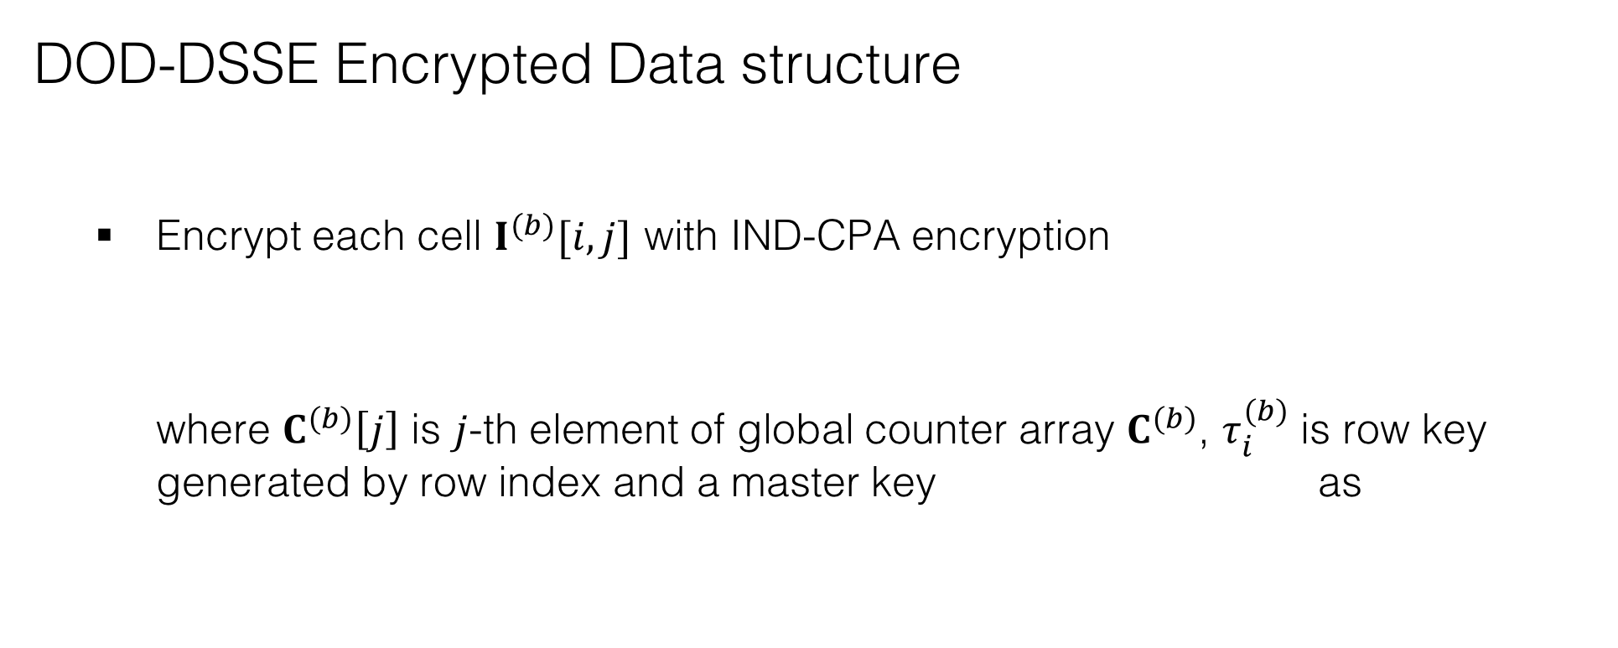
Distributed Oblivious Data Structure DSSE
Basic Construction
DOD-DSSE Encrypted Data structure
  Encrypt each cell $I^{(b)}[i,j]$ with IND-CPA encryption
    where $C^{(b)}\left[j\right]$ is $j$-th element of global counter array $C^{(b)}$, $τ_{i}^{(b)}$ is row key generated by row index and a master key as

Slide 26
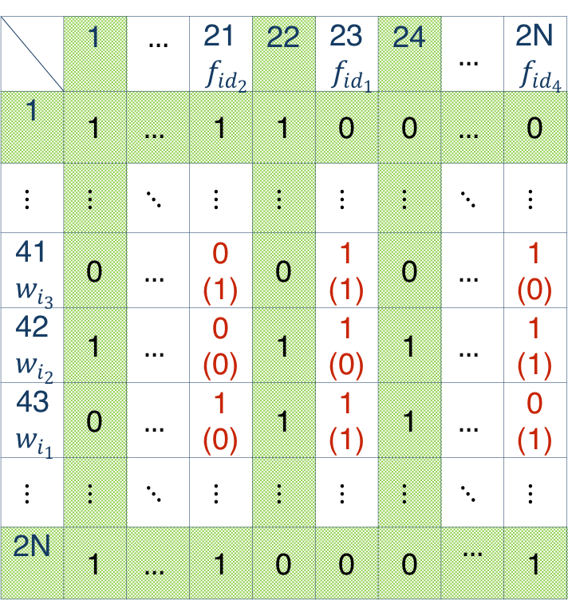


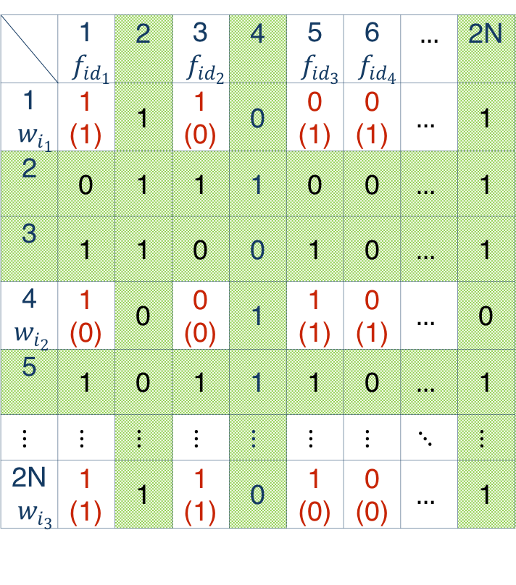
Distributed Oblivious Data Structure DSSE
Basic Construction
DOD-DSSE Encrypted Data structure: Example
$$I^{(0)}$$
$$I^{(1)}$$
 | 1 $${ f}_{{id}_{1}}$$ | 2 | 3 $${ f}_{{id}_{2}}$$ | 4 | 5 $${ f}_{{id}_{3}}$$ | 6 $${ f}_{{id}_{4}}$$ | $$…$$ | 2N
1 $${ w}_{i_{1}}$$ | 1 (1) | 1 | 1 (0) | 0 | 0 (1) | 0 (1) | $$…$$ | 1
2 | 0 | 1 | 1 | 1 | 0 | 0 | $$…$$ | 1
3 | 1 | 1 | 0 | 0 | 1 | 0 | $$…$$ | 1
4 $${ w}_{i_{2}}$$ | 1 (0) | 0 | 0 (0) | 1 | 1 (1) | 0 (1) | $$…$$ | 0
5 | 1 | 0 | 1 | 1 | 1 | 0 | $$…$$ | 1
$$⋮$$ | $$⋮$$ | $$⋮$$ | $$⋮$$ | $$⋮$$ | $$⋮$$ | $$⋮$$ | $$⋱$$ | $$⋮$$
2N $${ w}_{i_{3}}$$ | 1 (1) | 1 | 1 (1) | 0 | 1 (0) | 0 (0) | $$…$$ | 1
 | 1 | $$…$$ | 21 $${ f}_{{id}_{2}}$$ | 22 | 23 $${ f}_{id_{1}}$$ | 24 | $$…$$ | 2N $${ f}_{id_{4}}$$
1 | 1 | $$…$$ | 1 | 1 | 0 | 0 | $$…$$ | 0
$$⋮$$ | $$⋮$$ | $$⋱$$ | $$⋮$$ | $$⋮$$ | $$⋮$$ | $$⋮$$ | $$⋱$$ | $$⋮$$
41 $${ w}_{i_{3}}$$ | 0 | $$…$$ | 0 (1) | 0 | 1 (1) | 0 | $$…$$ | 1 (0)
42 $${ w}_{i_{2}}$$ | 1 | $$…$$ | 0 (0) | 1 | 1 (0) | 1 | $$…$$ | 1 (1)
43 $${ w}_{i_{1}}$$ | 0 | $$…$$ | 1 (0) | 1 | 1 (1) | 1 | $$…$$ | 0 (1)
$$⋮$$ | $$⋮$$ | $$⋱$$ | $$⋮$$ | $$⋮$$ | $$⋮$$ | $$⋮$$ | $$⋱$$ | $$⋮$$
2N | 1 | $$…$$ | 1 | 0 | 0 | 0 | $$…$$ | 1
1
(0)
encrypted bit by IND-CPA
actual bit showing keyword-file relationship

Slide 27
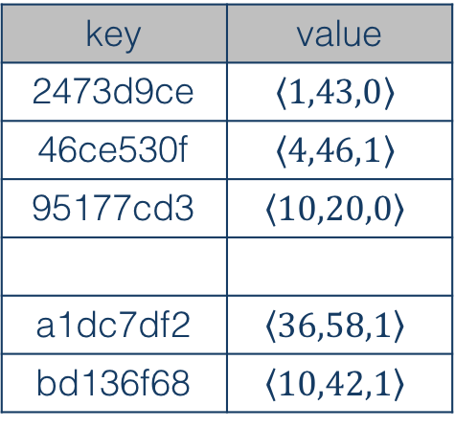



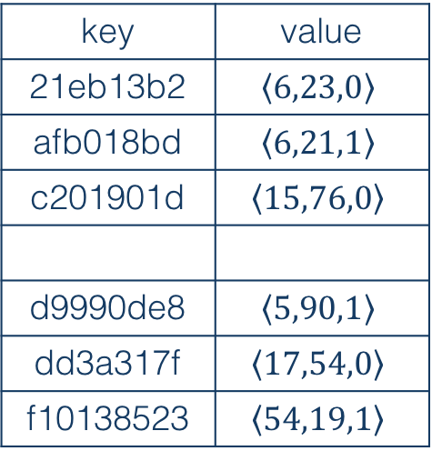
Distributed Oblivious Data Structure DSSE
Access Operation
Example: Search $x$
  Generate 2 search and 2 update queries per server:
    1 real
    7 random selected
key | value
2473d9ce | $$\left\langle 1,43,0\right\rangle$$
46ce530f | $$\left\langle 4,46,1\right\rangle$$
95177cd3 | $$\left\langle 10,20,0\right\rangle$$
a1dc7df2 | $$\left\langle 36,58,1\right\rangle$$
bd136f68 | $$\left\langle 10,42,1\right\rangle$$
key | value
21eb13b2 | $$\left\langle 6,23,0\right\rangle$$
afb018bd | $$\left\langle 6,21,1\right\rangle$$
c201901d | $$\left\langle 15,76,0\right\rangle$$
d9990de8 | $$\left\langle 5,90,1\right\rangle$$
dd3a317f | $$\left\langle 17,54,0\right\rangle$$
f10138523 | $$\left\langle 54,19,1\right\rangle$$
$$T_{w}$$
$$T_{f}$$
27

Slide 28


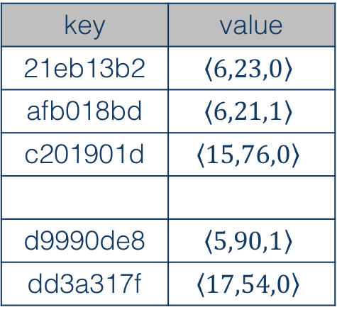
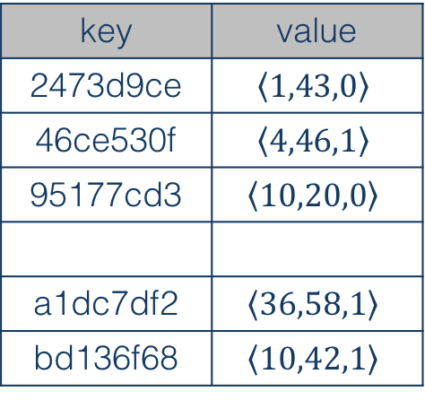
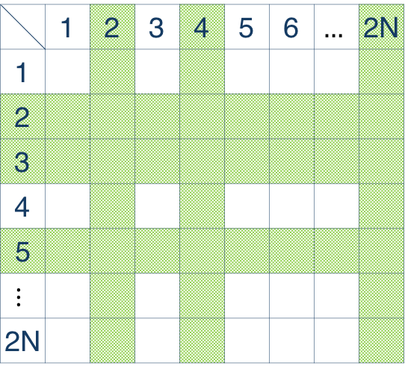
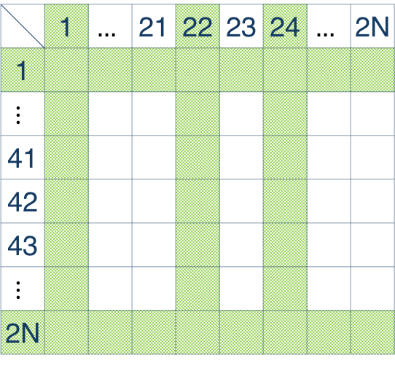
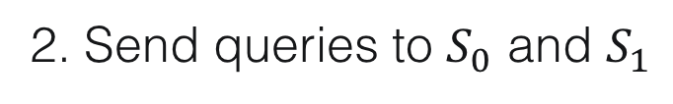
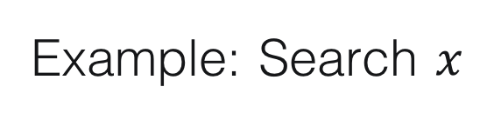

Distributed Oblivious Data Structure DSSE
Access Operation
$$I^{(0)}$$
$$I^{(1)}$$
 | 1 | 2 | 3 | 4 | 5 | 6 | $$…$$ | 2N
1
2
3
4
5
$$⋮$$
2N
Example: Search $x$
 | 1 | $$…$$ | 21 | 22 | 23 | 24 | $$…$$ | 2N
1
$$⋮$$
41
42
43
$$⋮$$
2N
2. Send queries to $S_{0}$ and $S_{1}$
$$T_{w}$$
$$T_{f}$$
key | value
2473d9ce | $$\left\langle 1,43,0\right\rangle$$
46ce530f | $$\left\langle 4,46,1\right\rangle$$
95177cd3 | $$\left\langle 10,20,0\right\rangle$$
a1dc7df2 | $$\left\langle 36,58,1\right\rangle$$
bd136f68 | $$\left\langle 10,42,1\right\rangle$$
key | value
21eb13b2 | $$\left\langle 6,23,0\right\rangle$$
afb018bd | $$\left\langle 6,21,1\right\rangle$$
c201901d | $$\left\langle 15,76,0\right\rangle$$
d9990de8 | $$\left\langle 5,90,1\right\rangle$$
dd3a317f | $$\left\langle 17,54,0\right\rangle$$

Slide 29
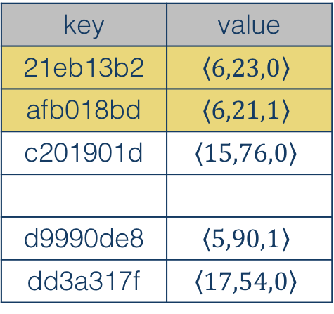
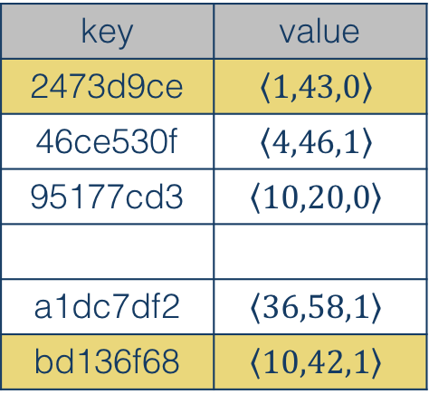
Distributed Oblivious Data Structure DSSE
Access Operation
$$I^{(0)}$$
$$I^{(1)}$$
 | 1 | 2 | 3 | 4 | 5 | 6 | $$…$$ | 2N
1
2
3
4
5
$$⋮$$
2N
Example: Search $x$
 | 1 | $$…$$ | 21 | 22 | 23 | 24 | $$…$$ | 2N
1
$$⋮$$
41
42
43
$$⋮$$
2N
3. Decrypt only “non-dummy” data
$$T_{w}$$
$$T_{f}$$
key | value
2473d9ce | $$\left\langle 1,43,0\right\rangle$$
46ce530f | $$\left\langle 4,46,1\right\rangle$$
95177cd3 | $$\left\langle 10,20,0\right\rangle$$
a1dc7df2 | $$\left\langle 36,58,1\right\rangle$$
bd136f68 | $$\left\langle 10,42,1\right\rangle$$
key | value
21eb13b2 | $$\left\langle 6,23,0\right\rangle$$
afb018bd | $$\left\langle 6,21,1\right\rangle$$
c201901d | $$\left\langle 15,76,0\right\rangle$$
d9990de8 | $$\left\langle 5,90,1\right\rangle$$
dd3a317f | $$\left\langle 17,54,0\right\rangle$$

Slide 30
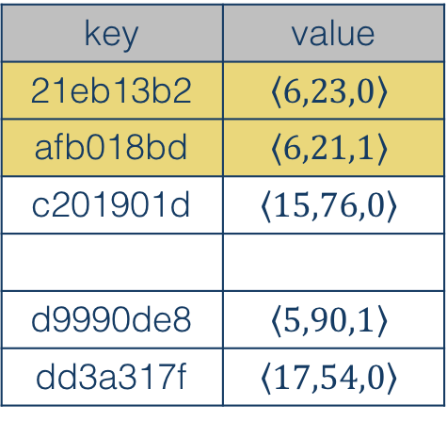
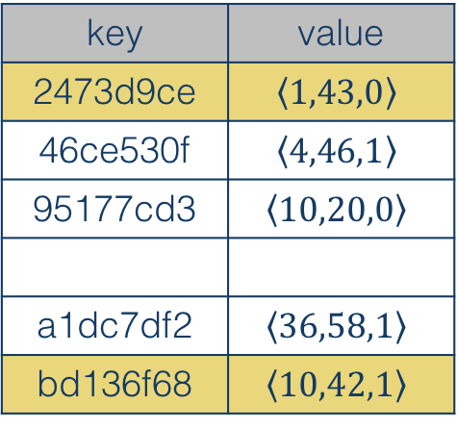



Distributed Oblivious Data Structure DSSE
Access Operation
$$I^{(0)}$$
$$I^{(1)}$$
 | 1 | 2 | 3 | 4 | 5 | 6 | $$…$$ | 2N
1
2
3
4
5
$$⋮$$
2N
Example: Search $x$
 | 1 | $$…$$ | 21 | 22 | 23 | 24 | $$…$$ | 2N
1
$$⋮$$
41
42
43
$$⋮$$
2N
4. Update hash table:
  Address of read data on the other server
  Server ID of read data
  Set old addresses of data on the other server to be dummy
$$T_{w}$$
$$T_{f}$$
key | value
2473d9ce | $$\left\langle 1,43,0\right\rangle$$
46ce530f | $$\left\langle 4,46,1\right\rangle$$
95177cd3 | $$\left\langle 10,20,0\right\rangle$$
a1dc7df2 | $$\left\langle 36,58,1\right\rangle$$
bd136f68 | $$\left\langle 10,42,1\right\rangle$$
key | value
21eb13b2 | $$\left\langle 6,23,0\right\rangle$$
afb018bd | $$\left\langle 6,21,1\right\rangle$$
c201901d | $$\left\langle 15,76,0\right\rangle$$
d9990de8 | $$\left\langle 5,90,1\right\rangle$$
dd3a317f | $$\left\langle 17,54,0\right\rangle$$

Slide 31
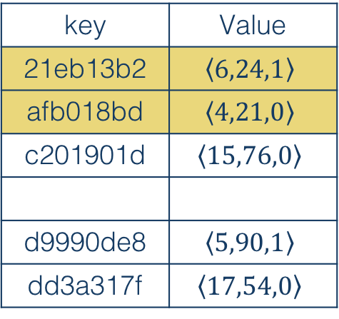

Distributed Oblivious Data Structure DSSE
Access Operation
$$I^{(0)}$$
$$I^{(1)}$$
 | 1 | 2 | 3 | 4 | 5 | 6 | $$…$$ | 2N
1
2
3
4
5
$$⋮$$
2N
Example: Search $x$
 | 1 | $$…$$ | 21 | 22 | 23 | 24 | $$…$$ | 2N
1
$$⋮$$
41
42
43
$$⋮$$
2N
4. Update hash table:
  Address of read data on the other server
  Server ID of read data
  Set old addresses of data on the other server to be dummy
$$T_{w}$$
$$T_{f}$$
key | Value
2473d9ce | $$\left\langle 1,2N,1\right\rangle$$
46ce530f | $$\left\langle 4,46,1\right\rangle$$
95177cd3 | $$\left\langle 10,20,0\right\rangle$$
a1dc7df2 | $$\left\langle 36,58,1\right\rangle$$
bd136f68 | $$\left\langle 5,42,0\right\rangle$$
key | Value
21eb13b2 | $$\left\langle 6,24,1\right\rangle$$
afb018bd | $$\left\langle 4,21,0\right\rangle$$
c201901d | $$\left\langle 15,76,0\right\rangle$$
d9990de8 | $$\left\langle 5,90,1\right\rangle$$
dd3a317f | $$\left\langle 17,54,0\right\rangle$$

Slide 32





Distributed Oblivious Data Structure DSSE
Access Operation
$$I^{(0)}$$
$$I^{(1)}$$
 | 1 | 2 | 3 | 4 | 5 | 6 | $$…$$ | 2N
1
2
3
4
5
$$⋮$$
2N
Example: Search $x$
 | 1 | $$…$$ | 21 | 22 | 23 | 24 | $$…$$ | 2N
1
$$⋮$$
41
42
43
$$⋮$$
2N
5. Create searchable representation of decrypted data on the other server
new keyword-file relationship on $S_{0}$
new keyword-file relationship on $S_{1}$
$$T_{w}$$
$$T_{f}$$
key | value
2473d9ce | $$\left\langle 1,2N,1\right\rangle$$
46ce530f | $$\left\langle 4,46,1\right\rangle$$
95177cd3 | $$\left\langle 10,20,0\right\rangle$$
a1dc7df2 | $$\left\langle 36,58,1\right\rangle$$
bd136f68 | $$\left\langle 5,42,0\right\rangle$$
key | value
21eb13b2 | $$\left\langle 6,24,1\right\rangle$$
afb018bd | $$\left\langle 4,21,0\right\rangle$$
c201901d | $$\left\langle 15,76,0\right\rangle$$
d9990de8 | $$\left\langle 5,90,1\right\rangle$$
dd3a317f | $$\left\langle 17,54,0\right\rangle$$

Slide 33
Distributed Oblivious Data Structure DSSE
Access Operation
$$I^{(0)}$$
$$I^{(1)}$$
 | 1 | 2 | 3 | 4 | 5 | 6 | $$…$$ | 2N
1
2
3
4
5
$$⋮$$
2N
Example: Search $x$
 | 1 | $$…$$ | 21 | 22 | 23 | 24 | $$…$$ | 2N
1
$$⋮$$
41
42
43
$$⋮$$
2N
6. Re-encrypt all data and write to addresses which were read on both servers
$$T_{w}$$
$$T_{f}$$
key | value
2473d9ce | $$\left\langle 1,2N,1\right\rangle$$
46ce530f | $$\left\langle 4,46,1\right\rangle$$
95177cd3 | $$\left\langle 10,20,0\right\rangle$$
a1dc7df2 | $$\left\langle 36,58,1\right\rangle$$
bd136f68 | $$\left\langle 5,42,0\right\rangle$$
key | value
21eb13b2 | $$\left\langle 6,24,1\right\rangle$$
afb018bd | $$\left\langle 4,21,0\right\rangle$$
c201901d | $$\left\langle 15,76,0\right\rangle$$
d9990de8 | $$\left\langle 5,90,1\right\rangle$$
dd3a317f | $$\left\langle 17,54,0\right\rangle$$

Slide 34
Distributed Oblivious Data Structure DSSE
Security Analysis

Slide 35
Distributed Oblivious Data Structure DSSE
Security Analysis

Slide 36
Distributed Oblivious Data Structure DSSE
Security Analysis

Slide 37
Distributed Oblivious Data Structure DSSE
Security Analysis

Slide 38
Distributed Oblivious Data Structure DSSE
Security Analysis

Slide 39
Distributed Oblivious Data Structure DSSE
Experiments
Hardware configuration
Client: HP Z230 Workstation
  Intel Xeon CPU E3-1231v3 @ 3.40GHz, 16 GB RAM and 256 GB SSD, CentOS 7.2
Server(s): Amazon EC2
  Ubuntu 14.04, m4.4xlarge instance: 16 vCPUs @ 2.4 GHz, Intel Xeon E5-2676v3, 64 GB RAM, 200 GB SSD

Slide 40

Distributed Oblivious Data Structure DSSE
Experiments
Software setting & optimizations
Google sparse hash table with dense_hash_map for $T_{w}$ and $T_{f}$ data structures
  Pros
  Best performance (execution,
  memory, etc.)
  Cons
  No well-documented APIs
  Auto-sizing (shrink/expansion)
  when adding/deleting
Figures taken from http://incise.org/hash-table-benchmarks.html

Slide 41

Distributed Oblivious Data Structure DSSE
Experiments
Software setting & optimizations
Libtomcrypt for cryptographic primitives
  AES-CTR for IND-CPA encryption/decryption
  AES-128 CMAC for hash function $H$
Intel AES-NI hardware accelerated library for cryptographic operation optimization on Intel infrastructure

Slide 42
Distributed Oblivious Data Structure DSSE
Experiments
Software setting & optimizations
ZeroMQ library for socket programing
  Pros
  Lightweight, simple, easy to use
  Well-documented APIs and well-organized objects
  Extremely fast for simple messages (our needs)
  Cons
  Not as many features (we don’t need!)

Slide 43
Distributed Oblivious Data Structure DSSE
Experiments
Software setting & optimizations
pthread library for multithreading (parallelism)
  Parallelized data downloading/uploading from 2 servers
  AES key precomputation while getting data

Slide 44

Distributed Oblivious Data Structure DSSE
Experiments
Dataset
Enron email with different subsets ranging from from ${10}^{8}$to $9×{10}^{10}$ keyword-file pairs.
Comparison
Traditional DSSE (Yavuz et al.)
Oblivious Data Structure with Path-ORAM-based building blocks on:
  Dictionary data structure (ODICT)
  Incidence matrix data structure (OMAT)

Slide 45
Distributed Oblivious Data Structure DSSE
Experiments
Figure 3. End-to-end cryptographic delay with in-state network latency (i.e., 11 ms)
Throughput: 100 Mbps
Configuration:
Client: Oregon State University, Corvallis, OR, 97331 ------- Amazon EC2 Server: Oregon West Region

Slide 46
Distributed Oblivious Data Structure DSSE
Experiments
DOD-DSSE is 170x-690x times faster than ORAM-based techniques while sealing all leakages in traditional DSSE
Figure 4. End-to-end cryptographic delay with out-state network latency (i.e., 31 ms)
Throughput: 30 Mbps
Configuration:
Client: Oregon State University, Corvallis, OR, 97331 ------- Amazon EC2 Server: California West Region

Slide 47
Distributed Oblivious Data Structure DSSE
Experiments
Table 1. Total size of encrypted data structure(s) in GB

Slide 48
Distributed Oblivious Data Structure DSSE
Summary
DOD-DSSE desirable properties:
Much faster than using ORAM.
Secure enough to prevent statistical attacks by sealing all leakages due to query linkability in traditional DSSE
Table 2. Security and performance of DOD-DSSE, traditional DSSE and ODS with specific DSSE data structure types¶.

Slide 49
Distributed Oblivious Data Structure DSSE
Conclusions
Proposed DOD-DSSE, the most secure DSSE scheme to date against attacks exploiting linkability between queries on DSSE data structure (e.g., statistical analysis attacks)
Next consideration: ORAM alternatives for oblivious access on encrypted files

Slide 50

Question & Answer
Thank you for your attention!

