Slide 1
S³ORAM: A Computation-Efficient and Constant Client Bandwidth Blowup ORAM with Shamir Secret Sharing
24th ACM CCS 2017
Thang Hoang†, Ceyhun D. Ozkaptan†, Attila A. Yavuz†, Jorge Guajardo‡, Tam Nguyen†
† School of EECS, Oregon State University, Corvallis, OR, 97331
‡ Robert Bosch Research and Technology Center, Pittsburgh, PA, 15222

Slide 2
Introduction
Oblivious Random Access Machine (ORAM) allows a client to physically access data on the cloud without leaking logical access patterns to the cloud provider
Not reveal logical accesses
ORAM
Read
Logical read
Physical read/write
Write
Logical write
Physical read/write
Some ORAM applications: Cloud storage-as-a-service (personal data storage, health-record database, password management), searchable encryption, secure multiparty computation

Slide 3
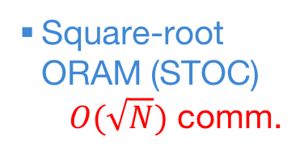
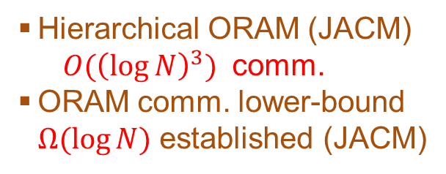
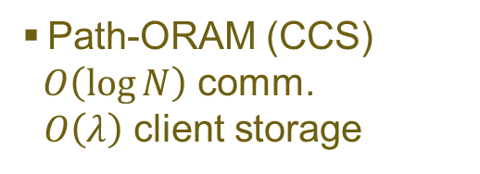
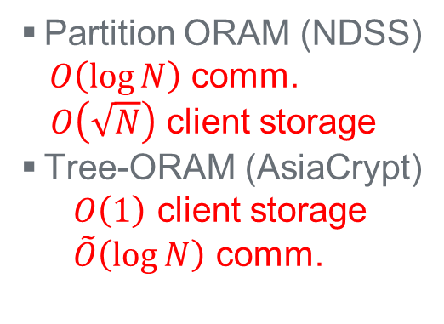
Progress on ORAM
ORAM was first introduced by Goldreich in the context of software protection. A number of progresses have been made to increase the efficiency of ORAM.
Square-root ORAM (STOC)
$O(\sqrt{N})$ comm.
Partition ORAM (NDSS)
$O\left(\log{N}\right)$ comm.
$O\left(\sqrt{N}\right)$ client storage
Tree-ORAM (AsiaCrypt)
$O\left(1\right)$ client storage
$\tilde{O}\left(\log{N}\right)$ comm.
Due to logarithmic communication overhead, ORAM was costly to be used in practice.
1996
2013
1987
2011
Hierarchical ORAM (JACM)
$O{(\left(\log{N}\right)}^{3})$ comm.
ORAM comm. lower-bound $Ω(\log{N})$ established (JACM)
Path-ORAM (CCS)
$O\left(\log{N}\right)$ comm.
$O\left(λ\right)$ client storage

Slide 4
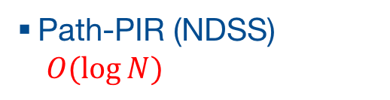
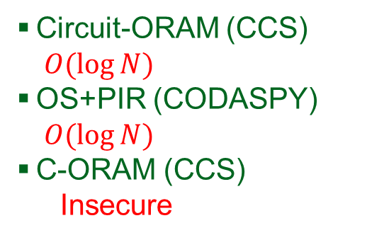
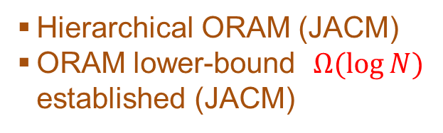
Progress on ORAM
Several studies attempted to reduce ORAM communication overhead, and break Goldreich’s lower bound using AHE and PIR…
Square-root ORAM (STOC)
Partition ORAM (NDSS)
Tree-ORAM (AsiaCrypt)
Path-PIR (NDSS)
$O(\log{N})$
1996
2013
2015
2017
1987
2011
2014
Circuit-ORAM (CCS)
$O(\log{N})$
OS+PIR (CODASPY)
$O(\log{N})$
C-ORAM (CCS)
Insecure
Hierarchical ORAM (JACM)
ORAM lower-bound $Ω(\log{N})$ established (JACM)
Lower bound on ORAM+PIR (PKC)
Path-ORAM (CCS)

Slide 5
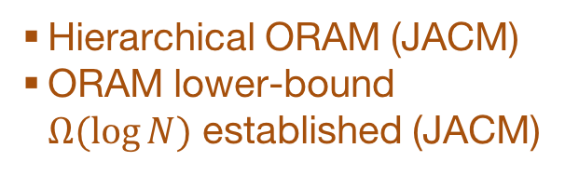
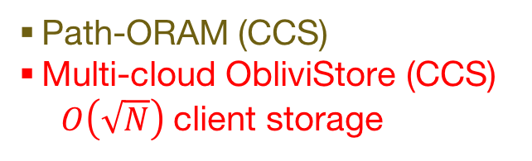
Progress on ORAM
… some successfully achieving O(1) bandwidth blowup via Fully/Additively Homomorphic Encryption or distributed setting
Square-root ORAM (STOC)
Partition ORAM (NDSS)
Tree-ORAM (AsiaCrypt)
Path-PIR (NDSS)
Apon et al. (PKC)
FHE
Onion-ORAM (TCC)
AHE
1996
2013
2015
2017
1987
2011
2014
2016
Hierarchical ORAM (JACM)
ORAM lower-bound $Ω(\log{N})$ established (JACM)
Path-ORAM (CCS)
Multi-cloud ObliviStore (CCS)
$O\left(\sqrt{N}\right)$ client storage
Circuit-ORAM (CCS)
OS+PIR (CODASPY)
C-ORAM (CCS)
Bucket-ORAM
FHE
Lower bound on ORAM+PIR (PKC)

Slide 6
Motivation
Onion-ORAM achieves the optimal asymptotic cost: O(1) bandwidth blowup and O(1) blocks of client storage without using FHE
However, it is still very costly to be used in practice due to:
  Additively homomorphic encryption ➔ high delay due to PKC operations
  Onion-layer (O(log N)) of encryption accumulated when performing eviction ➔ increase encryption & decryption costs at both client & server sides
Can we have a more efficient ORAM with optimal asymptotic complexity??

Slide 7

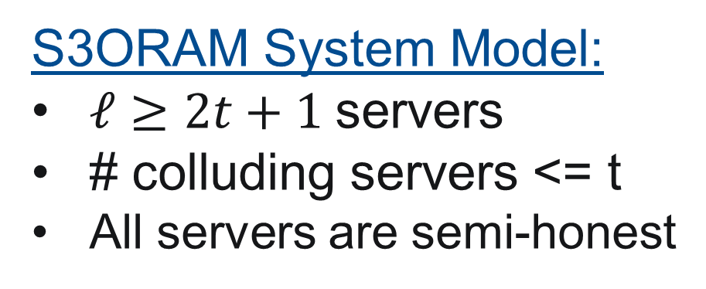
S³ORAM – Intuition
Exploit the efficiency of multi-party computation in distributed setting
  Homomorphic properties of Shamir Sharing Scheme (SSS)
  Secure multi-party Multiplication Protocol (SMP) to do eviction better
SMP protocol
PKC-based AHE
➔
AHE of SSS (10⁴× faster)
Onion-layers of AHE
S3ORAM System Model:
$ℓ≥2t+1$servers
# colluding servers <= t
All servers are semi-honest
…
➔
1-layer SSS share
SSS
SSS
AHE-based ORAM
SSS
SSS
Single-server setting
Distributed setting

Slide 8
S³ORAM – Desirable Properties
Low client-server communication
  O(1) bandwidth blowup with small block size
Low server computation
  Modular addition and multiplication
Low client computation
  Modular addition and multiplication
Compact storage
  O(1) blocks of client storage (no stash)
  Small constant (i.e., 4-8) server storage blowup (no ciphertext expansion)
High security
  Information-theoretic secure
Low end-to-end delay

Slide 9







S³ORAM Data Structures
Follow Tree-ORAM paradigm by Shi et al. (Asiacrypt’13)
Put each block to the bucket in the tree with a random Path ID
Store the Path ID and exact location in the path of each block in the position map
Fill other blocks with zeros or dummy data
$$B_{1}$$
Position map
Real blocks
Block ID | Path ID | Location
1 | 8 | 2
2 | 10 | 6
3 | 9 | 12
4 | 12 | 10
5 | 15 | 11
6 | 13 | 12
7 | 10 | 11
Dummy blocks
$$B_{2}$$
$$B_{4}$$
$$B_{7}$$
$$B_{5}$$
$$B_{3}$$
$$B_{6}$$
8
9
10
11
12
13
14
15
Path ID

Slide 10












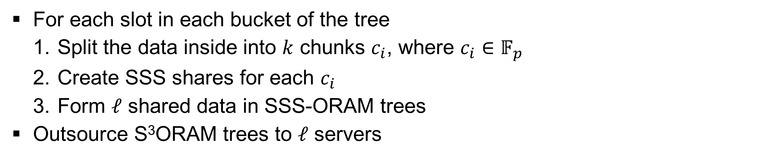



S³ORAM Data Structures
For each slot in each bucket of the tree
  Split the data inside into $k$ chunks $c_{i}$, where $c_{i}∈𝔽_{p}$
  Create SSS shares for each $c_{i}$
  Form $ℓ$ shared data in SSS-ORAM trees
Outsource S³ORAM trees to $ℓ$ servers
$$S_{1}$$
$$…$$
$$S_{ℓ}$$
1
$$c_{1}$$
$$c_{2}$$
$$…$$
$$c_{k}$$
2
3
SSS
$${⟦c_{1}⟧}_{1}$$
$$…$$
$${⟦c_{1}⟧}_{2}$$
$$…$$
$$…$$
$$⋮$$
$$⋮$$
$$⋱$$
$$⋮$$
$${⟦c_{1}⟧}_{ℓ}$$
$$…$$
3

Slide 11
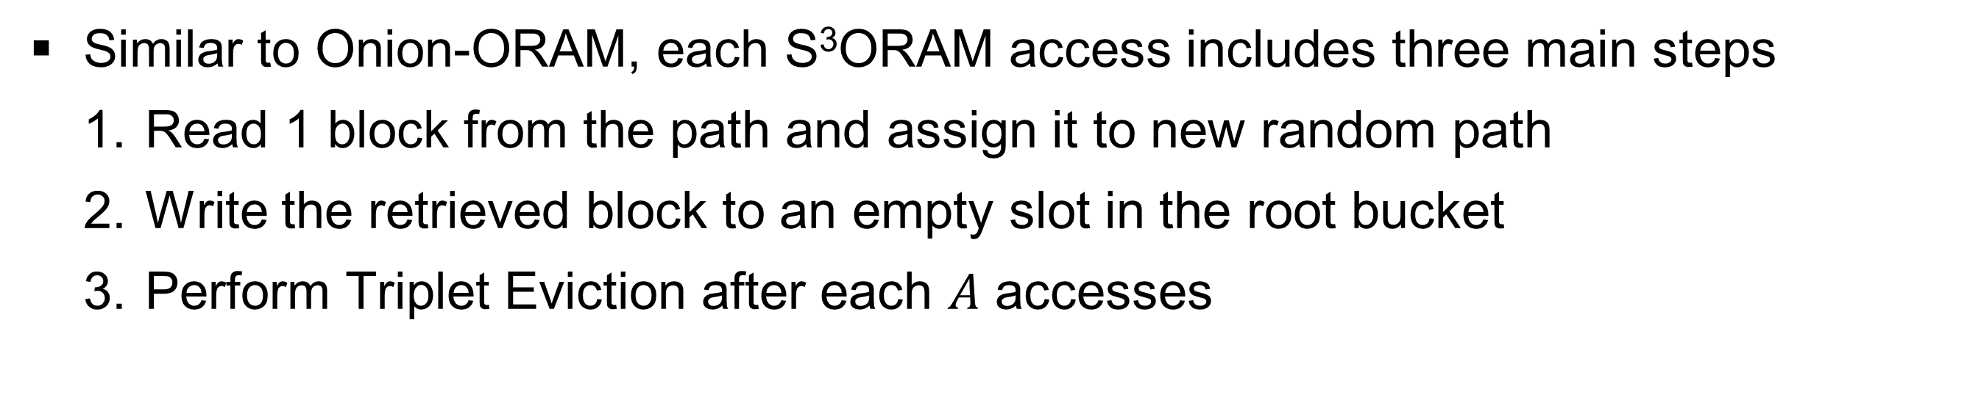
S³ORAM Access Protocol
Similar to Onion-ORAM, each S³ORAM access includes three main steps
  Read 1 block from the path and assign it to new random path
  Write the retrieved block to an empty slot in the root bucket
  Perform Triplet Eviction after each $A$ accesses
Server
Evict
new path: 15
8
9
10
11
12
13
14
15

Slide 12

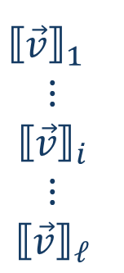

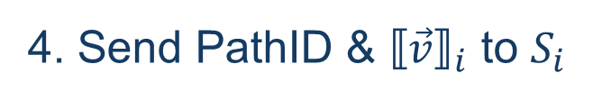


S³ORAM Access – Retrieval Subroutine
Leverage SSS-based PIR protocol
Client
read this block
$S_{i}$
1. Get the path ID & exact location of the block form posmap
2. Create a select vector according to the block location in the path
$$\vec{v}=(0,0,0,0,0,1,0,0,0,0,0,0,0,…)$$
3. Share select vector with SSS
Block ID | Path ID | Location
2 | 10 | 6
${⟦\vec{v}⟧}_{1}$
$$⋮$$
$${⟦\vec{v}⟧}_{i}$$
$$⋮$$
$${⟦\vec{v}⟧}_{ℓ}$$
$$\vec{v}$$
SSS
4. Send PathID & ${⟦\vec{v}⟧}_{i}$ to $S_{i}$
$${⟦\vec{v}⟧}_{i}$$
Share of a vector $\vec{v}$ is also a vector whose components are the share of components in $\vec{v}$

Slide 13


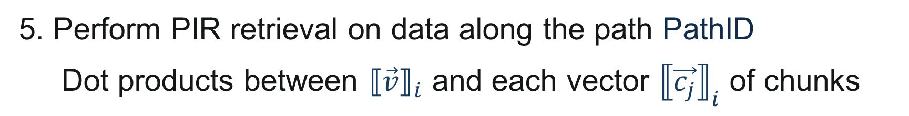
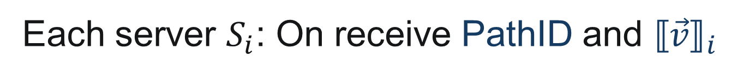
S³ORAM Access – Retrieval Subroutine
Leverage SSS-based PIR protocol
Each server $S_{i}$: On receive PathID and ${⟦\vec{v}⟧}_{i}$
5. Perform PIR retrieval on data along the path PathID
Dot products between ${⟦\vec{v}⟧}_{i}$ and each vector ${⟦\vec{c_{j}}⟧}_{i}$ of chunks
$${⟦\vec{c_{1}}⟧}_{i}^{(t)}$$
$$⋅{⟦\vec{v}⟧}_{i}^{(t)} = {⟦β_{1}⟧}_{i}^{(2t)}$$

Slide 14


S³ORAM Access – Retrieval Subroutine
Leverage SSS-based PIR protocol
Each server $S_{i}$: On receive PathID and ${⟦\vec{v}⟧}_{i}$
5. Perform PIR retrieval on data along the path PathID
Dot products between ${⟦\vec{v}⟧}_{i}$ and each vector ${⟦\vec{c_{j}}⟧}_{i}$ of chunks
$${⟦\vec{c_{1}}⟧}_{i}^{(t)}$$
$$⋅{⟦\vec{v}⟧}_{i}^{(t)} = {⟦β_{1}⟧}_{i}^{(2t)}$$
$${⟦\vec{c_{2}}⟧}_{i}^{(t)}$$
$$⋅{⟦\vec{v}⟧}_{i}^{(t)} = {⟦β_{2}⟧}_{i}^{(2t)}$$

Slide 15
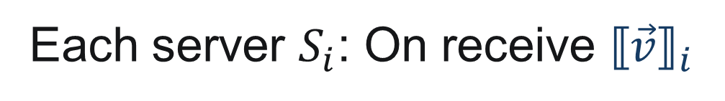


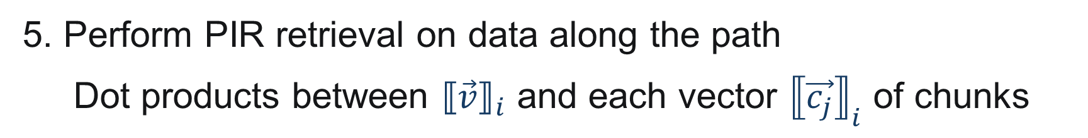
S³ORAM Access – Retrieval Subroutine
Leverage SSS-based PIR protocol
Each server $S_{i}$: On receive ${⟦\vec{v}⟧}_{i}$
5. Perform PIR retrieval on data along the path
Dot products between ${⟦\vec{v}⟧}_{i}$ and each vector ${⟦\vec{c_{j}}⟧}_{i}$ of chunks
$${⟦\vec{c_{1}}⟧}_{i}^{(t)}$$
$$⋅{⟦\vec{v}⟧}_{i}^{(t)} = {⟦β_{1}⟧}_{i}^{(2t)}$$
$${⟦\vec{c_{2}}⟧}_{i}^{(t)}$$
$$⋅{⟦\vec{v}⟧}_{i}^{(t)} = {⟦β_{2}⟧}_{i}^{(2t)}$$
$${⟦\vec{c_{3}}⟧}_{i}^{(t)}$$
$$⋅{⟦\vec{v}⟧}_{i}^{(t)} = {⟦β_{3}⟧}_{i}^{(2t)}$$

Slide 16



S³ORAM Access – Retrieval Subroutine
Leverage SSS-based PIR protocol
Each server $S_{i}$: On receive ${⟦\vec{v}⟧}_{i}$
5. Perform PIR retrieval on data along the path
Dot products between ${⟦\vec{v}⟧}_{i}$ and each vector ${⟦\vec{c_{j}}⟧}_{i}$ of chunks
$${⟦\vec{c_{1}}⟧}_{i}^{(t)}$$
Client
$$⋅{⟦\vec{v}⟧}_{i}^{(t)} = {⟦β_{1}⟧}_{i}^{(2t)}$$
$${⟦\vec{c_{2}}⟧}_{i}^{(t)}$$
$${⟦β_{1}⟧}_{i}^{(2t)}$$
$${⟦β_{2}⟧}_{i}^{(2t)}$$
$${⟦β_{3}⟧}_{i}^{(2t)}$$
$${⟦β_{4}⟧}_{i}^{(2t)}$$
$$⋅{⟦\vec{v}⟧}_{i}^{(t)} = {⟦β_{2}⟧}_{i}^{(2t)}$$
6. Send results to client
$${⟦\vec{c_{3}}⟧}_{i}^{(t)}$$
$$⋅{⟦\vec{v}⟧}_{i}^{(t)} = {⟦β_{3}⟧}_{i}^{(2t)}$$
$${⟦\vec{c_{3}}⟧}_{i}^{(t)}$$
$$⋅{⟦\vec{v}⟧}_{i}^{(t)} = {⟦β_{4}⟧}_{i}^{(2t)}$$

Slide 17


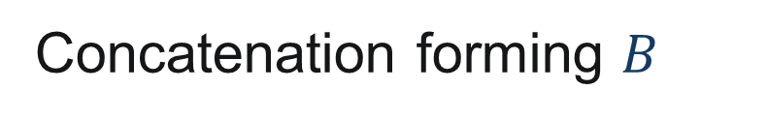
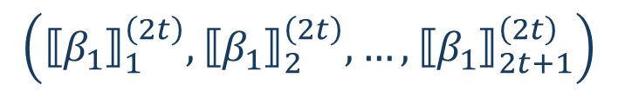
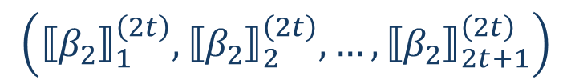





S³ORAM Access – Retrieval Subroutine
Leverage SSS-based PIR protocol
Client: On receive replies from at least $2t+1$ servers
7. Apply Lagrange interpolation over $2t+1$ shares of each chunk to compute the desired block $B$
$$\left({⟦β_{1}⟧}_{1}^{\left(2t\right)},{⟦β_{1}⟧}_{2}^{\left(2t\right)},…,{⟦β_{1}⟧}_{2t+1}^{\left(2t\right)}\right)$$
Lagrange Interpolation
$$β_{1}$$
$$\left({⟦β_{2}⟧}_{1}^{\left(2t\right)},{⟦β_{2}⟧}_{2}^{\left(2t\right)},…,{⟦β_{2}⟧}_{2t+1}^{\left(2t\right)}\right)$$
$$β_{2}$$
Concatenation forming $B$
$$…$$
$$…$$
$$⋮$$
$$\left({⟦β_{k}⟧}_{1}^{\left(2t\right)},{⟦β_{k}⟧}_{2}^{\left(2t\right)},…,{⟦β_{k}⟧}_{2t+1}^{\left(2t\right)}\right)$$
$$β_{k}$$

Slide 18







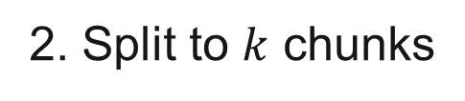




S³ORAM Access
Once the block is retrieved, update the block (if required), create new SSS shares for it and write to an empty slot in a root node of S³ORAM trees
Client
$$S_{1}$$
$$S_{ℓ}$$
$$…$$
2. Split to $k$ chunks
1. Update
$$B$$
$$B′$$
$$c_{1}$$
$$c_{2}$$
$$…$$
$$c_{k}$$
3. Create SSS shares
SSS
4. Write to an empty slot in root bucket
$$…$$
$$…$$
$$…$$
$$⋮$$
$$⋮$$
$$⋱$$
$$⋮$$
$$…$$
4. Write to an empty slot in root bucket

Slide 19




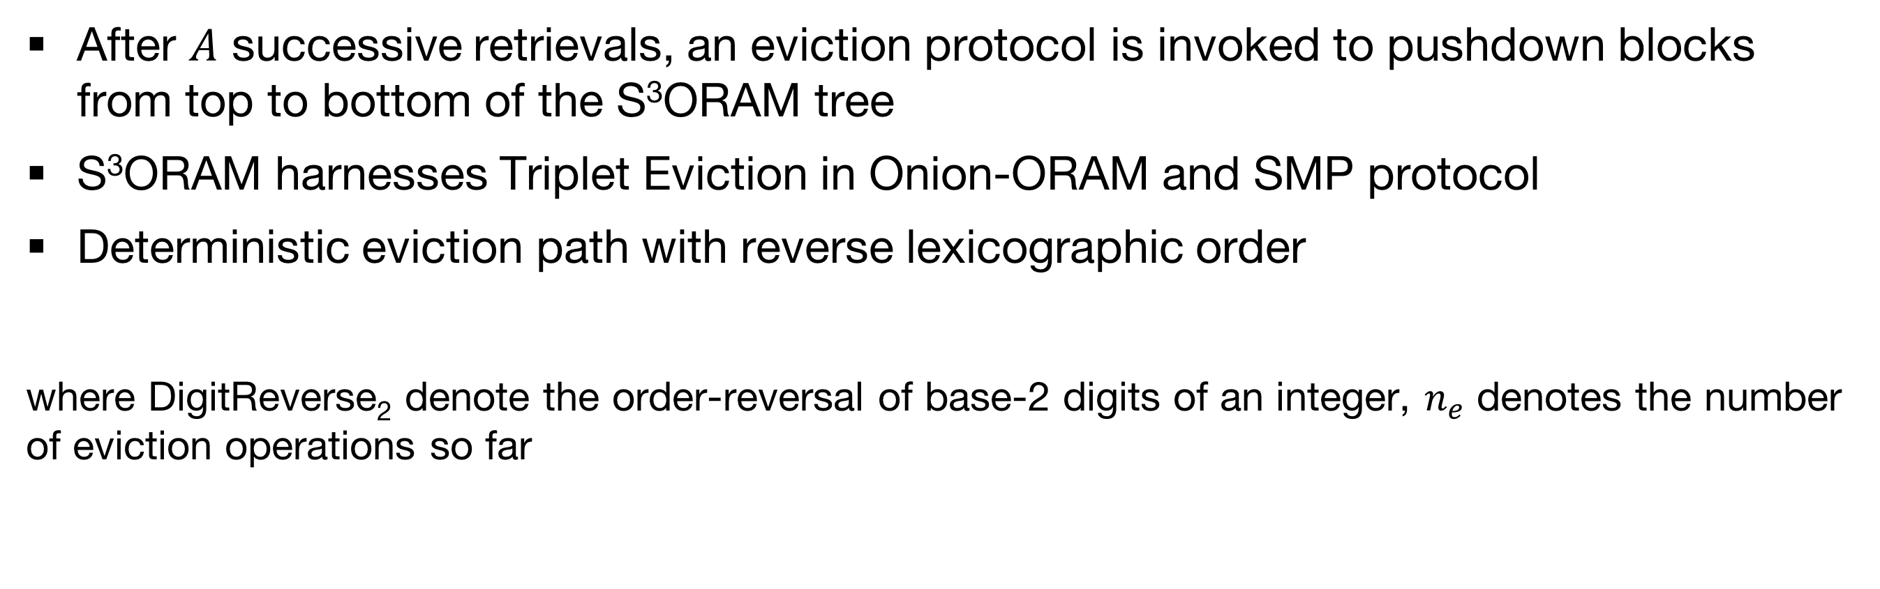
S³ORAM Access – Eviction Subroutine
After $A$ successive retrievals, an eviction protocol is invoked to pushdown blocks from top to bottom of the S³ORAM tree
S³ORAM harnesses Triplet Eviction in Onion-ORAM and SMP protocol
Deterministic eviction path with reverse lexicographic order
where DigitReverse₂ denote the order-reversal of base-2 digits of an integer, $n_{e}$ denotes the number of eviction operations so far
pushdown
Triplet
src
0
1
0
1
0
1
pushdown
0
1
src
Triplet
sibl
dest
pushdown
0
1
0
1
0
1
0
1
0
1
0
1
0
1
0
1
pushdown
sibl
dest
$$n_{e}=0→v=00$$
$$n_{e}=1→v=10$$
$$n_{e}=2→v=01$$
$$n_{e}=3→v=11$$

Slide 20
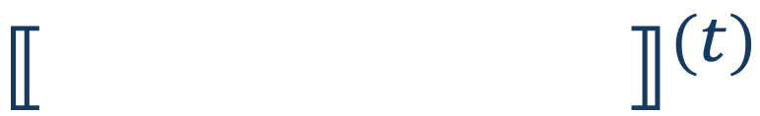

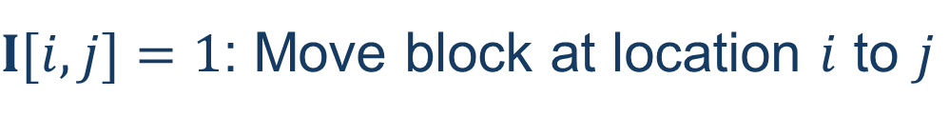



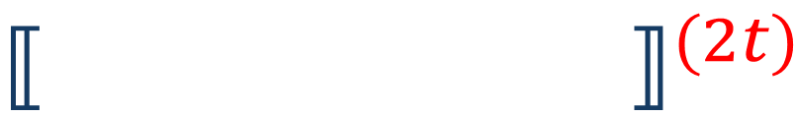
S³ORAM Access – Eviction Subroutine
src
copy!
??
Done by oblivious permutation via Matrix product
sibl
dest
$I[i,j]=1$: Move block at location $i$ to $j$
Empty due to previous eviction
$I[i+Z,i]=1$: Keep the block location in dest. bucket remain the same
$$I$$
$${⟦\begin{matrix} \\ \\ \begin{matrix}\begin{matrix} \\ \end{matrix} \\ \end{matrix}\end{matrix}⟧}^{(t)}$$
0 | 0 | 0
1 | 0 | 0
0 | 0 | 0
0 | 0 | 0
0 | 1 | 0
0 | 0 | 0
${⟦ ⟧}^{(t)}$
$$⋅$$
$$=$$
${⟦ ⟧}^{(2t)}$
 | B |  |  | E
 |  |  | B | E

Slide 21


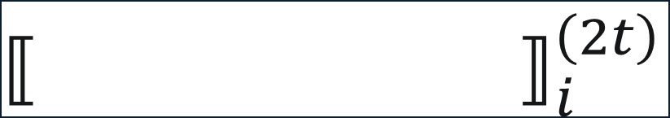
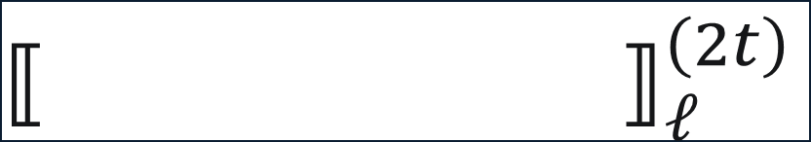
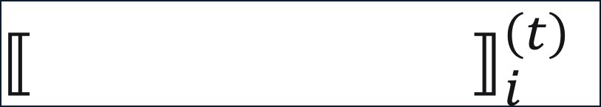
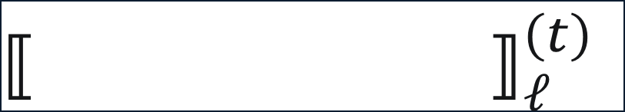




S³ORAM Access – Eviction Subroutine
src
copy!
Matrix product
sibl
dest
After matrix product, $ℓ$ servers execute SMP protocol together to reduce polynomial degree from $2t$ to $t$
$$S_{1}$$
${⟦ ⟧}_{i}^{\left(2t\right)}$
SMP Protocol
${⟦ ⟧}_{i}^{\left(t\right)}$
$$S_{1}$$
 |  |  | B | E
 |  |  | B | E
$$⋮$$
$$⋮$$
${⟦ ⟧}_{ℓ}^{\left(2t\right)}$
${⟦ ⟧}_{ℓ}^{\left(t\right)}$
$$S_{ℓ}$$
 |  |  | B | E
 |  |  | B | E
$$S_{ℓ}$$

Slide 22
S³ORAM Security

Slide 23
Experimental Configurations
  External Libraries
    Shoup’s NTL library v9.10.03
    ZeroMQ library
  Hardware
    Client(s): Laptop with Intel Core i5 2.90GHz; Google Nexus 6P phone
    Server(s): 3 Amazon EC2 instances with c4.4xlarge type
  Network
    Client-server: 29/5 Mbps (Laptop) ; 27/5 Mbps LTE (Mobile)
    Server-server: 250/250 Mbps
  Database
    40 GB randomly-generated data
    Block sizes: from 64 KB to 768 KB

Slide 24
Experimental Results
  S³ORAM is approximately 10⁴×, 5× and 8× faster than Onion-ORAM, Ring-ORAM and Path-ORAM, respectively.
End-to-end delay of S³ORAM and its counterparts on a laptop with home network setting

Slide 25
Experimental Results
  Server-server communication
Server I/O
I/O EC2 throughput: 150MB/s
Bucket Size: 333
256KB Block transmission
Query & matrix transmission
Server computation
Detailed cost breakdown of S³ORAM on a laptop with home network

Slide 26
Experimental Results
End-to-end delay of S³ORAM and its counterparts on a mobile with LTE network

Slide 27
Experimental Results
Client computation
Detailed cost breakdown of S³ORAM on a mobile with LTE network

Slide 28
Experimental Results
Ring-ORAM < S³ORAM
110 Mbps
Path-ORAM < S³ORAM
240 Mbps
End-to-end delay for varying block sizes for a 40GB DB
Delay for varying network throughputs for a 40GB of 128KB blocks
*Onion-ORAM is excluded since its delay is far beyond the limit of y-axis.

Slide 29
Summary
High-level comparison between S³ORAM and some state-of-the-art ORAMs

Slide 30
Conclusions
Introduced S³ORAM, an efficient distributed ORAM scheme featuring O(1) bandwidth blowup, O(1) blocks of client storage, low end-to-end delay and information-theoretic security simultaneously.
Next consideration:
  Malicious setting
  Generalization with k-ary tree structure

Slide 31


Thank you for your attention!
?
S³ORAM code: https://github.com/thanghoang/S3ORAM

Slide 33
Recursive S³ORAM
Store position map via smaller S³ORAM data structures
Store the block locations in meta-data of each bucket
Given position map is small in practice, it is recommended to locally store at the client to achieve better performance

Slide 34
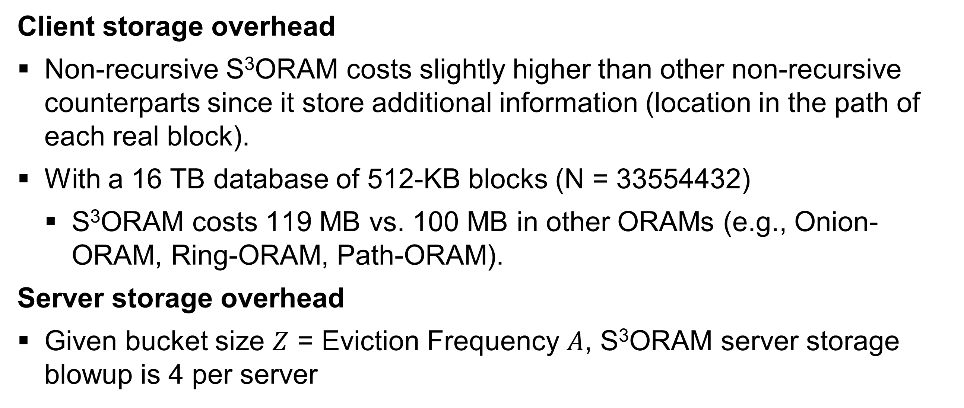
Experimental Results
Client storage overhead
Non-recursive S³ORAM costs slightly higher than other non-recursive counterparts since it store additional information (location in the path of each real block).
With a 16 TB database of 512-KB blocks (N = 33554432)
  S³ORAM costs 119 MB vs. 100 MB in other ORAMs (e.g., Onion-ORAM, Ring-ORAM, Path-ORAM).
Server storage overhead
Given bucket size $Z$ = Eviction Frequency $A$, S³ORAM server storage blowup is 4 per server

