Slide 1


MACAO: A Maliciously-Secure and Client-Efficient Active ORAM Framework
NDSS Symposium 2020
Thang Hoang†, Jorge Guajardo‡, Attila A. Yavuz†
†CSE, University of South Florida
hoangm@mail.usf.edu, attilaayavuz@usf.edu
‡Robert Bosch LLC – RTC
Jorge.GuajardoMerchan@us.bosch.com

Slide 2

Oblivious RAM
Oblivious Random Access Machine (ORAM) allows a client to hide the access pattern when accessing data stored on untrusted memory.
ORAM
Logical read
Physical read/write
Logical write
ORAM applications: Cloud storage-as-a-service (personal data storage, health-record database, password management), searchable encryption, secure multiparty computation

Slide 3

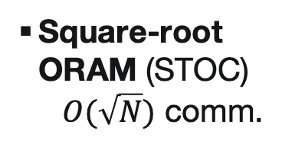
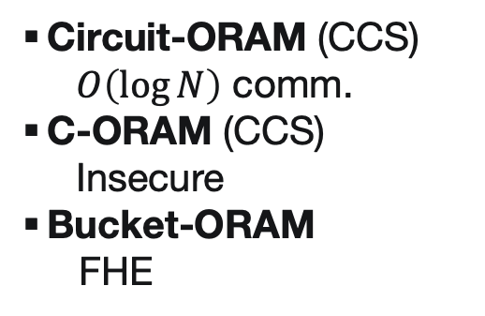
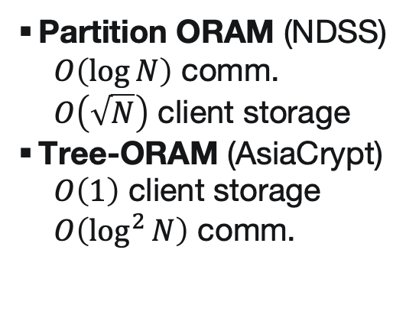
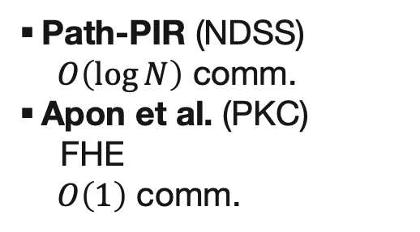
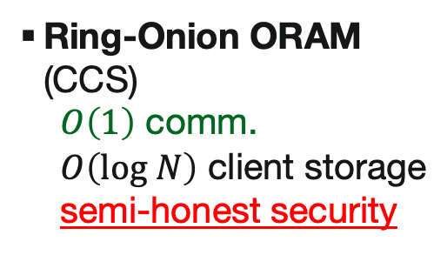
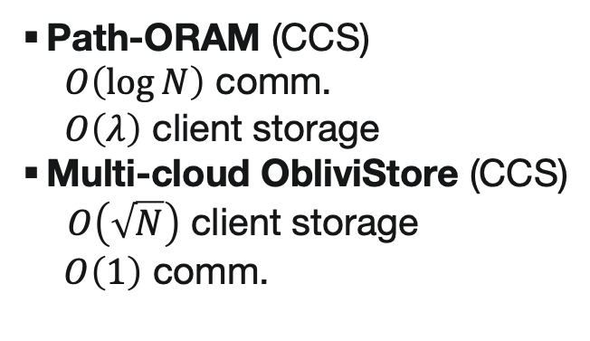
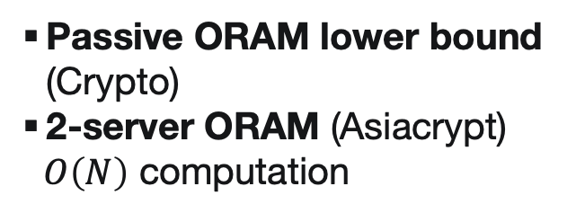
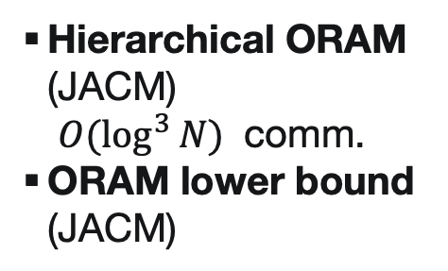
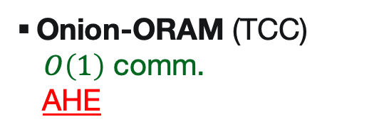
Oblivious RAM – Timeline
ORAM was first introduced by Goldreich for software protection
Recent attempts focused on reducing ORAM communication overhead
Square-root ORAM (STOC)
$O(\sqrt{N})$ comm.
Partition ORAM (NDSS)
$O\left(\log{N}\right)$ comm.
$O\left(\sqrt{N}\right)$ client storage
Tree-ORAM (AsiaCrypt)
$O\left(1\right)$ client storage
$O\left(\log^{2}{N}\right)$ comm.
Path-PIR (NDSS)
$O\left(\log{N}\right)$ comm.
Apon et al. (PKC)
FHE
$O\left(1\right)$ comm.
Onion-ORAM (TCC)
$O\left(1\right)$ comm.
AHE
Passive ORAM lower bound (Crypto)
  2-server ORAM (Asiacrypt)
  $O\left(N\right)$ computation
1996
2013
2015
2017
2019
1987
2011
2014
2016
2018
Ring-Onion ORAM (CCS)
$O\left(1\right)$ comm.
$O\left(log N\right)$ client storage
semi-honest security
Hierarchical ORAM (JACM)
$O(\log^{3}{N})$ comm.
ORAM lower bound (JACM)
Circuit-ORAM (CCS)
$O\left(\log{N}\right)$ comm.
C-ORAM (CCS)
  Insecure
Bucket-ORAM
FHE
Path-ORAM (CCS)
$O\left(\log{N}\right)$ comm.
$O\left(λ\right)$ client storage
Multi-cloud ObliviStore (CCS)
$O\left(\sqrt{N}\right)$ client storage
$O\left(1\right)$ comm.
S³ORAM (CCS)
$O\left(1\right)$ comm.
$O\left(1\right)$ client storage
semi-honest security

Slide 4
Tree-ORAM Paradigm [SCSL11]
Binary tree data structure
Block data located somewhere in the tree path
Empty nodes are filled with dummy data
General Access Protocol
Server
Get pID of A: 1
Retrieve path of A
Update A (if needed)
Randomly select new path for A: 4
Evict
B
D
F
A
C
E
pID
1
2
3
4
5
6
7
8
Client
Stash
Position map
A
Block | A | B | C | D | E | F
pID |  | 3 | 6 | 5 | 7 | 8
4
1

Slide 5











PIR-based ORAM: Malicious Security Concern
Due to unit vectors created in retrieval phase
  Contain only one element 1, while others are 0
  Malicious adversary can tamper with the blocks corresponding to elements “0”
    Computation result is still correct ➔ cannot be detected by client
    Learn real block positions
    Access pattern leakage
$⟦0⟧$
$$+$$
$$×$$
$$⟦0⟧$$
$$+$$
$$×$$
$$⟦0⟧$$
$$+$$
$$⟦A⟧$$
$$×$$
$$⟦1⟧$$

Slide 6

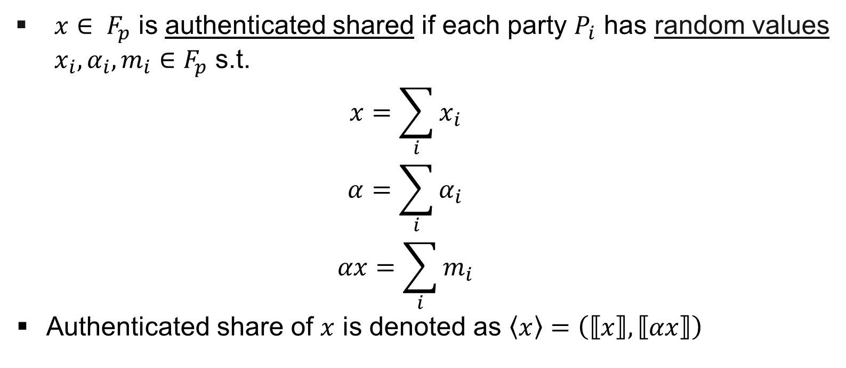
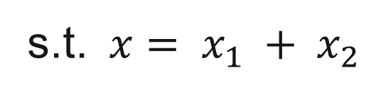



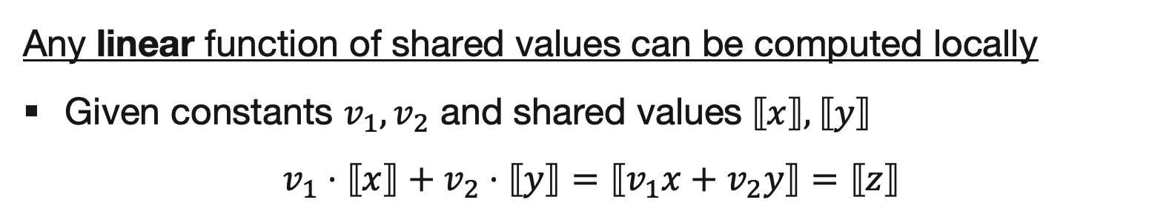
MACAO Framework
Based on (authenticated) additive secret sharing [DPSZ11]
$$x$$
$x∈ F_{p}$ is authenticated shared if each party $P_{i}$ has random values $x_{i}, α_{i}, m_{i}∈F_{p}$ s.t.
  $$x=\sum_{i}{x_{i}}$$
  $$α=\sum_{i}{α_{i}}$$
  $$αx=\sum_{i}{m_{i}}$$
Authenticated share of $x$ is denoted as $\left\langle x\right\rangle =\left(⟦x⟧,⟦αx⟧\right)$
  Random global MAC key
$$x_{2}∈𝔽_{p}$$
Any linear function of shared values can be computed locally
Given constants $v_{1},v_{2}$ and shared values$⟦x⟧,⟦y⟧$
$$v_{1}⋅⟦x⟧+v_{2}⋅⟦y⟧=⟦v_{1}x+v_{2}y⟧=⟦z⟧$$
$$x_{1}∈𝔽_{p}$$
s.t. $x= x_{1} + x_{2}$

Slide 7
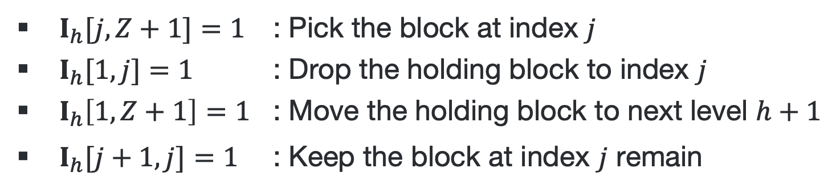

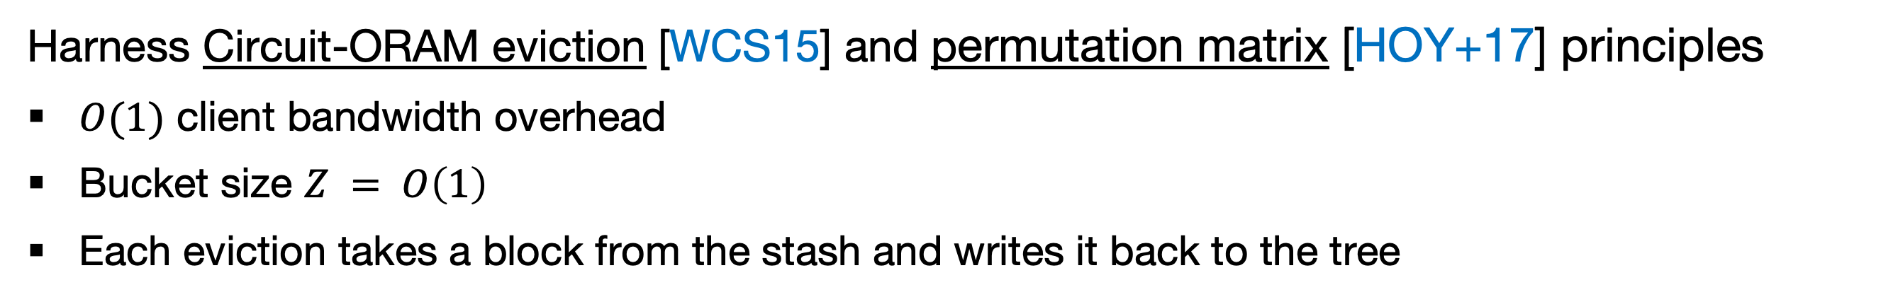

MACAO Framework
Harness Circuit-ORAM eviction [WCS15] and permutation matrix [HOY+17] principles
$O(1)$ client bandwidth overhead
  Bucket size $Z = O\left(1\right)$
Each eviction takes a block from the stash and writes it back to the tree
Circuit-ORAM Eviction Principle:
Only scan once from root to leaf
For each level, pick or drop (at most) 1 block
At any time, can only hold (at most) 1 block
Stash S
D
  $$|S| = O(log⁡N)$$
  $$Z = 2$$
Create ($H+1$) permutation matrices $I_{h}$ sized $\left(Z+1\right)×(Z+1)$ s.t.
B
$I_{h}[j,Z+1]=1$ : Pick the block at index $j$
$I_{h}[1,j]=1$ : Drop the holding block to index $j$
$I_{h}\left[1,Z+1\right]=1$ : Move the holding block to next level $h+1$
$I_{h}[j+1,j]=1$ : Keep the block at index $j$ remain
C
A

Slide 8

MACAO Framework
Two main schemes
$Π_{rss}$
  Replicated secret sharing (RSS)
  3-server setting with honest majority
$Π_{spdz}$
  SPDZ secret sharing
  General $ℓ$-server setting with dishonest majority

Slide 9


























MACAO Framework - $Π_{rss}$ scheme
S0
Retrieval
  Select query $q = {\left(0,…,1,…,0\right)}^{H+1}$
XOR-PIR: a pair of PIR queries $\left(q_{i}^{\left(1\right)},q_{i}^{\left(2\right)}\right)$ per authenticated share ${\left\langle T\right\rangle }_{i}$
  $q_{i}^{(1)}←_{\$} {\left\{0,1\right\}}^{H+1}$, $q_{i}^{(2)}← q⊕q_{i}^{(1)}$
$${\left\langle T\right\rangle }_{0}$$
$${\left\langle T\right\rangle }_{1}$$
$R_{0}^{(1)}←q_{0}^{(1)}⊕{\left\langle T\right\rangle }_{0}$
$$R_{1}^{(2)}$$
$$R_{0}^{(1)}$$
$R_{1}^{(2)}←q_{1}^{(2)}⊕{\left\langle T\right\rangle }_{1}$
S1
$$q_{1}^{(2)}$$
$$q_{0}^{(2)}$$
$$q_{1}^{(1)}$$
$$q_{0}^{(1)}$$
$${\left\langle T\right\rangle }_{1}$$
$${\left\langle T\right\rangle }_{2}$$
$$R_{1}^{(1)}←q_{1}^{(1)}⊕{\left\langle T\right\rangle }_{1}$$
$${\left\langle B\right\rangle }_{1}←R_{1}^{(1)}⊕R_{1}^{\left(2\right)}$$
$$R_{1}^{(1)}$$
$R_{2}^{\left(2\right)}←q_{2}^{(2)}⊕{\left\langle T\right\rangle }_{2}$
$${\left\langle B\right\rangle }_{0}←R_{0}^{(1)}⊕R_{0}^{\left(2\right)}$$
$${\left\langle B\right\rangle }_{2}←R_{2}^{(1)}⊕R_{2}^{\left(2\right)}$$
S2
$$(X,Y)←{\left\langle B\right\rangle }_{0}+{\left\langle B\right\rangle }_{1}+{\left\langle B\right\rangle }_{2}$$
      Check if $αX=?Y$
$${\left\langle T\right\rangle }_{2}$$
$${\left\langle T\right\rangle }_{0}$$
$R_{2}^{\left(1\right)}←q_{2}^{(1)}⊕{\left\langle T\right\rangle }_{2}$
$R_{0}^{(2)}←q_{0}^{(2)}⊕{\left\langle T\right\rangle }_{0}$
$$R_{0}^{(2)}$$

Slide 10



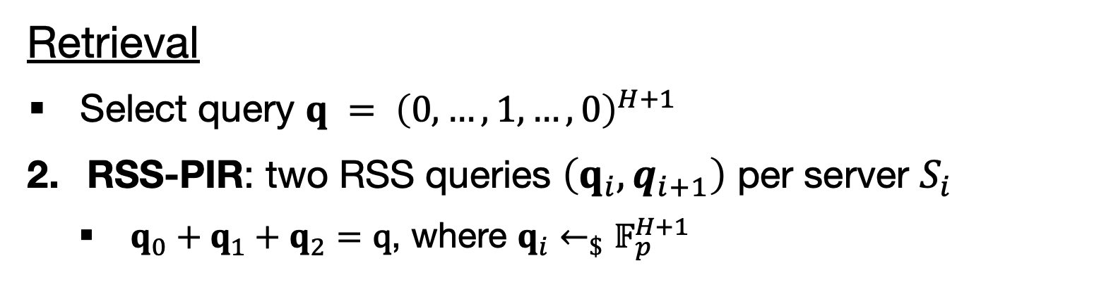











MACAO Framework - $Π_{rss}$ scheme
$$S_{0}$$
Retrieval
  Select query $q = {\left(0,…,1,…,0\right)}^{H+1}$
RSS-PIR: two RSS queries $\left(q_{i},q_{i+1}\right)$ per server $S_{i}$
  $q_{0}+q_{1}+q_{2}=\text{q}$, where $q_{i}←_{\$}𝔽_{p}^{H+1}$
$${\left\langle T\right\rangle }_{0}$$
$${\left\langle T\right\rangle }_{1}$$
$${\left\langle R\right\rangle }_{0}$$
$${\left\langle R\right\rangle }_{0}←q_{0}⋅{\left\langle T\right\rangle }_{0}+q_{1}⋅{\left\langle T\right\rangle }_{0}+{q_{0}⋅\left\langle T\right\rangle }_{1}$$
$$S_{1}$$
$$q_{0}, q_{2}$$
$$q_{1}, q_{2}$$
$$q_{0}, q_{1},q_{2}$$
$$q_{0}, q_{1}$$
$${\left\langle T\right\rangle }_{1}$$
$${\left\langle T\right\rangle }_{2}$$
$${\left\langle R\right\rangle }_{1}←q_{1}⋅{\left\langle T\right\rangle }_{1}+q_{2}⋅{\left\langle T\right\rangle }_{1}+{q_{1}⋅\left\langle T\right\rangle }_{2}$$
$${\left\langle R\right\rangle }_{1}$$
$$(X,Y)←{\left\langle R\right\rangle }_{0}+{\left\langle R\right\rangle }_{1}+{\left\langle R\right\rangle }_{2}$$
      Check if $αX=?Y$
$$S_{2}$$
$${\left\langle T\right\rangle }_{2}$$
$${\left\langle T\right\rangle }_{0}$$
$${\left\langle R\right\rangle }_{2}←q_{2}⋅{\left\langle T\right\rangle }_{2}+q_{0}⋅{\left\langle T\right\rangle }_{2}+{q_{2}⋅\left\langle T\right\rangle }_{0}$$
$${\left\langle R\right\rangle }_{2}$$

Slide 11
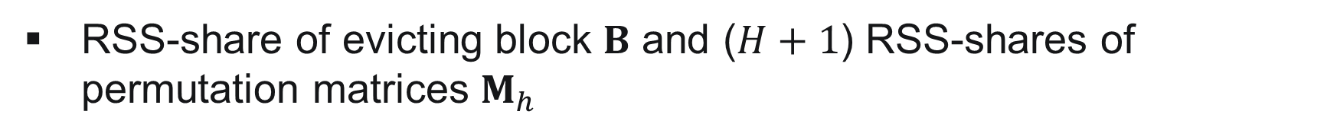








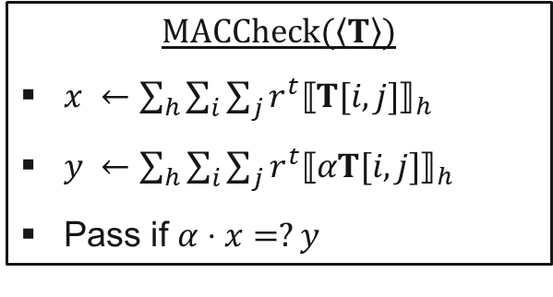



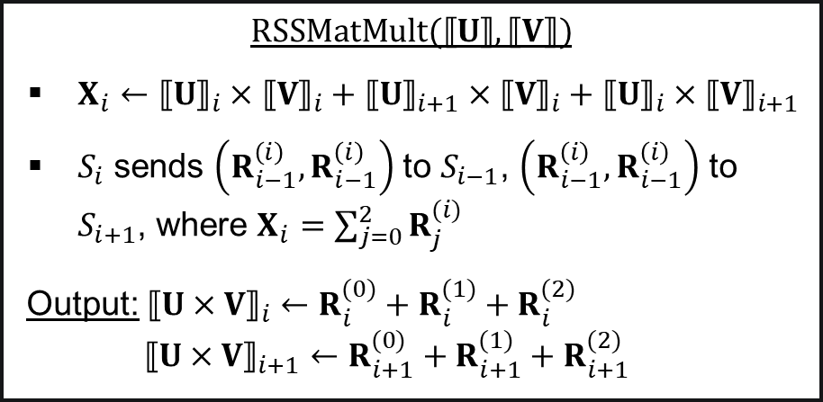


MACAO Framework - $Π_{rss}$ scheme
    $$RSSMatMult(⟦U⟧,⟦V⟧)$$
    $X_{i}←{⟦U⟧}_{i}×{⟦V⟧}_{i}+{⟦U⟧}_{i+1}×{⟦V⟧}_{i}+{⟦U⟧}_{i}×{⟦V⟧}_{i+1}$
    $S_{i}$ sends $\left(R_{i−1}^{\left(i\right)},R_{i−1}^{\left(i\right)}\right)$ to $S_{i−1}$, $\left(R_{i−1}^{\left(i\right)},R_{i−1}^{\left(i\right)}\right)$ to $S_{i+1}$, where $X_{i}=\sum_{j=0}^{2}{R_{j}^{(i)}}$
    Output: ${⟦U×V⟧}_{i}←R_{i}^{(0)}+R_{i}^{(1)}+R_{i}^{(2)}$
    ${⟦U×V⟧}_{i+1}←R_{i+1}^{(0)}+R_{i+1}^{(1)}+R_{i+1}^{(2)}$
Eviction: based on RSS-based matrix multiplication protocol
RSS-share of evicting block $B$ and ($H+1$) RSS-shares of permutation matrices $M_{h}$
$$MACCheck(\left\langle T\right\rangle )$$
$x ←\sum_{h}{\sum_{i}{\sum_{j}{r^{t}{⟦T[i,j]⟧}_{h}}}}$
$y ←\sum_{h}{\sum_{i}{\sum_{j}{r^{t}{⟦αT[i,j]⟧}_{h}}}}$
Pass if $α⋅x=?y$
$${⟦M_{h}⟧}_{0},{⟦M_{h}⟧}_{1}$$
$${⟦M_{h}⟧}_{0},{⟦M_{h}⟧}_{2}$$
$$M_{h}={⟦M_{h}⟧}_{0}+{⟦M_{h}⟧}_{1}+{⟦M_{h}⟧}_{2}$$
$${⟦M_{h}⟧}_{1},{⟦M_{h}⟧}_{2}$$
$$B={⟦B⟧}_{0}+{⟦B⟧}_{1}+{⟦B⟧}_{2}$$
$${⟦B⟧}_{0},{⟦B⟧}_{1}$$
$${⟦B⟧}_{0},{⟦B⟧}_{2}$$
$${⟦B⟧}_{1},{⟦B⟧}_{2}$$
(Random linear combination)
Jointly execute MACCheck(${\left\langle T\right\rangle }_{h}$) to verify eviction integrity
$$S_{0}$$
$$S_{1}$$
$$S_{2}$$
$$⟦T_{h}^{′}⟧←RSSMatMult\left(⟦M_{h}⟧,⟦T_{h}⟧\right)$$
$T_{h}$: holding block and current blocks at level $h$
$$⟦αT_{h}^{′}⟧←RSSMatMult\left(⟦M_{h}⟧,⟦αT_{h}⟧\right)$$

Slide 12

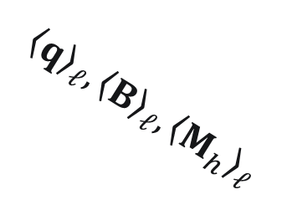
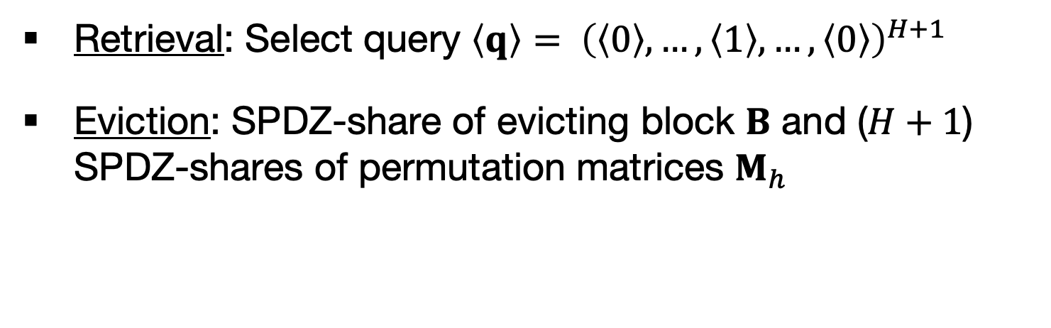
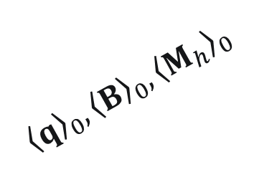

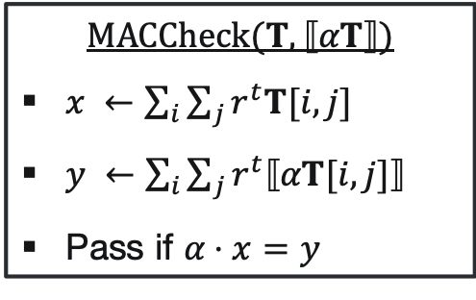
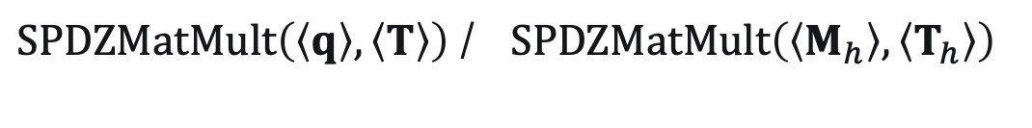
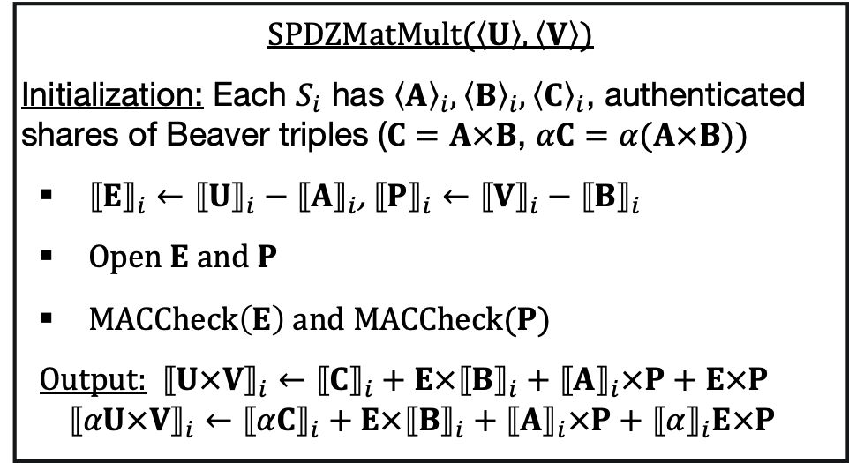

MACAO Framework - $Π_{spdz}$ scheme
Both retrieval and eviction are based on SPDZ-based authenticated matrix multiplication protocol
Retrieval: Select query $\left\langle q\right\rangle = {\left(\left\langle 0\right\rangle ,…,\left\langle 1\right\rangle ,…,\left\langle 0\right\rangle \right)}^{H+1}$
Eviction: SPDZ-share of evicting block $B$ and ($H+1$) SPDZ-shares of permutation matrices $M_{h}$
    $$SPDZMatMult(\left\langle U\right\rangle ,\left\langle V\right\rangle )$$
    Initialization: Each $S_{i}$ has ${\left\langle A\right\rangle }_{i},{\left\langle B\right\rangle }_{i},{\left\langle C\right\rangle }_{i}$, authenticated shares of Beaver triples ($C=A×B$, $αC=α(A×B))$
    ${⟦E⟧}_{i}←{⟦U⟧}_{i}−{⟦A⟧}_{i}$, ${⟦P⟧}_{i}←{⟦V⟧}_{i}−{⟦B⟧}_{i}$
    Open $E$ and $P$
    $MACCheck\left(E\right)$ and $MACCheck(P)$
    Output: ${⟦U×V⟧}_{i}←{⟦C⟧}_{i}+E×{⟦B⟧}_{i}+{⟦A⟧}_{i}×P+E×P$
    $${⟦αU×V⟧}_{i}←{⟦αC⟧}_{i}+E×{⟦B⟧}_{i}+{⟦A⟧}_{i}×P+{⟦α⟧}_{i}E×P$$
$${\left\langle q\right\rangle }_{0},{\left\langle B\right\rangle }_{0},{\left\langle M_{h}\right\rangle }_{0}$$
$${\left\langle q\right\rangle }_{ℓ},{\left\langle B\right\rangle }_{ℓ},{\left\langle M_{h}\right\rangle }_{ℓ}$$
$$…$$
$$MACCheck(T,⟦αT⟧)$$
$x ←\sum_{i}{\sum_{j}{r^{t}T[i,j]}}$
$y ←\sum_{i}{\sum_{j}{r^{t}⟦αT[i,j]⟧}}$
Pass if $α⋅x=y$
Jointly execute MACCheck to verify retrieval and eviction integrity
$$S_{0}$$
$$S_{n−1}$$
(Random linear combination)
$SPDZMatMult\left(\left\langle q\right\rangle ,\left\langle T\right\rangle \right)$ / $SPDZMatMult\left(\left\langle M_{h}\right\rangle ,\left\langle T_{h}\right\rangle \right)$

Slide 13




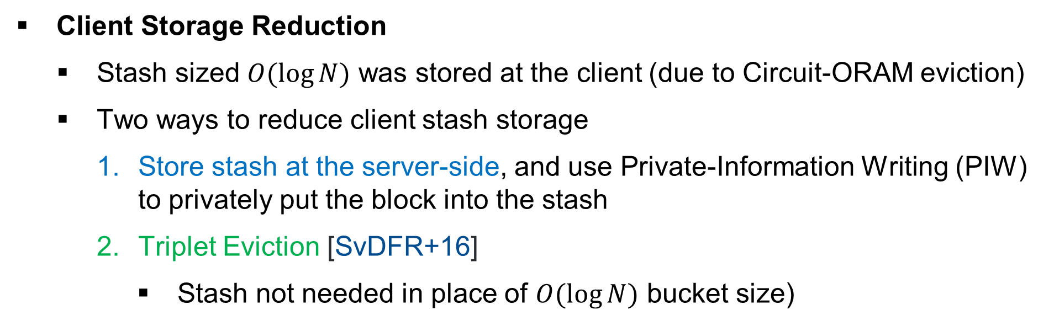
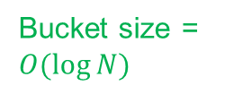







MACAO Framework - Extension
Bandwidth Reduction
  Pseudo-random function (PRF) to generate additive shares locally [CDI05, DSZ14, RWTS+17]
$$s_{1}$$
$$s_{2}$$
$$a_{0},b_{0}$$
S0
S1
S2
$${\hat{s}}_{0}^{1}$$
$${\hat{s}}_{1}^{0}$$
$${\hat{s}}_{1}^{2}$$
$${\hat{s}}_{2}^{1}$$
$${\hat{s}}_{0}^{2}$$
$${\hat{s}}_{2}^{0}$$
$$a= a_{0} + a_{1} + a_{2}$$
$$b= b_{0} + b_{1} + b_{2}$$
$$PRF(s_{1})$$
$$PRF(s_{2})$$
PIW to put a block
Client Storage Reduction
  Stash sized $O(log⁡N)$ was stored at the client (due to Circuit-ORAM eviction)
  Two ways to reduce client stash storage
    Store stash at the server-side, and use Private-Information Writing (PIW) to privately put the block into the stash
    Triplet Eviction [SvDFR+16]
      Stash not needed in place of $O(log⁡N)$ bucket size)
Triplet Eviction
  Bucket size = $O(log⁡N)$
Retrieval path

Slide 14
MACAO Framework – Performance (1/3)
MACAO schemes were 7× faster than single-server ORAMs and up to 1.5× slower than S³ORAM
End-to-end delay of MACAO schemes and their counterparts.
    Configuration: Library: NTL, tomcrypt, zeroMQ, pthread; Client: Macbook Pro 2018; Servers: Amazon EC2 c5.4xlarge, EBS-based storage; Client-server bandwidth: 29/5 Mbps; Inter-server bandwidth: 250/250 Mbps; DB Size: 1GB – 1TB; Block size: 4KB, 256KB

Slide 15
MACAO Framework – Performance (2/3)
Server computation contributed the most portion to the overall delay
Bandwidth reduction trick significantly reduced the communication costs
Cost breakdown of MACAO schemes
    Configuration: Library: NTL, tomcrypt, zeroMQ, pthread; Client: Macbook Pro 2018; Servers: Amazon EC2 c5.4xlarge, EBS-based storage; Client-server bandwidth: 29/5 Mbps; Inter-server bandwidth: 250/250 Mbps; DB Size: 1GB – 1TB; Block size: 4KB, 256KB

Slide 16
MACAO Framework – Performance (3/3)
Bandwidth reduction trick also helped to reduce the delay when increasing number of servers for higher privacy levels
End-to-end delay with varied privacy levels
    Configuration: Library: NTL, tomcrypt, zeroMQ, pthread; Client: Macbook Pro 2018; Servers: Amazon EC2 c5.4xlarge, EBS-based storage; Client-server bandwidth: 29/5 Mbps; Inter-server bandwidth: 250/250 Mbps; DB Size: 1GB – 1TB; Block size: 4KB, 256KB

Slide 17
Conclusion & Future Work
Proposed MACAO, a multi-server active ORAM framework providing integrity, access pattern obliviousness against active adversaries, and secure computation capability.
  Based on Authenticated additive secret sharing and tree ORAM paradigm
Future Work
Oblivious Distributed File System (ODFS) implementation
Multi-user Oblivious Storage based on MACAO
The proposed ODFS Model

Slide 18

Thank you for your attention!
?
MACAO code: https://github.com/thanghoang/MACAO

Slide 19
References
[CDI05] Cramer, Ronald, Ivan Damgård, and Yuval Ishai. "Share conversion, pseudorandom secret-sharing and applications to secure computation." In Theory of Cryptography Conference, pp. 342-362. Springer, Berlin, Heidelberg, 2005.
[SCSL11] Shi, Elaine, T-H. Hubert Chan, Emil Stefanov, and Mingfei Li. "Oblivious RAM with O ((logN) 3) worst-case cost." In International Conference on The Theory and Application of Cryptology and Information Security, pp. 197-214. Springer, Berlin, Heidelberg, 2011.
[DPSZ11] Damgård, Ivan, Valerio Pastro, Nigel Smart, and Sarah Zakarias. "Multiparty computation from somewhat homomorphic encryption." In Annual Cryptology Conference, pp. 643-662. Springer, Berlin, Heidelberg, 2012.
[DSZ14] Demmler, Daniel, Thomas Schneider, and Michael Zohner. "Ad-hoc secure two-party computation on mobile devices using hardware tokens." In 23rd {USENIX} Security Symposium ({USENIX} Security 14), pp. 893-908. 2014.
[WCS15] Wang, Xiao, Hubert Chan, and Elaine Shi. "Circuit oram: On tightness of the goldreich-ostrovsky lower bound." In Proceedings of the 22nd ACM SIGSAC Conference on Computer and Communications Security, pp. 850-861. 2015
[SvDFR+16] Devadas, Srinivas, Marten van Dijk, Christopher W. Fletcher, Ling Ren, Elaine Shi, and Daniel Wichs. "Onion ORAM: A constant bandwidth blowup oblivious RAM." In Theory of Cryptography Conference, pp. 145-174. Springer, Berlin, Heidelberg, 2016.
[HOY+17] Hoang, Thang, Ceyhun D. Ozkaptan, Attila A. Yavuz, Jorge Guajardo, and Tam Nguyen. "S3oram: A computation-efficient and constant client bandwidth blowup oram with shamir secret sharing." In Proceedings of the 2017 ACM SIGSAC Conference on Computer and Communications Security, pp. 491-505. 2017.
[RWTS+17] Riazi, M. Sadegh, Christian Weinert, Oleksandr Tkachenko, Ebrahim M. Songhori, Thomas Schneider, and Farinaz Koushanfar. "Chameleon: A hybrid secure computation framework for machine learning applications." In Proceedings of the 2018 on Asia Conference on Computer and Communications Security, pp. 707-721. 2018.

Slide 20
Our Motivation
Single-server active ORAM (e.g., Onion-ORAM) offers O(1) bandwidth blowup and malicious security
  High computation overhead due to Homomorphic Encryption (HE)
  Cut-and-choose technique → incurs higher communication and computation overhead for malicious security
Multi-server active ORAM (i.e., S³ORAM) offers O(1) bandwidth with efficient computation
  However, it only offers semi-honest security
An efficient multi-server ORAM with active security?

Slide 21
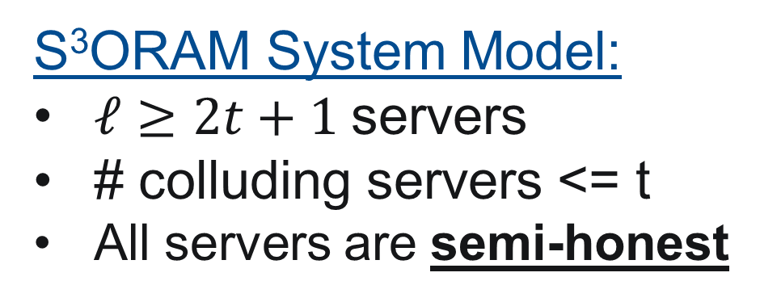
S³ORAM [HOY+17]
Tree-ORAM paradigm
Exploit the efficiency of multi-party computation in distributed setting
  Shamir Secret Sharing (SSS) Scheme
  Retrieval: SSS-Private Information Retrieval – Eviction: Permutation Matrix
Secret-Sharing Multiplication Protocol
S³ORAM System Model:
$ℓ≥2t+1$servers
# colluding servers <= t
All servers are semi-honest
SSS
SSS
SSS
Distributed setting

Slide 22
MACAO Framework – Summary
Asymptotic comparison of state-of-the-art ORAM schemes.

Slide 23
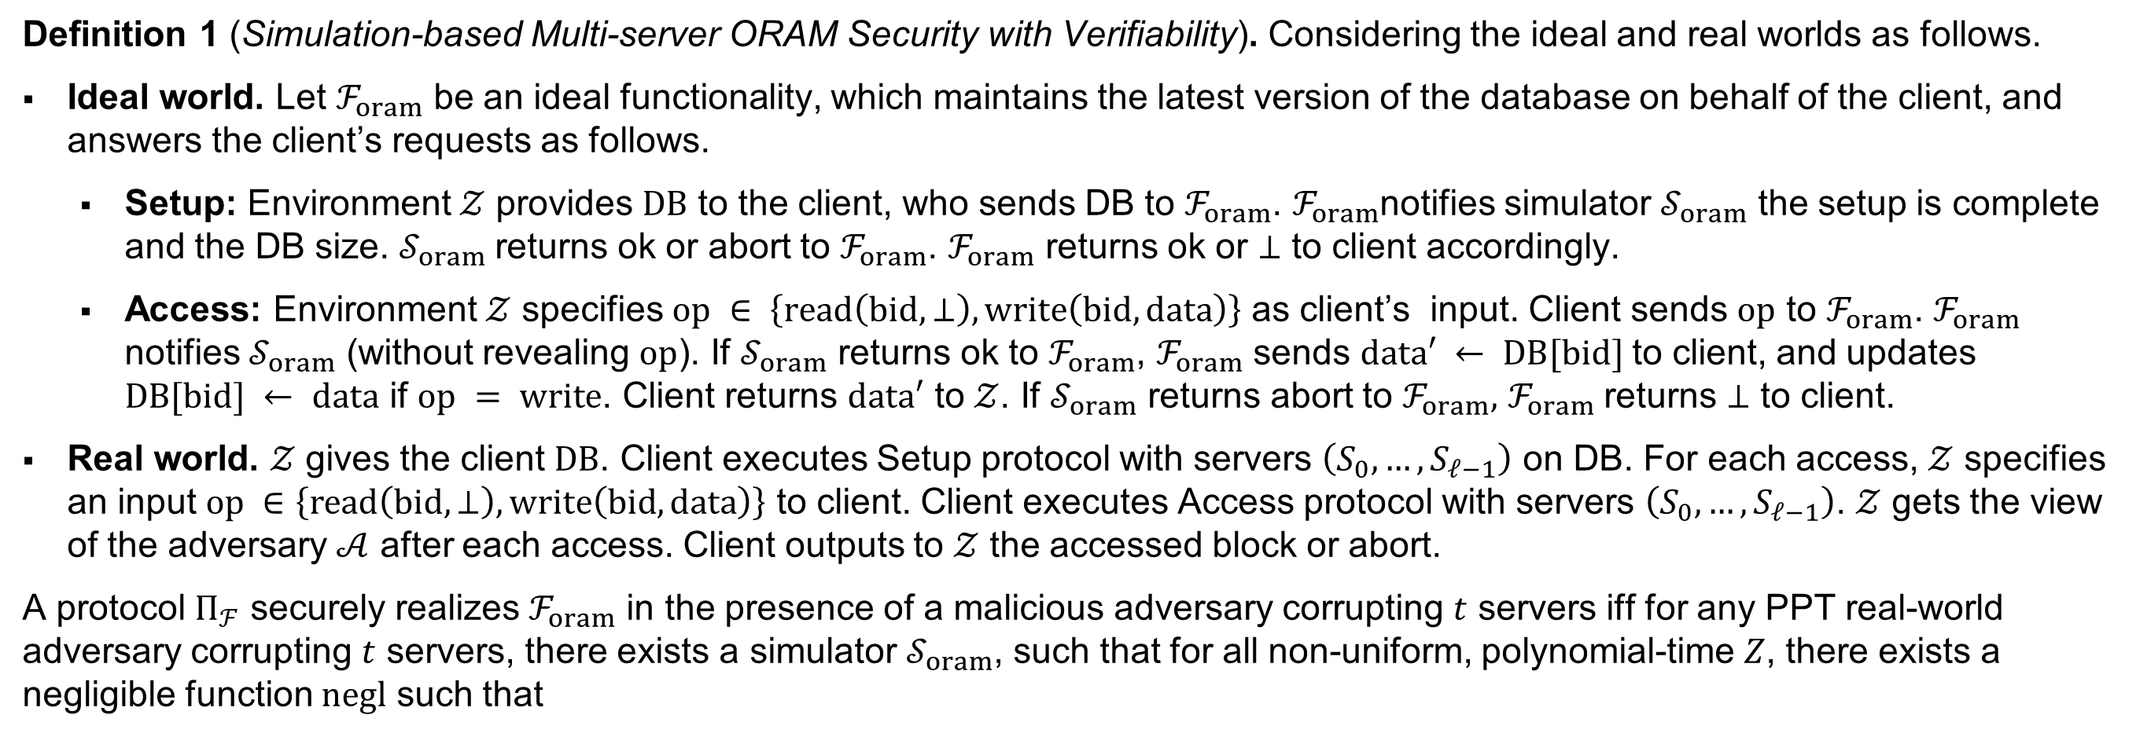
MACAO Security
Definition 1 (Simulation-based Multi-server ORAM Security with Verifiability). Considering the ideal and real worlds as follows.
Ideal world. Let $ℱ_{oram}$ be an ideal functionality, which maintains the latest version of the database on behalf of the client, and answers the client’s requests as follows.
  Setup: Environment $𝒵$ provides $DB$ to the client, who sends DB to $ℱ_{oram}$. $ℱ_{oram}$notifies simulator $𝒮_{oram}$ the setup is complete and the DB size. $𝒮_{oram}$returns ok or abort to $ℱ_{oram}$. $ℱ_{oram}$ returns ok or ⊥ to client accordingly.
  Access: Environment $𝒵$ specifies $op ∈ \left\{read\left(bid, ⊥\right), write\left(bid, data\right)\right\}$ as client’s input. Client sends $op$ to $ℱ_{oram}$. $ℱ_{oram}$ notifies $𝒮_{oram}$ (without revealing $op$). If $𝒮_{oram}$ returns ok to $ℱ_{oram}$, $ℱ_{oram}$ sends $data′ ← DB[bid]$to client, and updates $DB[bid] ← data$ if $op = write$. Client returns $data′$ to $𝒵$. If $𝒮_{oram}$ returns abort to $ℱ_{oram},$ $ℱ_{oram}$returns ⊥ to client.
Real world. $𝒵$ gives the client $DB$. Client executes Setup protocol with servers $\left(S_{0},…,S_{ℓ−1}\right)$ on DB. For each access, $𝒵$ specifies an input $op ∈\left\{read\left(bid,⊥\right),write\left(bid,data\right)\right\}$ to client. Client executes Access protocol with servers $\left(S_{0},…,S_{ℓ−1}\right)$. $𝒵$ gets the view of the adversary $𝒜$ after each access. Client outputs to $𝒵$ the accessed block or abort.
A protocol $Π_{ℱ}$ securely realizes $ℱ_{oram}$ in the presence of a malicious adversary corrupting $t$ servers iff for any PPT real-world adversary corrupting $t$ servers, there exists a simulator $𝒮_{oram}$, such that for all non-uniform, polynomial-time $Z$, there exists a negligible function $negl$ such that
$$\left|\operatorname{Pr}\left[{REAL}_{Π_{ℱ},𝒜,𝒵\left(λ\right)} = 1\right]−\operatorname{Pr}\left[{IDEAL}_{ℱ_{oram},𝒮_{oram},𝒵\left(λ\right)} = 1\right]\right|≤ negl(λ)$$
Theorem 1 (MACAO security). MACAO framework is statistically (information-theoretically) secure by Deﬁnition 1.

