Slide 1
Polynomial Commitment with a One-to-Many Prover and Applications
Jiaheng Zhang, Tiancheng Xie, Thang Hoang, Elaine Shi, Yupeng Zhang
1
Notes:
Hello everyone, I am Jiaheng from UC Berkeley. I am happy to talk about our recent work on polynomial commitment with a one-to-many prover and applications. It is a joint work with Tiancheng also from Berkeley, Thang from virginia tech, Elaine from CMU and Yupeng from TAMU.

Slide 2
Zero-knowledge proofs (ZKP) [GMR85]
Verification: ✓ or ✗
$C(x, w) = y$+
Witness: $w$
Completeness: Pr[ honest prover and verification is ✓ ] = 1
Soundness: Pr[$y≠C(x, w)$ and verification is ✓ ] $≤2^{−100}$
Zero knowledge: proof leaks no information about w
2
Notes:
First of all, we need some background on the zero knowledge proofs.
Applications!!!

Slide 3
Zero-knowledge proofs (ZKP) [GMR85]
$C(x, w) = y$+
$$w$$
Circuit $C$
$$y$$
Witness: $w$
$$x$$
3

Slide 4
One-to-many prover
$$w$$
Circuit $C$
$${ y}_{1}$$
$$π_{1}$$
Verifier 1
$${ y}_{2}$$
$$π_{2}$$
$$x$$
Verifier 2
$$⋯$$
$$⋯$$
$${ y}_{N}$$
$$π_{N}$$
Verifier N

Slide 5
Application: verifiable secret sharing (VSS)
share
reconstruct
$π_{1}$, $sk_{1}$
Verifier 1
$$sk$$
$π_{2}$, $sk_{2}$
$$sk$$
Verifier 2
Prover
$$⋯$$
Threshold $t= O(N)$⇒ tolerate $t−1$ compromises
$π_{N}$, $sk_{N}$
Verifier N
5

Slide 6
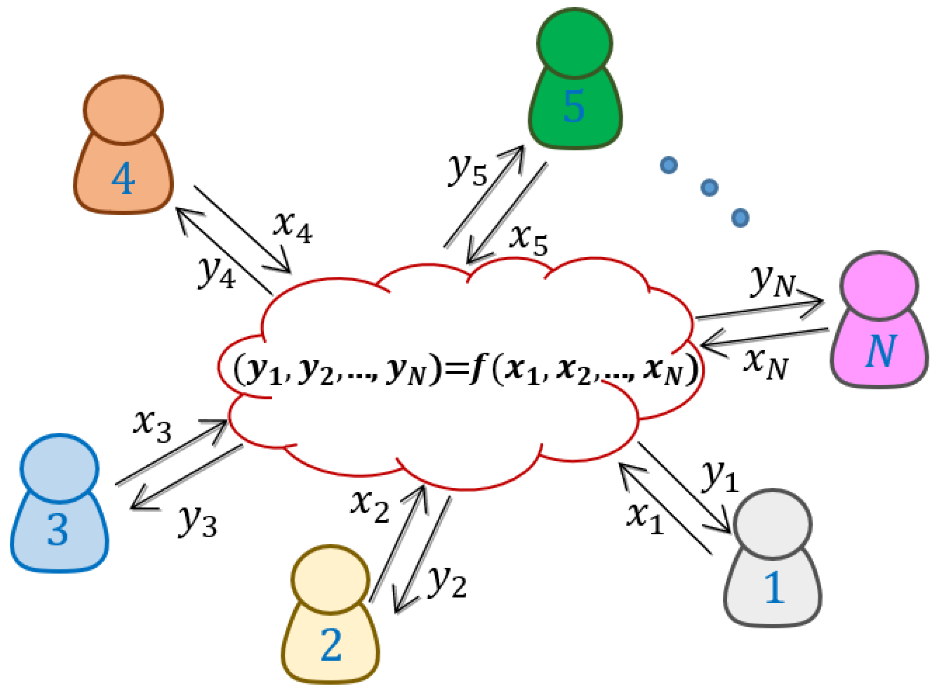
Applications of VSS
MPC
Cryptocurrency wallet
random beacon
6
Notes:
There are many applications on VSS. For example, they can be used to construct MPC scheme. It can also be used to build resilient cryptocurrency wallet as we showed the case before. Additionally, it can be used to construct distributed key generation scheme and the random beacon on blockchain, which is useful for on chain games or on-chain election.

Slide 7
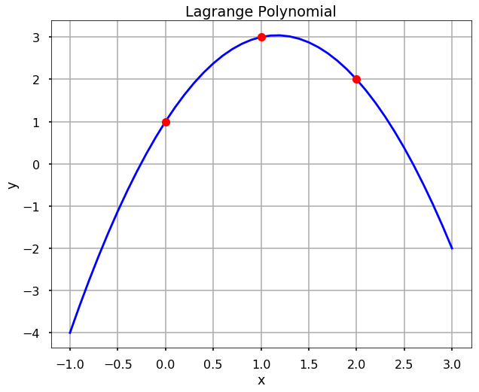
Shamir secret sharing [Shamir79]
Evaluation
Interpolation
$$f\left(1\right), π_{1}$$
Verifier 1
$$sk$$
$$sk$$
$$f\left(2\right), π_{2}$$
Verifier 2
Prover
$$⋯$$
$$sk=f(0)$$
$$f\left(x\right)=a_{0}+a_{1}x+⋯+a_{t}x^{t}$$
Threshold $t= O(N)$
$$f\left(N\right), π_{N}$$
Verifier N
7
Notes:
Shamir constructed a secret sharing scheme by a polynomial. In shamir’s secret sharing, Given the threshold of t, the dealer encodes sk with a polynomial f with degree t. He sets sk equals f(-1). Then for each verifier i, he sends f(i) to verifier i. In the reconstruct phase, if there are at least t verifiers. Then can recover the function and get the secret by lagrange poly. Otherwise, they can not reconstruct the function f and cannot recover sk.

Slide 8
Naïve solution: run ZKP N times
$$w$$
Circuit $C$
$${ y}_{1}$$
$$π_{1}$$
Verifier 1
$${ y}_{2}$$
$$π_{2}$$
$$x$$
Verifier 2
$$⋯$$
$$⋯$$
$${ y}_{N}$$
$$O(N|C| )$$
$$π_{N}$$
Can the prover produce all
N proofs for the cost of one
Verifier N
Notes:
Since some useful applications Let us go back to the our new one-to-many prover model
Naïve solution
Natural question

Slide 9
Our contribution: run ZKP once
$$w$$
Circuit $C$
$${ y}_{1}$$
$$π_{1}$$
Verifier 1
$${ y}_{2}$$
$$π_{2}$$
$$x$$
Verifier 2
$$⋯$$
$$⋯$$
$${ y}_{N}$$
$$O\left(N\left|C\right|\right)→O(|C|)$$
$$π_{N}$$
Verifier N
Notes:
The answer is yes!

Slide 10
Technical overview
$$w$$
Circuit $C$
$${ y}_{1}$$
$$π_{1}$$
Verifier 1
$${ y}_{2}$$
$$π_{2}$$
$$x$$
Verifier 2
$$⋯$$
$$⋯$$
$${ y}_{N}$$
$$π_{N}$$
Verifier N
Notes:
Let us move to the technical part
Layered circuit: ZKP protocols working on layered circuit like Hyrax, Libra and Virgo
These protocols reduce the claim about the output to the claim about the input layer by layer

Slide 11
Technical overview: step 1
$$w$$
Circuit $C$
$${ y}_{r}$$
$${ y}_{1}$$
$$π_{1}$$
Verifier 1
$${ y}_{2}$$
$$π_{2}$$
$$x$$
Verifier 2
$$⋯$$
$$⋯$$
$${ y}_{N}$$
$$O(NlogN )$$
$$π_{N}$$
Verifier N
Aggregate N claims
Notes:
In the first step, we insert an extra layer on top of the output layer in the circuit

Slide 12
Technical overview: step 2
$$w$$
Circuit $C$
$${ y}_{r}$$
$$π$$
Verifier 1
$$π$$
$$x$$
Verifier 2
$$⋯$$
$$O(|C|)$$
$$π$$
Verifier N
Share the same proof
Notes:
Generate the ZKP proof for the claim about y_r with the same input x, w and the circuit C
The proof is the same for each verifier. The prover only needs to run the circuit once and produces the common proof pi.
Combine two costs

Slide 13
Technical overview: non-interactive proof
$${ r}_{1}$$
Verifier 1
$${ r}_{2}$$
$$r$$
Merkle tree
Verifier 2
$$⋯$$
$$⋯$$
$${ r}_{N}$$
New Fiat-Shamir transformation
Verifier N
Notes:
Our algorithm has an assumption that all verifiers share the same randomness r. But this is not true in the non-interactive setting as they have different statements.
To force all verifiers to agree on the common randomness. I

Slide 14
Apply to VSS
$$f$$
FFT Circuit $C$
$$f(1)$$
$$π_{1}$$
Verifier 1
$$f(2)$$
$$π_{2}$$
Verifier 2
$$⋯$$
$$⋯$$
$$f(N)$$
$$O\left(N^{2}\right)→O(NlogN)$$
$$π_{N}$$
No trusted setup
Verifier N

Slide 15
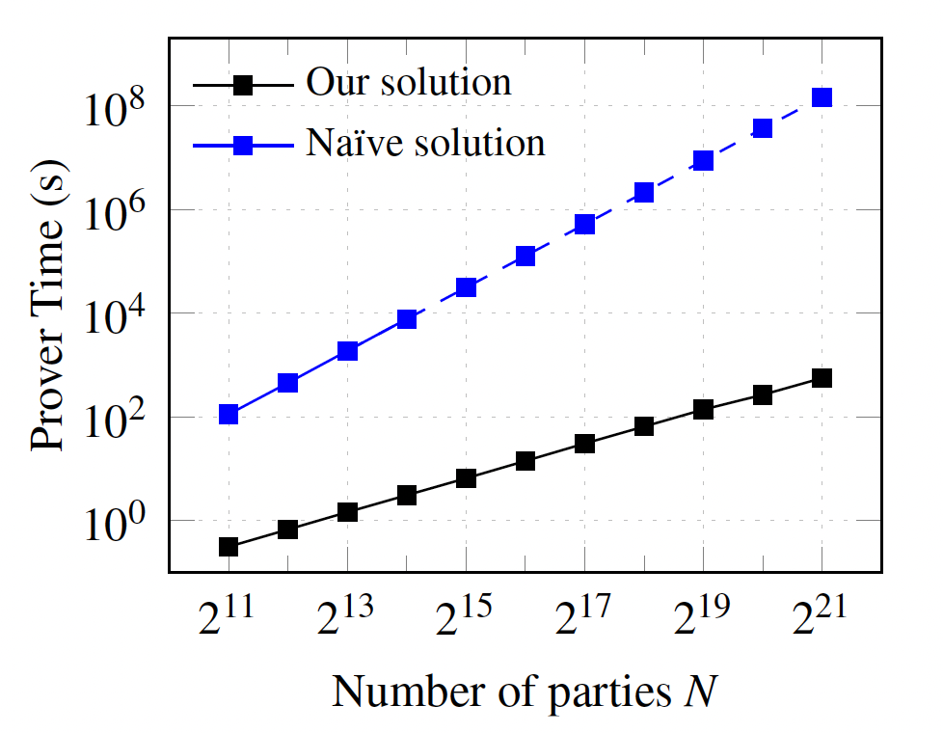
Experiment on VSS (without trusted setup)
19000X
Number of verifiers N
15

Slide 16
Optimal VSS scheme based on KZG (trusted setup)
KZG commitment [KZG10]
AMT based on KZG [TCZ+20]
$O(1)$proof size per verifier
$O(N^{2})$prover computation
$O(log N)$proof size per verifier $O(N\log{N})$prover computation
$O(1)$proof size
$O(N\log{N})$ prover computation
Optimal
The same algorithm was also proposed independently by Dankrad Feist and Dmitry Khovratovich at https://github.com/khovratovich/Kate.
Notes:
Change to flowchat

Slide 17
Summary
New one-to-many prover
⇒ Prover-optimal VSS scheme without trusted setup
$O(N log⁡N)$ prover time
$O(\log^{2}N)$ proof size per verifier
Optimal VSS with trusted setup
$O(N log⁡N)$ prover time
$O(1)$ proof size per verifer
code: https://github.com/sunblazeucb/Virgo/tree/evss
Thank you!
Jiaheng Zhang
jiaheng_zhang@berkeley.edu
17

Slide 18
Thank you!
Jiaheng Zhang
jiaheng_zhang@berkeley.edu
code: https://github.com/sunblaze-ucb/Virgo/tree/evss
18

Slide 19
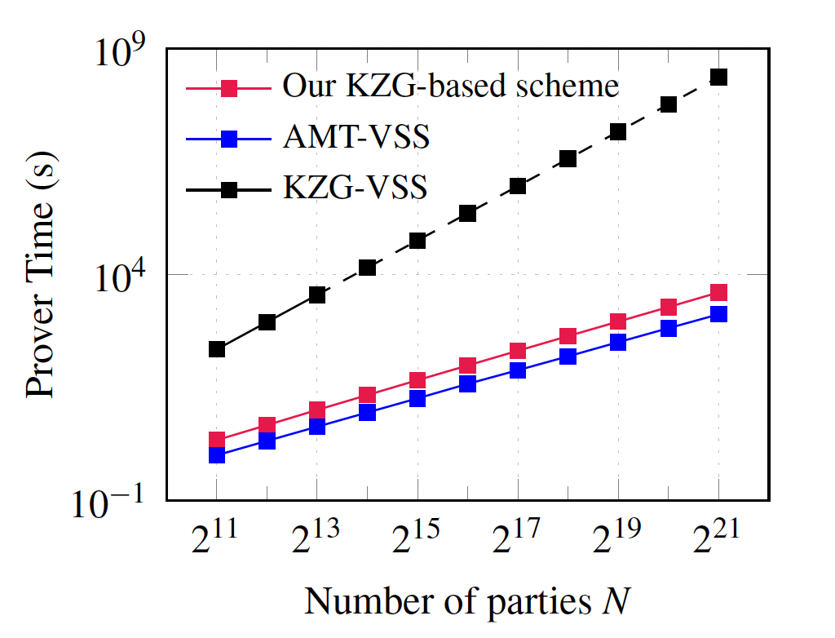
Experiment on VSS (with trusted setup)
57800X
3X
19
Notes:
Slowly. The red square The black square represents
The dashed line means we estimate the dealer time for KZG-VSS scheme as it cannot scale to large instances with large number of parties.

Slide 20
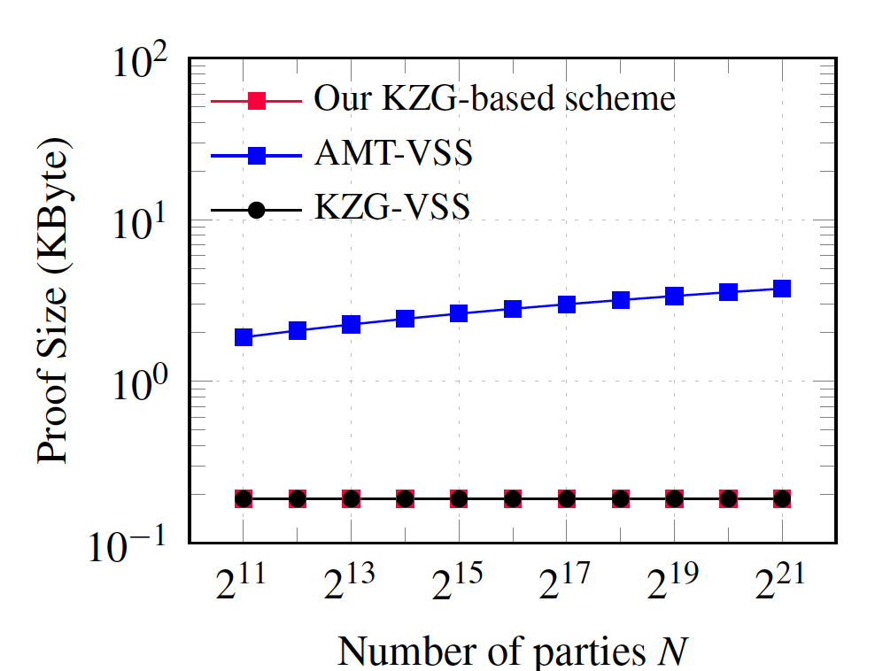
Experiment on VSS (with trusted setup)
42X
20
Notes:
For both our scheme and the original KZG scheme, for each verifier, the proof size is constant. For AMT-VSS, the proof size increases as the number of parties increases. That is because the proof in AMT-VSS scheme is logarithmic in the number of parties, which justifies the theoretical results.

Slide 21
Thank you!
Jiaheng Zhang
jiaheng_zhang@berkeley.edu
code: https://github.com/sunblaze-ucb/Virgo/tree/evss
21

Slide 22
Experiment on VSS (with trusted setup)
57800X
3X
22
Notes:
Slowly. The red square The black square represents
The dashed line means we estimate the dealer time for KZG-VSS scheme as it cannot scale to large instances with large number of parties.

Slide 23
Experiment on VSS (with trusted setup)
42X
23
Notes:
For both our scheme and the original KZG scheme, for each verifier, the proof size is constant. For AMT-VSS, the proof size increases as the number of parties increases. That is because the proof in AMT-VSS scheme is logarithmic in the number of parties, which justifies the theoretical results.

Slide 24
Summary
One-to-many prover -> VSS
Optimal VSS based on KZG

Slide 25
Apply to VSS
$$x$$
$$O(\log^{2}{N} )$$
$$O(\log^{2}{N} )$$
Verifier 0
circuit $C$
$$O(\log^{2}{N} )$$
$$O(\log^{2}{N} )$$
Verifier 1
$$O(N\log{N} )$$
$$O(\log^{2}{N} )$$
$$⋯$$
$$y_{0}$$
$$y_{1}$$
$$⋯$$
$$y_{N−1}$$
$$O(\log^{2}{N} )$$
$$⋯$$
Verifier 0
Verifier 1
Verifier N-1
25

Slide 26
Secret sharing (SS) [Shamir79, Blakley79]
share
reconstruct
$$sk_{0}$$
Verifier 0
$$sk$$
$$sk_{1}$$
$$sk$$
Verifier 1
Dealer
$$⋯$$
Threshold $t= O(N)$⇒ tolerate $t−1$ compromises
$$sk_{N−1}$$
Verifier N-1
26
Notes:
One cryptographic tool can address the problem, which is called secret sharing. For secret sharing setting, there is a dealer who keeps some secret sk. Then he shares his secret to N verifiers. This is the sharing phase. Later on, the verifiers can reconstruct the secret by their shares. This phase is the reconstruct phase. As I mentioned before, we need a threshold t here. That means any subset of verifiers with size smaller than t cannot recover the secret while any subset with size at least t can recover the secret. In general. We suppose t has the same order as N.

Slide 27
Application: verifiable secret sharing (VSS)
$$C(ω^{0}, f){, π}_{0}$$
Verifier 0
$${C\left(ω^{1}, f\right), π}_{1}$$
Verifier 1
$$C\left(ω^{N−1}, f\right), π_{N−1}$$
$$⋯$$
$$s=f(0)$$
$$f\left(x\right)=a_{0}+a_{1}x+⋯+a_{t}x^{t}$$
Verifier N-1
27

Slide 28
Shamir secret sharing (SSS) [Shamir79]
share
reconstruct
$$f(0)$$
Verifier 0
$$sk$$
$$f(1)$$
Verifier 1
Dealer
$$⋯$$
$$sk$$
$$sk=f(−1)$$
$$f\left(x\right)=a_{0}+a_{1}x+⋯+a_{t}x^{t}$$
Threshold $t= O(N)$
$$f(N−1)$$
Verifier N-1
28
Notes:
Shamir constructed a secret sharing scheme by a polynomial. In shamir’s secret sharing, Given the threshold of t, the dealer encodes sk with a polynomial f with degree t. He sets sk equals f(-1). Then for each verifier i, he sends f(i) to verifier i. In the reconstruct phase, if there are at least t verifiers. Then can recover the function and get the secret by lagrange poly. Otherwise, they can not reconstruct the function f and cannot recover sk.

Slide 29
Verifiable Shamir secret sharing
share
reconstruct
$$π_{0},$$
$$f(0)$$
Verifier 0
$$sk$$
$π_{1}$,
$$f(1)$$
Verifier 1
Dealer
$$⋯$$
$$sk=f(−1)$$
$$f\left(x\right)=a_{0}+a_{1}x+⋯+a_{t}x^{t}$$
Threshold $t= O(N)$
$$f(N−1)$$
$π_{N−1}$,
Verifier N-1
29
Notes:
If we extraly require shamir secret sharing is varifialbe. The dealer commits f first and then sends evaluations to verifiers along with the corresponding proof.

Slide 30
Application: verifiable secret sharing (VSS)
$$C(ω^{0}, f){, π}_{0}$$
Verifier 0
$${C\left(ω^{1}, f\right), π}_{1}$$
Verifier 1
$$C\left(ω^{N−1}, f\right), π_{N−1}$$
$$⋯$$
$$s=f(0)$$
$$f\left(x\right)=a_{0}+a_{1}x+⋯+a_{t}x^{t}$$
Verifier N-1
30

Slide 31
Zero-knowledge proofs (ZKP) [GMR85]
Verification: ✓ or ✗
$C(x, w) = y$+
Witness: $w$
Completeness: Pr[ honest prover and verification is ✓ ] = 1
Soundness: Pr[$y≠C(x, w)$ and verification is ✓ ] $≤2^{−100}$
Zero knowledge: proof leaks no information about w
31
Notes:
First of all, what is the zero knowledge proofs? That means we have a prover and a verifier. The prover wants to convince the verifier the computation of a function F(w) equals to y without leaking the information of the input w, which is a secret to the prover. After seeing the proof and the output y, the verifier checks the proof and decides to accept or reject. And there are three important properties of zero knowledge proofs. Completeness means the verifier would accept if the computation is correct. Soundness means the verifier will accept it with very low probability if the computation is wrong. Zero knowledge means the verifier could learn nothing about the secret of prover.

Slide 32
Motivation: multi-users with ZK
$$C\left(x_{0}, w\right), π_{0}$$
Witness: $w$
$$C\left(x_{1}, w\right), π_{1}$$
$$C\left(x_{2}, w\right), π_{2}$$
Can we aggregate these
computation in one shot
32

Slide 33
One-to-many prover
Verification: ✓ or ✗
$C(x, w) = y$+
Witness: $w$
Completeness: Pr[ honest prover and verification is ✓ ] = 1
Soundness: Pr[$y≠C(x, w)$ and verification is ✓ ] $≤2^{−100}$
Zero knowledge: proof leaks no information about w
33
Notes:
First of all, what is the zero knowledge proofs? That means we have a prover and a verifier. The prover wants to convince the verifier the computation of a function F(w) equals to y without leaking the information of the input w, which is a secret to the prover. After seeing the proof and the output y, the verifier checks the proof and decides to accept or reject. And there are three important properties of zero knowledge proofs. Completeness means the verifier would accept if the computation is correct. Soundness means the verifier will accept it with very low probability if the computation is wrong. Zero knowledge means the verifier could learn nothing about the secret of prover.

Slide 34
Motivation
Help me
compute $C$ on $x$
$$C\left(x\right)$$
Integrity
Efficiency
34

Slide 35
Verifiable computation [GMR85]
Verification: ✓ or ✗
$C(x) = y$+
Completeness: Pr[ honest prover and verification is ✓ ] = 1
Soundness: Pr[$y≠C(x)$ and verification is ✓ ] $≤2^{−100}$
35
Notes:
First of all, what is the zero knowledge proofs? That means we have a prover and a verifier. The prover wants to convince the verifier the computation of a function F(w) equals to y without leaking the information of the input w, which is a secret to the prover. After seeing the proof and the output y, the verifier checks the proof and decides to accept or reject. And there are three important properties of zero knowledge proofs. Completeness means the verifier would accept if the computation is correct. Soundness means the verifier will accept it with very low probability if the computation is wrong. Zero knowledge means the verifier could learn nothing about the secret of prover.

Slide 36
Motivation: multi-users
$$C{\left(x\right)}_{0}, π_{0}$$
$$C{\left(x\right)}_{1}, π_{1}$$
$$C{\left(x\right)}_{2}, π_{2}$$
Can we aggregate these
computation in one shot
36

Slide 37
Our contribution
New one-to-many prover algorithm
$$w$$
Circuit $C$
$${ y}_{1}$$
$$π_{1}$$
Verifier 1
$${ y}_{1}$$
$$π_{2}$$
$$x$$
Verifier 1
$$⋯$$
$$⋯$$
$${ y}_{1}$$
$$O\left(N\left|C\right|\right)→O(|C|)$$
$$π_{N}$$
Verifier N

Slide 38
One-to-many prover
$$C(x, w) = y$$
$$w$$
$$y_{1}, π_{1}$$
Verifier 1
$$y_{2}, π_{2}$$
Verifier 2
Prover
$$⋯$$
$$y_{N}, π_{N}$$
Verifier N
38
Notes:
The scheme is “verifiable” if honest receivers can reliably detect a cheating dealer who deals internally inconsistent shares to different receivers. So Besides the shares, each verifier requires a proof from the dealer validating the share is consistent with the samre secret.

