Slide 1
MAPLE: A METADATA-HIDING POLICY-CONTROLLABLE ENCRYPTED SEARCH PLATFORM WITH MINIMAL TRUST
Tung Le, Thang Hoang
Virginia Tech, USA
Privacy Enhancing Technologies Symposium (PETs) 2023
Lausanne, Switzerland
Notes:
Hello everyone, now I’m going to present our paper “MAPLE: Metadata-hiding policy-controllable encrypted search platform with minimal trust”.
I’m Tung Le. This is the joint work with my advisor, Thang Hoang.

Slide 2
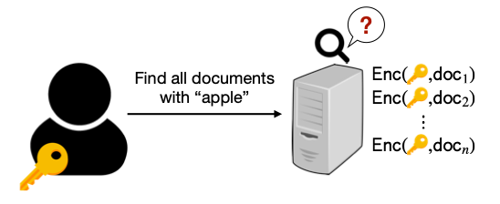
Overview
Storage-as-a service (STaaS)
Notes:
Nowadays, data outsourcing services have become more and more ubiquitous.
Nevertheless, outsourcing data to external clouds might lead to privacy concerns, especially for sensitive data.
↓ Although end-to-end encryption can enable data confidentiality, it also prevents data utilities (e.g., querying, analytics), thereby invalidating the benefits of data outsourcing services.
↓ Basically, people expect that they can perform search queries over their encrypted database in a secure and efficient manner.

Slide 3
Overview
Searchable Encryption (SE)
Search Request
Matched Results
Previous SEs | Our Work (MAPLE)
ODSE’19, DORY’20, DURASIFT’20: Hide Search Access Pattern with Search Complexity $O\left(N.m\right)$*. Limited Multi-user Support. | Minimal Leakage. Search Complexity $O\left(N\log{m}\right).$ Multi-user Support.
* $N$: #documents, $m$: keyword space/keyword representation
Notes:
So, we aim to design a searchable encrypted system that can allow users ↓ to send keyword search requests, then receive the matched results ↓.
So far, there have been a lot of works on searchable encryption focusing on different purposes.
↓ We compare our work with the most recent ones that achieve similar security properties as ours.
So, previous schemes hide search access patterns by using PIR techniques, which incurs O(N.m), where N is the number of documents and m is the number of keywords or size of keyword representation, while ours is only O(N.logm).
And prior works can support multi-user settings but depend on the assumption that the users are trusted, or control access policies based on access level.
In our work, we support multi-user with fine-grained access control.

Slide 4
Oblivious RAM (ORAM)
Oblivious Random Access Machine (ORAM) allows a client to hide the access pattern when accessing data stored on untrusted memory.
ORAM applications: Cloud storage-as-a-service (personal data storage, health-record database, password management), searchable encryption, secure multiparty computation
Notes:
A little bit for the background of our work. The first one is Oblivious RAM, or ORAM.
So ORAM allows a client to hide access patterns when accessing data stored on untrusted memory ↓.
As illustrated here, ORAM is going to convert logical read and write operations of the user to a specific address in the memory into oblivious physical read and write operations.
And the server cannot know what are addresses actually accessed.
↓ ORAM has many practical applications in which access patterns are critical to be hidden.

Slide 5
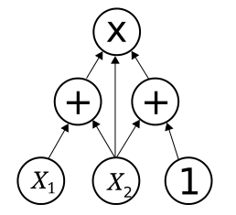
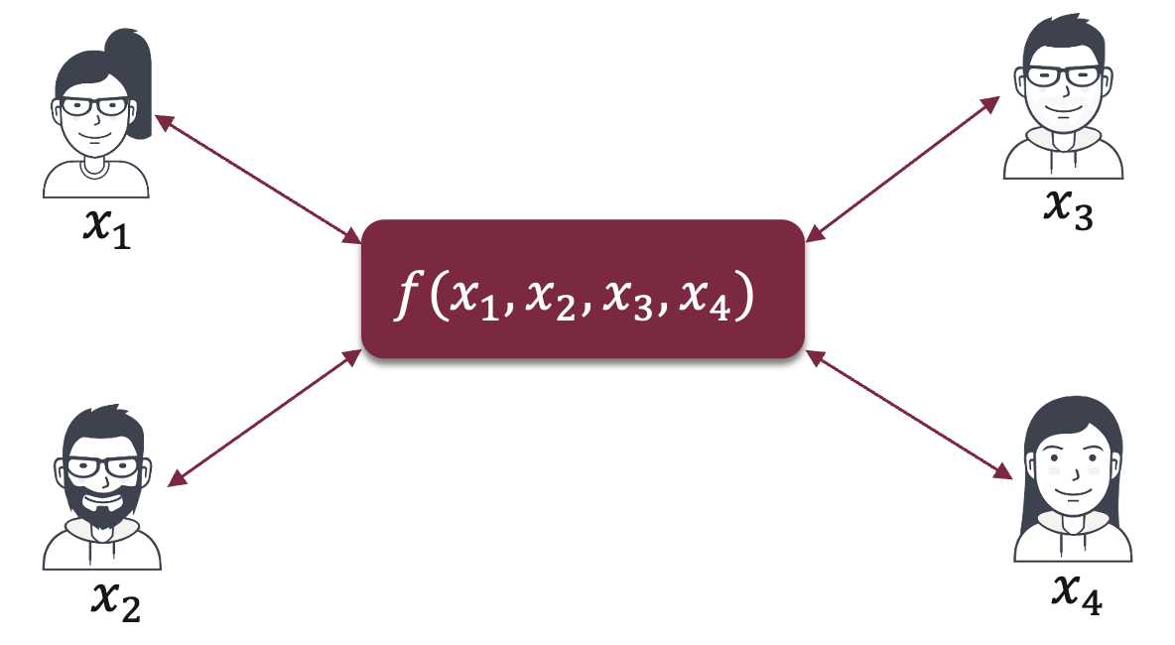
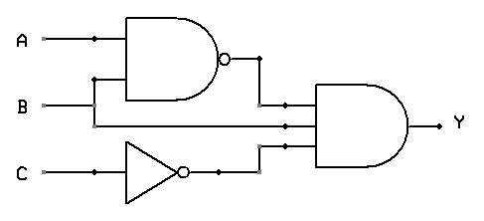
Multi-Party Computation (MPC)
Arithmetic MPC (SPDZ, Shamir SS, replicated SS)
daBits, edaBits
MPC permits multiple parties to jointly evaluate a function without revealing private inputs of individuals
Boolean MPC (garbled circuits)
Notes:
And our second building block is Multi-party Computation or MPC.
↓ MPC allows multiple parties to jointly evaluate a function without revealing private inputs of individuals.
↓ MPC protocols are categorized into two groups: arithmetic MPC with SPDZ as the most well-known one ↓ and Boolean MPC with garbled circuit as a representative.
↓ And there are protocols to convert between these two kinds of operands in multi-party settings as well.
In our work, we use garbled-circuit-based MPC.

Slide 6
Leakage-abuse Attacks
Search Pattern: [IKK’12, LZWT’14, OK’ 21].
Access Pattern: [IKK’12, CGPR’14, ZKP’16, LCNL’22, OK’22].
Volume Pattern: [BKM’19, LCNL’22, OK’22, ZWXYL’23].
Update Pattern: [ACMR’16, RACM’17].
….[PW’16, KKNO’16, GTS’17, PWLP’20]
Discover keywords in queries.
Recover document plaintext.
Notes:
Searchable Encryption schemes so far might be vulnerable to various types of leakage-abuse attacks, including:
↓ Search Pattern is the replication of search tokens/queries.
↓ Access Pattern is the documents matched the search queries.
↓ Volume Pattern is the number of matched results/size of matched documents.
↓ Update Pattern is the replication of updated positions.
↓ And there are many other attacks such as file-injection, etc.
↓ The aim of these attacks is to discover keywords in queries, or recover document plaintext.
So it’s important to hide leakage patterns in searchable encryption design. And our work aims to hide all of these.

Slide 7
System and Threat Model
A document owner
Malicious Security:
Malicious users
Malicious servers
Collusion between users & servers
$ℓ$ servers
$t$ users
Notes:
About system and threat model.
↓ Our system includes a document owner, who shares his database with other users.
↓ We have $ℓ$ serves, in which up to $ℓ$-1 servers can be corrupted and behave maliciously.
↓ ↓ And we have t users.
We consider users to be malicious and can collude with corrupted servers.

Slide 8
System Design
Server 1
Server 1
Multi-server MPC Proxy
Oblivious search/update
Access control
Request API
Server 2
Server 2
Authenticated input
Authenticated output
Server 3
Server 3
Polynomial identity testing
Cryptographic proof techniques
Polynomial identity testing
Oblivious Data Structures
Circuit-ORAM
Notes:
We visualize the overall system of our MAPLE as follows.
↓ We have $ℓ$ servers, where all but one can be corrupted and behave maliciously.
↓ The user sends input queries ↓ to the servers using authenticated input protocols.
We deploy authenticated input by cryptographic proof techniques such as polynomial identity testing.
↓ The servers play the role of multi-server MPC proxy, ↓ which performs oblivious search and update protocols with access control to the underlying oblivious data structures.
↓ After operations are finished, the user receives output and can verify its correctness from the output of multiple servers.
↓ In our work here, oblivious access protocols are built based on Circuit-ORAM algorithms.

Slide 9
Search Index Design
False Positive Rate:
$$ε={\left(1−{\left(\frac{1}{m}\right)}^{kn}\right)}^{k}$$
Bloom Filter
BF₁
BF₂
BF₃
…
BF_{m}
w₁
w₂
w₃
…
w_{M}
$k$: # BF indices for each item
$m$: BF size
$n$: # inserted items
Doc #1
1 | 0 | 1 | 0 | 1
0 | 1 | 1 | 0 | 0
1 | 1 | 0 | 0 | 0
0 | 1 | 0 | 1 | 1
1 | 0 | 0 | 1 | 1
Keyword representation
Doc #2
0
0
0
1
0
Doc #3
…
Doc #N
$$⨂$$
Search Index (IDX)
Notes:
Now, I am describing our search index design.
↓ We consider the search index as a table, where the row dimension corresponds to documents ↓ , and columns correspond to keywords ↓.
However, because the keyword space can be large and sparse, we employ Bloom filter as an efficient way to compress the keyword dimension ↓.
So the columns are now actually Bloom filter representing keyword appearance in each document.
↓ Thus, each row is a keyword representation for the corresponding document.
To search a keyword, we compute Bloom filter indices of that keyword, ↓ and retrieve corresponding columns, then bit-wise and them together ↓ to filter out positions of value 1 ↓.
↓ Although Bloom filter incurs false positives as shown in the formula here, we can control this rate by configuring appropriate parameters.

Slide 10
Access Policy Index
IDX
AC
User #1
…
User #t
1 | 0 | 1 | 1 | 0 | 1 | 1
1 | 1 | 0 | 1 | 1 | 0 | 1
1 | 1 | 0 | 0 | 1 | 0 | 0
1 | 0 | 1 | 0 | 1 | 1 | 0
0 | 1 | 0 | 1 | 1 | 1 | 0
0 | 1 | 0 | 1 | 0 | 0 | 0
1 | 0 | 1 | 0 | 0 | 1 | 0
w | w | r | r | . | w | .
w | w | . | r | . | r | .
. | w | w | w | w | . | r
. | w | r | w | . | r | w
r | . | w | r | w | r | w
. | w | r | r | r | . | r
. | r | w | . | w | r | w
1 | 0 | 1 | 1 | 0 | 1 | 1
1 | 1 | 0 | 1 | 1 | 0 | 1
1 | 1 | 0 | 0 | 1 | 0 | 0
1 | 0 | 1 | 0 | 1 | 1 | 0
0 | 1 | 0 | 1 | 1 | 1 | 0
0 | 1 | 0 | 1 | 0 | 0 | 0
1 | 0 | 1 | 0 | 0 | 1 | 0
w | w | r | r | . | w | .
w | w | . | r | . | r | .
. | w | w | w | w | . | r
. | w | r | w | . | r | w
r | . | w | r | w | r | w
. | w | r | r | r | . | r
. | r | w | . | w | r | w
Doc #1
00 | 01 | 10 | 00 | 10
11 | 10 | 10 | 11 | 11
01 | 10 | 01 | 00 | 00
10 | 11 | 11 | 00 | 11
11 | 11 | 00 | 11 | 10
Doc #2
Doc #3
…
$$⨂$$
0
1
0
0
0
0
0
Doc #N
Access Control (AC)
Notes:
↓ And we do similarly for the access control table. Its row dimension corresponds to documents ↓, and columns are users ↓.
So, to retrieve the permission of a user for documents, we retrieve the column of that user ↓.
↓ ↓ So basically, to filter out documents matched a specific keyword that the user is allowed to access, we get columns corresponding to that keyword in the search index ↓, and the column of that user in access policy index ↓, then bit-wise AND all of them together ↓.

Slide 11
Oblivious Table (OTAB)
?
?
1 =
1
$$⊕$$
0
$$⊕$$
0
?
?
IDX
AC
read $c_{1}$
ORAM
R&W to $1,2,4,9$
$$m × z$$
$$t × z$$
write $c_{1}$
R&W to $1,3,5,11$
1 | 0 | 1 | 1 | 0 | 1
1 | 1 | 0 | 1 | 1 | 0
1 | 1 | 0 | 0 | 1 | 0
1 | 0 | 1 | 0 | 1 | 1
0 | 1 | 0 | 1 | 1 | 1
0 | 1 | 0 | 1 | 0 | 0
1 | 0 | 1 | 0 | 0 | 1
0 | 1 | 1 | 0 | 1 | 0
Same order!!!
w | w | r | r | . | w
w | w | . | r | . | r
. | w | w | w | w | .
. | w | r | w | . | r
r | . | w | r | w | r
. | w | r | r | r | .
. | r | w | . | w | r
r | . | w | w | . | r
read $c_{1}$
R&W to $1,3,6,12$
$$N × z$$
$$N × z$$
write $c_{2}$
R&W to $1,2,4,8$
Notes:
To support both oblivious access and update on search index and access control table ↓, we expand the dimensions of them ↓ z times, and consider these data structures as Tree-ORAMs, ↓ and every access operation will be an ORAM operation and becomes oblivious ↓ ↓ ↓ ↓.
Therefore, the adversary cannot know access patterns of the user on these tables ↓.
↓ It’s important that the document dimension of these two tables need to be kept consistent so that we can bit-wise AND columns together.
↓ Finally, the document owner creates XOR-shares of these tables, and distributes them to servers.

Slide 12
Search Operation
Permutation Matrix
$$m × z$$
1 | 0 | 0 | 0 | 0 | 0
0 | 0 | 1 | 0 | 0 | 0
0 | 0 | 0 | 0 | 0 | 1
0 | 0 | 0 | 1 | 0 | 0
1 | 0 | 0 | 0 | 0 | 0
0 | 0 | 1 | 0 | 0 | 0
0 | 0 | 0 | 0 | 0 | 1
0 | 0 | 0 | 1 | 0 | 0
MPC
$$m$$
Columns of IDX are shuffled, how to update?
IDX
AC
$$m × z$$
$$t × z$$
Oblivious Protocols
1 | 0 | 1 | 1 | 0 | 1
1 | 1 | 0 | 1 | 1 | 0
1 | 1 | 0 | 0 | 1 | 0
1 | 0 | 1 | 0 | 1 | 1
0 | 1 | 0 | 1 | 1 | 1
0 | 1 | 0 | 1 | 0 | 0
1 | 0 | 1 | 0 | 0 | 1
0 | 1 | 1 | 0 | 1 | 0
w | w | r | r | . | w
w | w | . | r | . | r
. | w | w | w | w | .
. | w | r | w | . | r
r | . | w | r | w | r
. | w | r | r | r | .
. | r | w | . | w | r
r | . | w | w | . | r
1 | 0 | 1 | 1 | 0 | 1
1 | 1 | 0 | 1 | 1 | 0
1 | 1 | 0 | 0 | 1 | 0
1 | 0 | 1 | 0 | 1 | 1
0 | 1 | 0 | 1 | 1 | 1
0 | 1 | 0 | 1 | 0 | 0
1 | 0 | 1 | 0 | 0 | 1
0 | 1 | 1 | 0 | 1 | 0
w | w | r | r | . | w
w | w | . | r | . | r
. | w | w | w | w | .
. | w | r | w | . | r
r | . | w | r | w | r
. | w | r | r | r | .
. | r | w | . | w | r
r | . | w | w | . | r
$$N × z$$
$$N × z$$
Retrieve $k$ columns
Retrieve $1$ column
Notes:
We have all building blocks so far ↓. The user can perform oblivious access and update to data structures stored on the servers.
And the servers execute ORAM operations using MPC.
For keyword search ↓, as described before, k columns in search index are retrieved ↓, and the column corresponding to the user in access control ↓ is obtained ↓. Then all are combined together to get the search output.
Due to ORAM operations, the columns in search index are shuffled after each access operation ↓.
So in update, we need to transform the keyword representation of the updated document to the current state of Bloom filter.
↓ This can be done by maintaining a permutation matrix. ↓ And any access operations that happen on IDX also happens similarly on this matrix.

Slide 13
Document Update
AC
$$t × z$$
Server 1
w | w | r | r | . | w | .
w | w | . | r | . | r | .
. | w | w | w | w | . | r
. | w | r | w | . | r | w
r | . | w | r | w | r | w
. | w | r | r | r | . | r
. | r | w | . | w | r | w
w | w | r | r | . | w | .
w | w | . | r | . | r | .
. | w | w | w | w | . | r
. | w | r | w | . | r | w
r | . | w | r | w | r | w
. | w | r | r | r | . | r
. | r | w | . | w | r | w
Permutation Matrix
$$N × z$$
[uid], [doc_id], [1 0 1 0]
Request API
$$m × z$$
1 | 0 | 0 | 0 | 0 | 0
0 | 0 | 1 | 0 | 0 | 0
0 | 0 | 0 | 0 | 0 | 1
0 | 0 | 0 | 0 | 1 | 0
[uid], [doc_id], [0 1 1 1]
$$\left[…\right] ×$$
$$m$$
IDX
Server 2
[uid], [doc_id], [1 1 0 0]
$$m × z$$
1 | 0 | 1 | 1 | 0 | 1 | 1
1 | 1 | 0 | 1 | 1 | 0 | 1
1 | 1 | 0 | 0 | 1 | 0 | 0
1 | 0 | 1 | 0 | 1 | 1 | 0
0 | 1 | 0 | 1 | 1 | 1 | 0
0 | 1 | 0 | 1 | 0 | 0 | 0
1 | 0 | 1 | 0 | 0 | 1 | 0
1 | 0 | 1 | 1 | 0 | 1 | 1
1 | 1 | 0 | 1 | 1 | 0 | 1
1 | 1 | 0 | 0 | 1 | 0 | 0
1 | 0 | 1 | 0 | 1 | 1 | 0
0 | 1 | 0 | 1 | 1 | 1 | 0
0 | 1 | 0 | 1 | 0 | 0 | 0
1 | 0 | 1 | 0 | 0 | 1 | 0
Server 3
$$N × z$$
Authenticated input
Notes:
For document update, ↓ the user sends authenticated secret shares of her user id, document id, and new Bloom filter to the MPC proxy ↓.
The MPC proxy multiplies the bloom filter with the permutation matrix ↓ to transform it to the correct order of the current bloom filter.
Then, MPC proxy obtains the user’s permission on the updated document ↓ as a selection value ↓ between keeping the old data or replacing with the new one.
↓ It is followed by an oblivious access on the search index ↓ to update that document.
↓ As both accesses here are on the row dimension and to the same document position, the order of documents on AC and IDX is kept consistent after document update.

Slide 14
Permission Update
AC
$$t × z$$
Multi-server MPC Proxy
Oblivious search/update
Access control
w | w | r | r | . | w | .
w | w | . | r | . | r | .
. | w | w | w | w | . | r
. | w | r | w | . | r | w
r | . | w | r | w | r | w
. | w | r | r | r | . | r
. | r | w | . | w | r | w
w | w | r | r | . | w | .
w | w | . | r | . | r | .
. | w | w | w | w | . | r
. | w | r | w | . | r | w
r | . | w | r | w | r | w
. | w | r | r | r | . | r
. | r | w | . | w | r | w
[uid], [doc_id], [r/w]
$$N × z$$
Document owner
Authenticated input
Notes:
For permission update, the document owner ↓ sends authenticated secret-shares ↓ of user id, document id, and permission to the MPC proxy ↓ ↓ to update access control table.

Slide 15
Evaluation - Configuration
Server:
Amazon EC2 r5n.16xlarge.
32-core Intel Xeon Platinum 8375C CPU @ 2.9 GHz.
512 GB RAM.
Client:
Macbook Pro 14 2021 M1-Max.
32 GB RAM.
Implementation:
C++ with ~4,000 LOCs.
EMP-toolkit, ZeroMQ
Notes:
↓ To evaluate our MAPLE, we use amazon ec2 instances with 32-core Intel Xeon and 512 GB RAM.
Our client is a Macbook Pro M1-Max with 32 GB RAM.
Our implementation is in C++.
We use EMP-toolkit library for authenticated garbling circuit, and ZeroMQ for network communication between the client and servers.

Slide 16
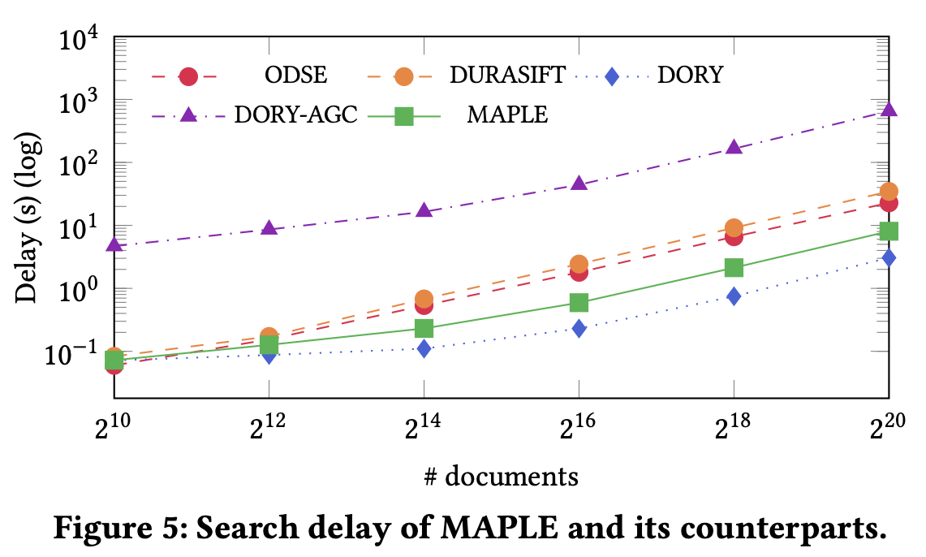
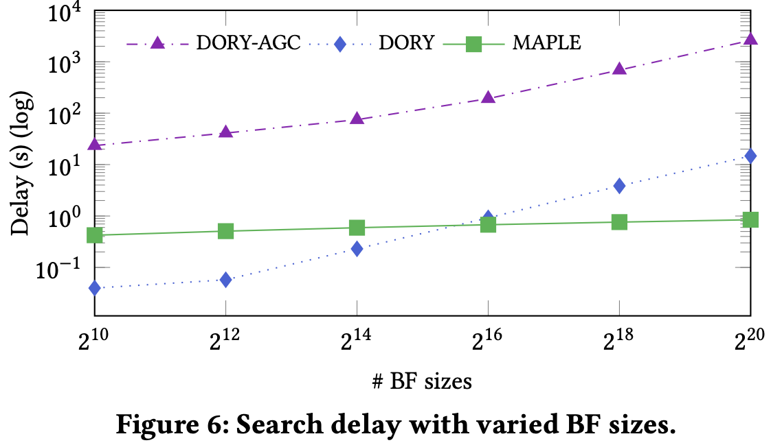
Evaluation – Search Delay
DORY: $O(N.m$), MAPLE: $O\left(N.\log{m}\right).$
$2.6×−10.7×$ slower than DORY with BF size $≤2^{14}$, and outperforms when BF size $≥2^{16}$.
Notes:
↓ ↓ About search latency. In comparison with DORY which also uses Bloom filter to compress keyword space as ours.
Our MAPLE is slower than DORY with Bloom filter sizes less than 16K, and starts to outperform when Bloom filter size is greater than or equal to 64K.

Slide 17
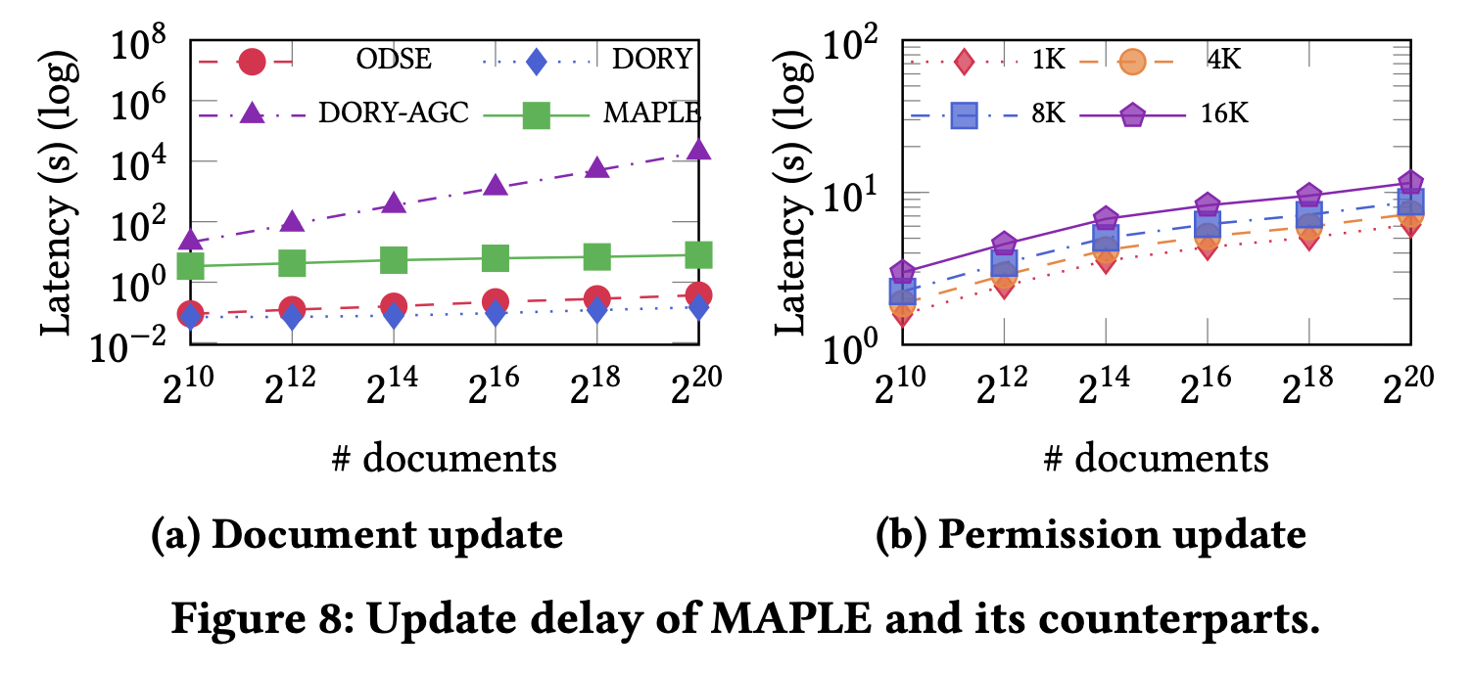
Evaluation – Update Delay
Document update: $O(m\log{N}+m^{2})$
3.3s – 7.8s slower to achieve oblivious update
Notes:
↓ ↓ Regarding update latency, due to multiplication with permutation matrix, our document update complexity is O(m.log N + m^2).
For concrete performance, our update latency is about 3 to 8 seconds slower to achieve oblivious update in comparison with prior ones.

Slide 18
Conclusion
Our MAPLE:
Support multi-user with fine-grained access control.
Oblivious search with better complexity $O(N\log{m})$.
Minimal leakage with malicious security.
Our source code is available at: github.com/vt-asaplab/MAPLE
Notes:
In conclusion, $↓$
Over this work, we design a searchable encryption scheme called MAPLE that achieves the following features:
↓ First, it supports multi-user with fine-grained access control.
↓ Second, it features oblivious search in better complexity, which is O(N.log m), in comparison with prior arts, which is O(N.m).
↓ Finally, it achieves minimal leakage with malicious security.
↓ Our source code is available at the link here.

Slide 19
Thank you for your attention
Q&A
Notes:
This is the end of my presentation. Thank you for your attention. I would be happy to answer any questions.

