Slide 1
MUSES: Efficient Multi-User Searchable Encrypted Database
Tung Le, Rouzbeh Behnia, Jorge Guajardo, Thang Hoang
USENIX Security 2024
Philadelphia, Pennsylvania
Notes:
Hello everyone, now I’m going present our work “MUSES: Efficient Multi-User Searchable Encrypted Database”.
I’m Tung Le from Virginia Tech. This is the joint work with Dr. Behnia from University of South Florida, Dr. Guajardo from Robert Bosch, and my advisor Thang Hoang.

Slide 2
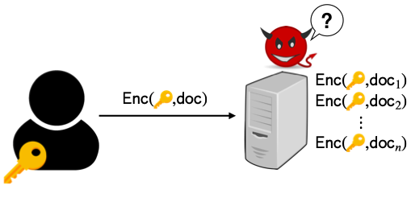
Overview
End-to-end encrypted systems are increasingly popular
Provide strong security guarantees if attacker compromises server
Notes:
We all know that end-to-end encrypted data outsourcing systems are increasingly popular.
They can provide strong security guarantees against adversaries compromising the server.
However, encryption also prevents the capabilities that can execute on plaintext data, such as querying, analytics.

Slide 3
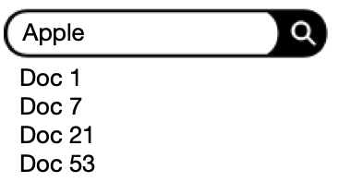
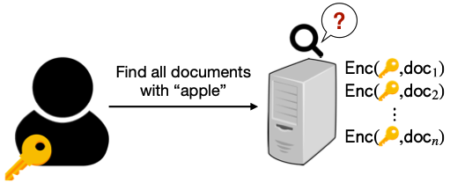
Overview
Users expect the ability to execute search
Challenge: server cannot decrypt data to search
Notes:
A fundamental feature that the user would like to do is the ability to search over their encrypted data in a secure manner without revealing the content of data and query to the server.
Therefore, searchable encryption was proposed to handle this matter.

Slide 4
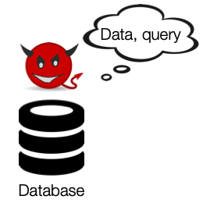
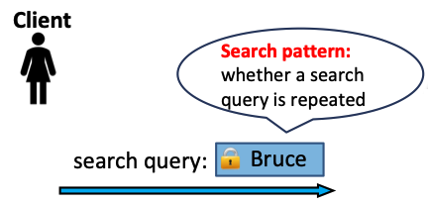
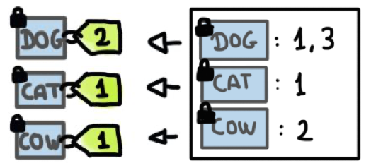
Overview
Leakage-abuse Attacks in Searchable Encryption:
Search Pattern: [IKK’12, LZWT’14, OK’21]
Result Pattern: [IKK’12, CGPR’14, ZKP’16, LCNL’22, OK’22]
Result pattern:
Repetition of returned matching documents
Volume pattern:
The number of matching documents
Volume Pattern: [BKM’19, LCNL’22, OK’22, ZWXYL’23]
Notes:
A common issue with searchable encryption is leakage-abuse attacks, which exploit patterns by observing the operations of the user, for example:
Search pattern is the repetition of search queries.
Result pattern is the repetition of matches in search results.
Volume pattern is the number of matching documents.
All these pattern leakage attacks aim to uncover the user's data and query.

Slide 5
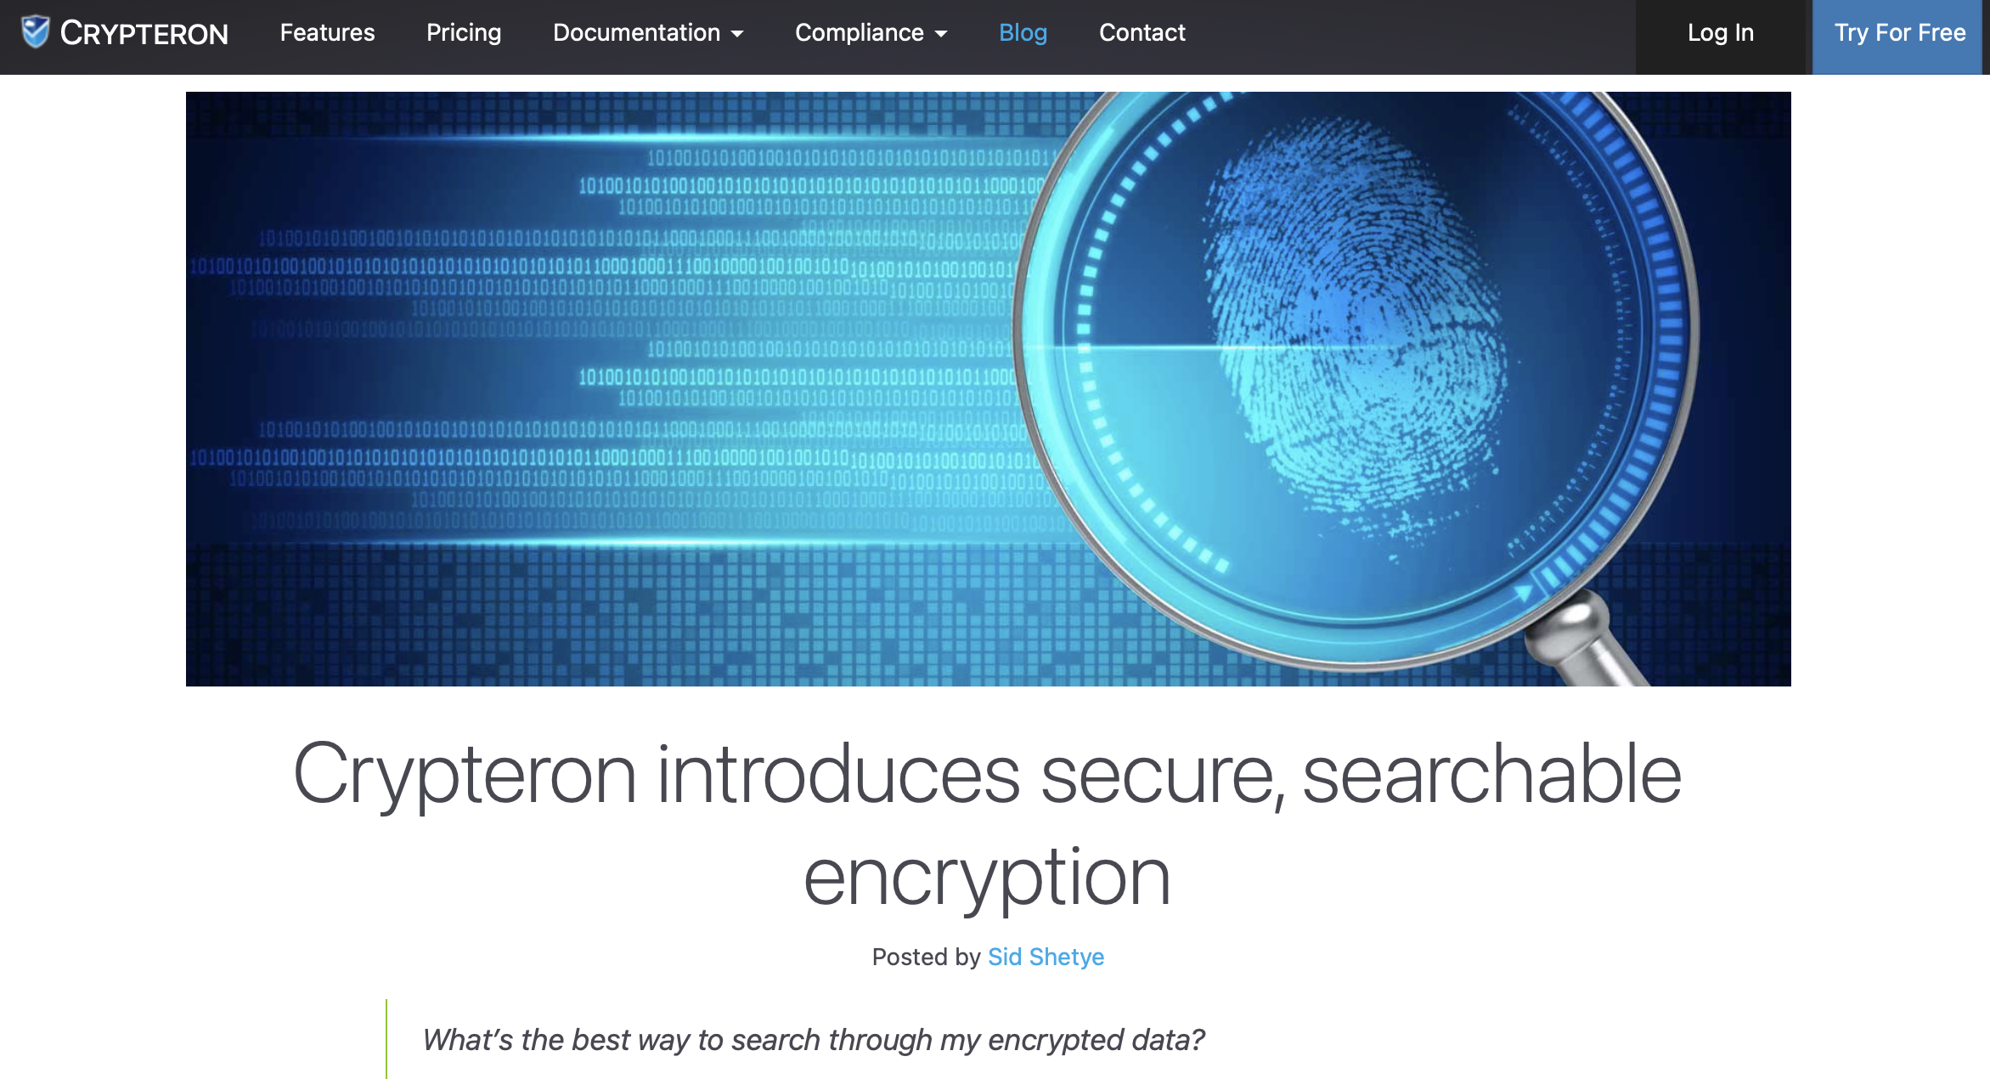
MUSES: Efficient Multi-Writer Encrypted Search
Practical examples of searchable encrypted platforms:
Cosmian
Amazon AWS Database Encryption SDK
MongoDB
We propose MUSES, which features by:
Multi-writer support
Hide all statistical information, including search, result, and volume patterns
Minimal user overhead (regarding computation and communication costs)
Notes:
There have already been many practical searchable encryption platforms.
In our work, we propose MUSES, which can support multi-writer, hide all statistical information, including search, result and volume patterns.
Also, MUSES achieves minimal user overhead regarding both the computation and communication cost.

Slide 6
System and Threat Model
An honest reader who holds a public/private key pair
Multiple writers, where each owns its independent database
$L$ servers, in which up to $L−1$ servers can be corrupt
Security against semi-honest servers and potentially corrupt writers
Notes:
About system and threat model, we consider a setting with an honest reader who holds a public and private key pair.
Our system can have an arbitrary number of writers, in which any writer can be adversarial.
Each writer has an independent database.
And L servers, in which up to L-1 servers can be corrupt.
We assume the adversary is semi-honest.
In our system, the writers contribute and share data with the reader, and the reader is the one who executes search over database of writers.

Slide 7
Search Index
…
Update:
“amazon”
“google”
“netflix”
“apple”
doc 1
1 | 0 | 1 | 0 | 1
0 | 1 | 1 | 0 | 0
1 | 1 | 0 | 0 | 0
0 | 1 | 0 | 1 | 1
1 | 0 | 0 | 1 | 1
Bitmap for keywords in doc 2
doc 2
doc 3
…
Search:
doc N
Notes:
To support keyword search efficiently, we build a search index beside document collection.
Our search index is a table, where rows correspond to documents and columns correspond to keywords.
The value 1 indicates the appearance of the keyword in the document, so each row is a bitmap for keywords of the corresponding document.
To update a document, we change the corresponding row of that document in the search index.
To search or to find out which documents contain a specific keyword, we obtain the column corresponding to that keyword.

Slide 8
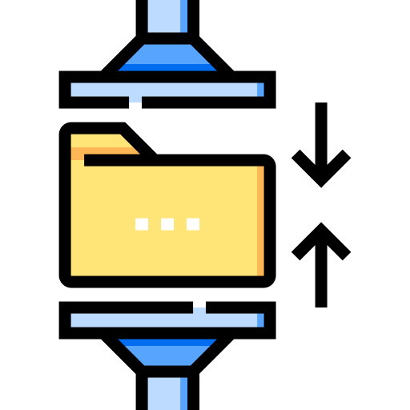
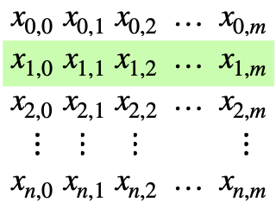
Compressing Search Index
Using Bloom filter to compress the search index
H(“apple” || 2)
H(“apple” || 1)
H(“orange” || 2)
H(“orange” || 1)
Search index with Bloom filters
Notes:
With that design, the search index will be very large when the number of keywords is significant.
We use Bloom filter, which provides efficient membership testing, to compress the search index.
For each keyword, we hash it to different locations in the bloom filter and set their values to 1.
We do this for every keyword, then we obtain the search index with Bloom filters instead of bitmaps.
Now to retrieve documents matching a keyword, we need to obtain multiple columns that the keyword is hashed to, instead of a single one as before.
Using Bloom filter may incur false positives, but we can configure parameters to achieve a low rate.

Slide 9
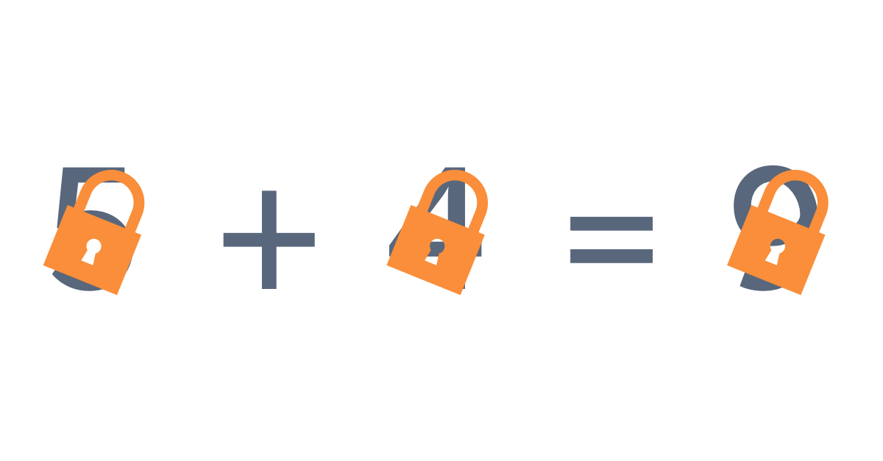
Encrypted Search Index
Key-Homomorphic Pseudorandom Function (KH-PRF): [BLMR’13]
Learning with Rounding (LWR):
$$F:ℤ_{q}^{n} × {\{0, 1\}}^{∗} → ℤ_{p}$$
$$F\left(k^{\left(1\right)}+k^{\left(2\right)},s\right)= F\left(k^{\left(1\right)},s\right)+F\left(k^{\left(2\right)},s\right)+e$$
, $e∈\left\{0, 1\right\}$ is a small error
$$k=k^{(1)}+k^{(2)}$$
${Enc}_{k}(x_{i,j})$ $=x_{i,j}+F\left(k_{j}, s_{i}\right) (mod p)$
Notes:
To protect the confidentiality of the search index, we need to encrypt it before uploading to the server.
We use key-homomorphic pseudorandom function proposed by Boneh et al. in 2013. I am going to call it PRF for short.
With this technique, we can split a key into two random parts, where the PRF output with the original key is equal to the sum of PRF output with the split keys and a small error.
We encrypt each value of the search index by adding it with the output of the PRF.

Slide 10
Distributed Point Functions (DPFs)
Uses multiple servers to hide which element the user is retrieving
If at least one server is honest, an attacker cannot learn the index requested
Requires a linear scan over the entire array
$$\begin{matrix}a_{0} & a_{1} & \begin{matrix}a_{2} & \begin{matrix}… & a_{n}\end{matrix}\end{matrix}\end{matrix}$$
$$Q_{1}$$
$$R_{1}$$
$$Q_{2}$$
$$R_{2}$$
Retrieve $a_{2}$
$$\begin{matrix}a_{0} & a_{1} & \begin{matrix}a_{2} & \begin{matrix}… & a_{n}\end{matrix}\end{matrix}\end{matrix}$$
Assemble $a_{2}$ from responses
$$R_{3}$$
$$Q_{3}$$
$$\begin{matrix}a_{0} & a_{1} & \begin{matrix}a_{2} & \begin{matrix}… & a_{n}\end{matrix}\end{matrix}\end{matrix}$$
Notes:
Next, I’m going to describe our search protocol. A primitive we use is Distributed Point Function or DPF for short.
This technique uses multiple servers to hide the element being queried and it requires computation overhead linear in the database size.
For example, the user creates and sends DPF queries corresponding to the requested index.
The servers will evaluate and return responses so that the user can assemble and obtain the queried element.

Slide 11
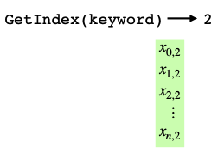
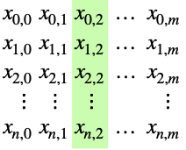
Leveraging DPFs to search
If at least one trust server is honest, MUSES hides search patterns
Cloud
DPF queries
$$\left(\begin{matrix}2 \\ 5 \\ 0\end{matrix}\right)$$
$$\left(\begin{matrix}4 \\ 7 \\ 3\end{matrix}\right)$$
$$\left(\begin{matrix}3 \\ 4 \\ 6\end{matrix}\right)$$
Responses
$!Ο(N)$ Communication Overhead
Oblivious Protocols
$$\left(\begin{matrix}2 \\ 5 \\ 0\end{matrix}\right)$$
$$\left(\begin{matrix}4 \\ 7 \\ 3\end{matrix}\right)$$
$$\left(\begin{matrix}3 \\ 4 \\ 6\end{matrix}\right)$$
$$= \left(\begin{matrix}1 \\ 0 \\ 1\end{matrix}\right)$$
$$+$$
$$+$$
$$mod 2^{3}$$
Dec
Notes:
So we can apply this technique to search without revealing search patterns.
The reader uses DPF to retrieve secret shares of the queried column, add them together, decrypt, and obtain the final output.
However, this incurs a significant amount of communication overhead, which is linear in the number of documents, as the column dimension of the search index is the number of documents.
So, our approach to avoid this overhead is to design oblivious protocols to offload most overhead to the servers, and only return a small number of matching results to the reader.

Slide 12
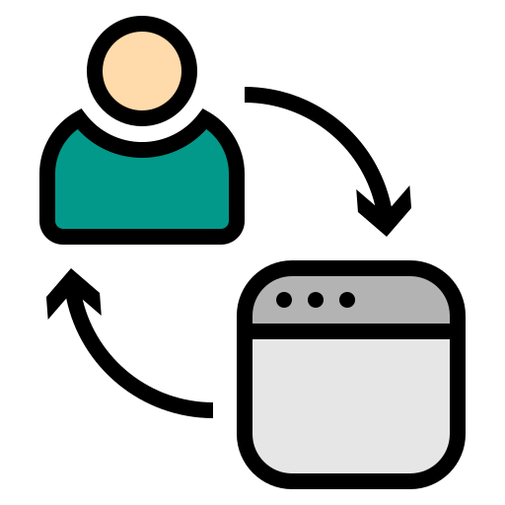
Delegating Decryption
Server 1
Enc
Key-homomorphic PRFs:
Keys are secret shared
→ No server can learn private data
Key secret-shares are random
Hide search patterns
$$κ_{1}$$
Dec
$$κ_{2}$$
Enc
Reader
Server 2
Dec
$$κ_{3}$$
Enc
Server 3
Dec
Can the servers open secret shares and output documents?
Our ideas: Oblivious Padding & Shuffling
→ No, it reveals result and volume patterns
Notes:
After the previous step, DPF evaluation, the servers hold secret shares of search results but still in encrypted form since as I mentioned before, the search index is encrypted.
To remove encryption and convert them to secret shares in plaintext form, followed by the previous step, the reader sends the splits of PRF keys to the servers for decryption.
Because the keys are split randomly, no server can learn the actual key to uncover private data, and also these keys are random, it does not reveal search patterns.
After this step, each server holds a secret share of the search results in plaintext form.
The servers can broadcast their results to each other to open the search output, but doing so reveals result and volume patterns.
To hide these patterns, we design two new multiparty protocols operating on secret share values, one is called oblivious padding and another is oblivious shuffling.
Our multiparty oblivious padding and shuffling are built based on secret-shared shuffle of Chase et al. in 2020.

Slide 13
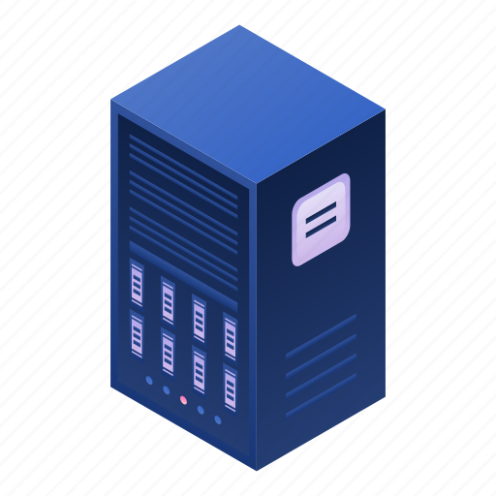
Multiparty Oblivious Counting
Efficiency:
1 communication round
Local lightweight operations: circular shifts, additions over small integer numbers
Most overhead is done in the preprocessing phase
More efficient than generic MPCs (e.g., Garbled Circuit) when counting values are small (e.g., < 10)
$$\left(\begin{matrix}∴ \\ \begin{matrix}\begin{matrix}∴ \\ ⋮\end{matrix} \\ \begin{matrix}∴ \\ ∴\end{matrix}\end{matrix}\end{matrix}\right)$$
$$s_{1}$$
Reader
Server 1
$$\left(\begin{matrix}∴ \\ \begin{matrix}∴ \\ \begin{matrix}⋮ \\ \begin{matrix}∴ \\ ∴\end{matrix}\end{matrix}\end{matrix}\end{matrix}\right)$$
$$s_{2}$$
$$s_{3}$$
Server 2
$$s=s_{1}+s_{2}+s_{3}$$
(mod $n_{s}$)
$$\left(\begin{matrix}∴ \\ \begin{matrix}∴ \\ \begin{matrix}⋮ \\ \begin{matrix}∴ \\ ∴\end{matrix}\end{matrix}\end{matrix}\end{matrix}\right)$$
$n_{s}$: search result size
Server 3
Notes:
First, we develop multiparty oblivious counting protocol to count the number of matches in the secret-share form.
The input is arithmetic secret-shared data vector in the previous step, and the output is the secret-share of the counting result.
The reader can obtain this counting number, and then compute the number of necessary padding values.
Our oblivious counting is efficient, which requires only 1 communication round and lightweight computations in the online phase.
$↓$ Most overhead is done in preprocessing phase.
In fact, our oblivious counting is more efficient than generic MPC like Garbled Circuit when the counting values are small.

Slide 14
Multiparty Oblivious Padding
$$\left(\begin{matrix}∴ \\ \begin{matrix}\begin{matrix}∴ \\ ⋮\end{matrix} \\ \begin{matrix}∴ \\ ∴\end{matrix}\end{matrix}\end{matrix}\right)$$
$$\left(\begin{matrix}∴ \\ \begin{matrix}\begin{matrix}∴ \\ ⋮\end{matrix} \\ \begin{matrix}∴ \\ ∴\end{matrix}\end{matrix}\end{matrix}\right)$$
Search result size: $n_{s}$
Secret shares of padding values
$$\left(\begin{matrix}∴ \\ ∴\end{matrix}\right)$$
Padding vector size: $n_{s}$
Reader
Server 1
$$\left(\begin{matrix}∴ \\ \begin{matrix}∴ \\ \begin{matrix}⋮ \\ \begin{matrix}∴ \\ ∴\end{matrix}\end{matrix}\end{matrix}\end{matrix}\right)$$
$$\left(\begin{matrix}∴ \\ \begin{matrix}∴ \\ \begin{matrix}⋮ \\ \begin{matrix}∴ \\ ∴\end{matrix}\end{matrix}\end{matrix}\end{matrix}\right)$$
$$\left(\begin{matrix}∴ \\ ∴\end{matrix}\right)$$
Total (padded) size: ${N+n}_{s}$
$$\left(\begin{matrix}∴ \\ ∴\end{matrix}\right)$$
Server 2
?
$$\left(\begin{matrix}∴ \\ \begin{matrix}∴ \\ \begin{matrix}⋮ \\ \begin{matrix}∴ \\ ∴\end{matrix}\end{matrix}\end{matrix}\end{matrix}\right)$$
Always the same number of matches is returned for all queries
$$\left(\begin{matrix}∴ \\ \begin{matrix}∴ \\ \begin{matrix}⋮ \\ \begin{matrix}∴ \\ ∴\end{matrix}\end{matrix}\end{matrix}\end{matrix}\right)$$
Server 3
Notes:
In the next step, by counting the number of matches, the reader creates and sends secret shares of padding values to the servers, which are appended to their output in the delegating decryption step.
We assume the search result size is bound by a number, so the size of the padding vector is also bound under the same value.
With N documents, then the total padded size will be the sum of the number of documents and the search result size.
Our purpose is to always return the same number of matches for all queries to hide volume patterns.
At this step, the servers have yet opened the results since that will reveal result patterns and padded positions.

Slide 15
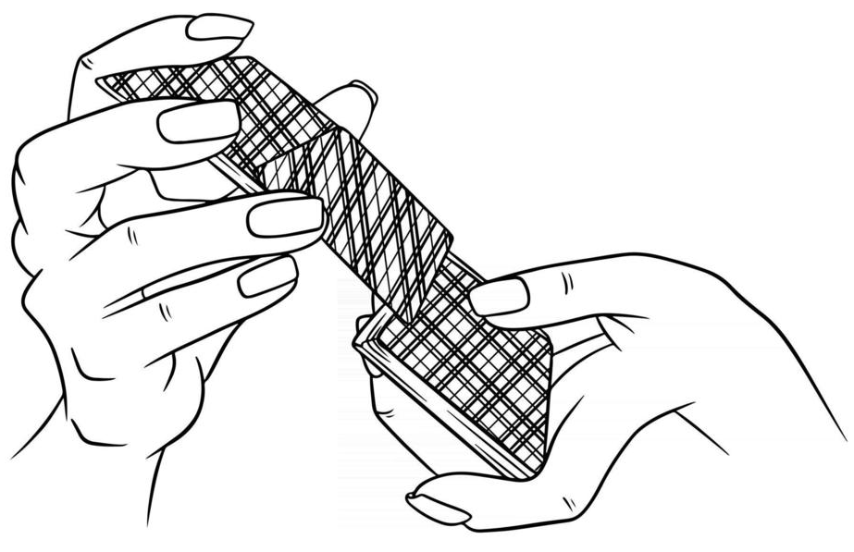
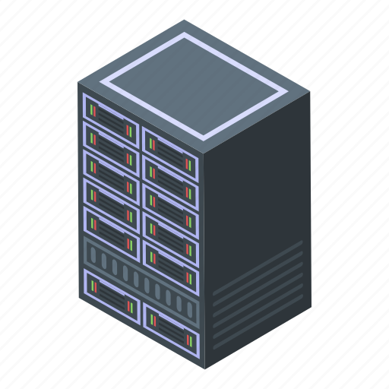
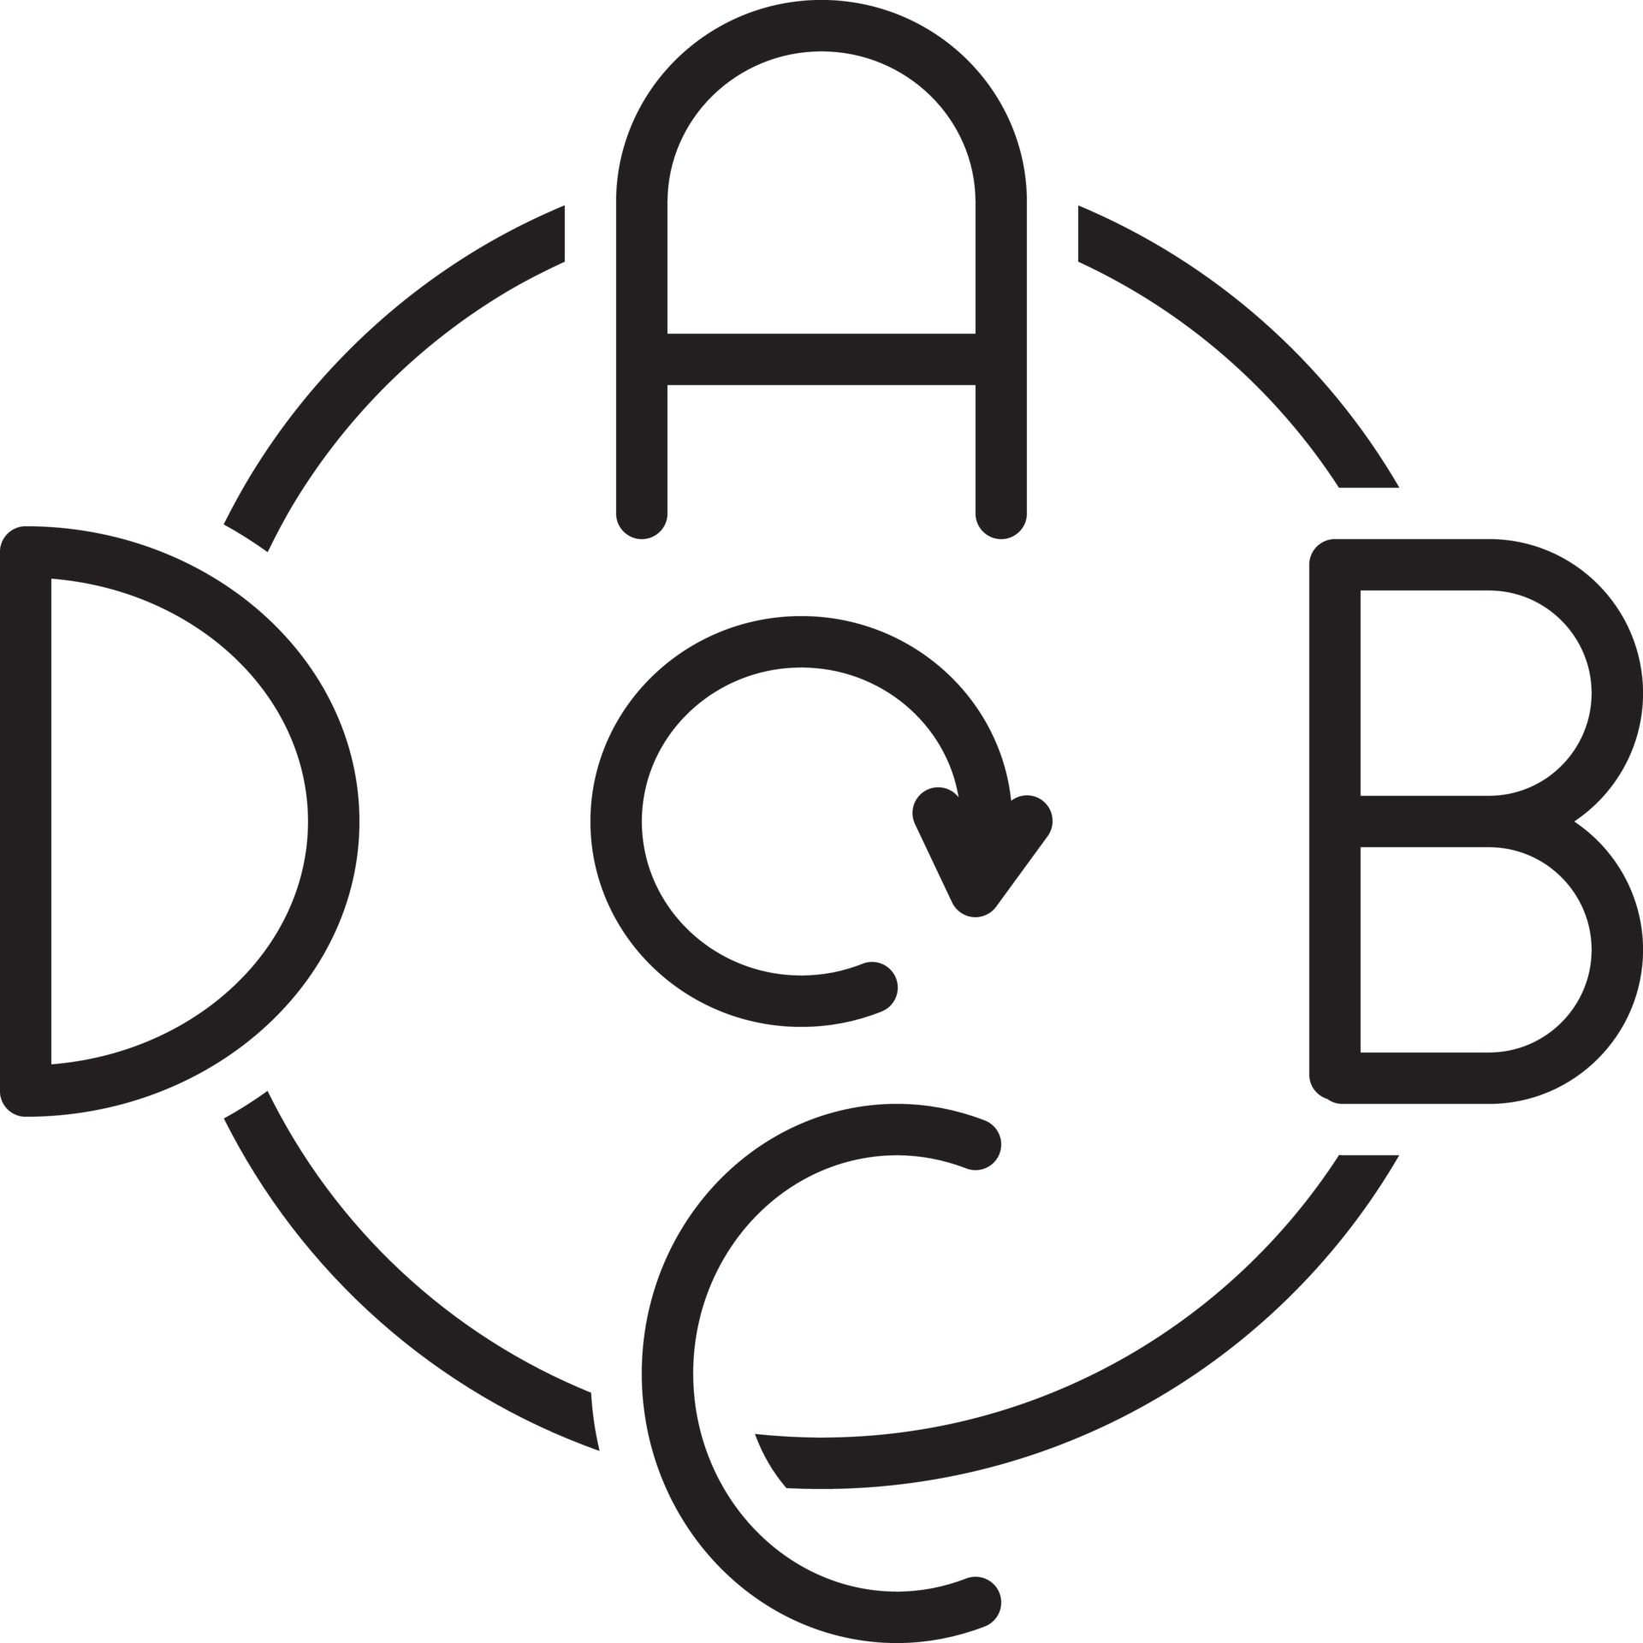
Multiparty Oblivious Shuffling
Input: Arithmetic secret shares of a data vector
$$d_{1}=\left(\begin{matrix}⦿ \\ ◈ \\ \begin{matrix} \\ ► \\ \end{matrix}\end{matrix}\right)$$
Output:
A permutation $π_{i}$ for each server${ P}_{i} ∈\{P_{1},…, P_{L−1}\}$
Opened shuffled data vector for server $P_{L}$
$$π_{1}$$
Server 1
$$d=d_{1}+d_{2}+d_{3} =\left(\begin{matrix}⦿ \\ ◈ \\ \begin{matrix} \\ ► \\ \end{matrix}\end{matrix}\right)$$
$$d_{2}=\left(\begin{matrix}⦿ \\ ◈ \\ \begin{matrix} \\ ► \\ \end{matrix}\end{matrix}\right)$$
$$π_{2}$$
Server 2
$$d_{3}=\left(\begin{matrix}⦿ \\ ◈ \\ \begin{matrix} \\ ► \\ \end{matrix}\end{matrix}\right)$$
$$d′=π_{2}(π_{1}\left(d\right)) =\left(\begin{matrix} \\ ► \\ \begin{matrix}◈ \\ \\ ⦿\end{matrix}\end{matrix}\right)$$
Server 3
Notes:
To hide result patterns and padded values, we develop multiparty oblivious shuffling protocol.
The input is arithmetic secret shares of a data vector, and the output is a permutation for each of the first L-1 parties, and the opened shuffled data vector for the last party.
As illustrated here, for the first two servers, each holds a permutation whereas the server 3 holds the shuffled data in plaintext.

Slide 16
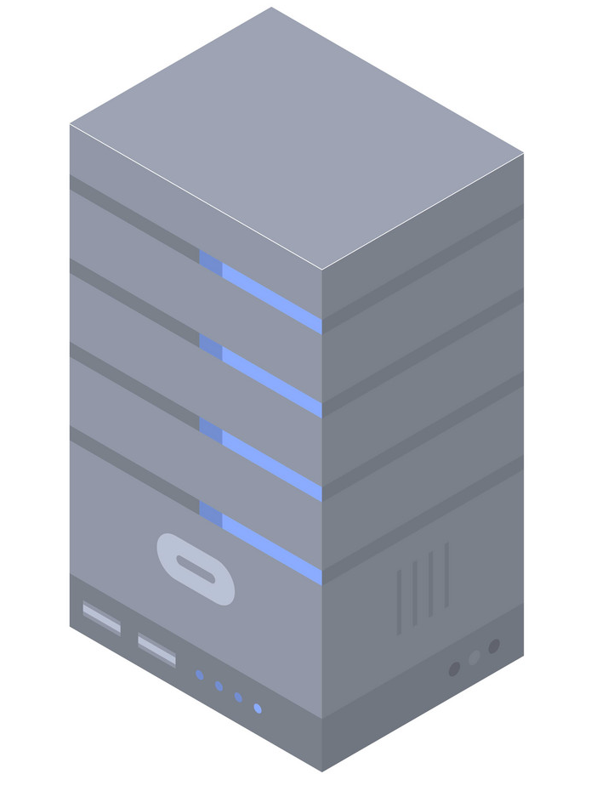
Final Step – Reverse Shuffling/Output
Search Complexity:
Reader communication: $O\left(n_{s}\right)$
Reader computation: $O\left(N\right)$
Server computation: $O\left(N.m\right)$, including additions and multiplications over small integer numbers
Parameters:
$n_{s}:$search result size
$m:$ Bloom filter size
$N:\#$documents
$$d= π_{1}^{−1}{(π}_{2}^{−1}(d^{′}))$$
$$π_{1}$$
Server 1
$$=\left(\begin{matrix}⦿ \\ ◈ \\ \begin{matrix} \\ ► \\ \end{matrix}\end{matrix}\right)$$
$$π_{2}$$
Padded values
Server 2
$$d′$$
Server 3
Notes:
In the final step, the reader receives permutations and the permuted data vector from the servers.
The reader then applies reverse permutations to recover the original data, also remove the padded values, and then obtain the final search output.
Regarding search complexity, the reader communication overhead is bound by the search result size, the reader computation overhead is linear in the number of documents, and the server computation is linear in the number of documents times Bloom filter size.
In fact, server computation is fast because it only includes additions and multiplications over small integer numbers in the range of 16 bits or 2 bytes.

Slide 17
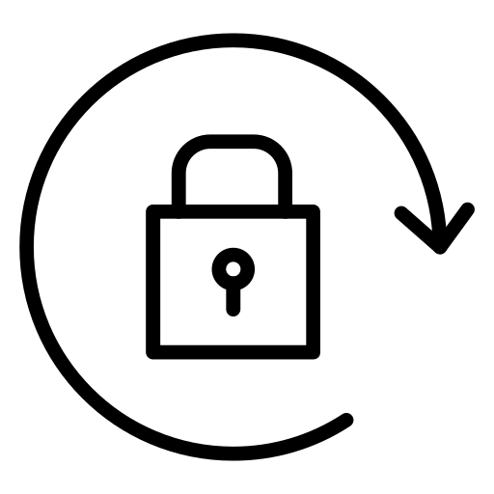
Permission Revocation
A writer needs to revoke the reader's search permission
Re-encrypt its search index
Key rotation:
A good practice recommended by Google, Microsoft, or Amazon
Mandated by regulations: NIST.SP.800-57pt1r4, PCI-DSS-v4-0
Server 1
$κ_{1}^{′} { κ}_{2}^{′}$ ${ κ}_{3}^{′}$
$$κ_{1}^{′}+κ_{2}^{′}+{ κ}_{3}^{′} =κ′$$
Server 2
Server 3
A writer
Notes:
Apart from keyword search, our MUSES supports permission revocation efficiently, which happens when a writer needs to revoke the reader’s search permission.
The way we choose to implement it for long-term privacy is to re-encrypt the search index of the writer with new secret keys, which is so-called key rotation.
This is a good practice recommended by companies and even mandated by regulations.
Our high-level idea is to secret-share the new key for multiple servers, so that the servers can cooperate to update the encrypted search index securely without revealing the new secret key and the data of the writer.

Slide 18
Evaluation - Configuration
Servers:
Amazon EC2 r5n.4xlarge instances
8-core Intel Xeon Platinum 8375C CPU @ 2.9 GHz, 128 GB RAM
Client:
Intel i7-6820HQ CPU @ 2.7 GHz, 16 GB RAM
Implementation:
C++ with ~2,500 LOCs
Libraries: Secp256k1, OpenSSL, EMP-Toolkit, ZeroMQ
Notes:
To evaluate our MUSES $↓$, we use amazon ec2 instances with octa-core high-performance CPU.
Our client is a laptop quad-core i7.
Our implementation is in Cpp.
We use popular and standard cryptographic libraries in our implementation, and ZeroMQ for network communication between the servers and client.

Slide 19
Evaluation – Search
Reader’s bandwidth:
$12×−97×$ smaller than DORY (hide patterns), $6×$ larger than FP-HSE (leak patterns)
End-to-end latency:
$2×−4×$ faster than DORY, $127×−632×$ faster than FP-HSE
Notes:
We compare our MUSES with state-of-the-art searchable encrypted systems$↓$.
$↓$ Regarding the reader’s bandwidth, MUSES is up to two orders of magnitudes smaller than DORY, which also hides patterns, and about 6 times larger than HSE, which offers multi-writer feature but leaks all patterns.
$↓$ About the end-to-end latency, MUSES is 2-4 times faster than DORY, and a hundred to six hundreds times faster than HSE.

Slide 20
Evaluation – Permission Revocation
Writer’s bandwidth:
$2×−150×$ smaller than DORY/FP-HSE
Writer’s latency:
$12×−9600×$ faster than DORY/FP-HSE
End-to-end latency:
$2×−6×$ faster than DORY/FP-HSE
Notes:
$↓$ $↓$ $↓$ $↓$ For permission revocation, the writer’s bandwidth is up to two orders of magnitudes smaller than DORY and HSE, which do not have this built-in capability.
The writer’s latency is up to four orders of magnitudes faster, and the end-to-end latency is 2-6 times faster than DORY and HSE.

Slide 21
Evaluation – Multiple Servers
Keyword search: 7.4s-8.6s (1ms network latency), 10.3s-13.8s (60ms latency)
Permission revocation: 16.5s-23.8s (1ms latency), 20.1s-25.2s (60ms latency)
Notes:
Our implementation can support up to 6 servers. Adding more servers can enhance the security level as we allow up to L-1 out of L servers can be corrupt.
We evaluate with more servers and also under different network latencies between the servers.
In the case of 60ms latency, keyword search takes 3 – 5 seconds longer than with 1 ms latency, while permission revocation takes 1 - 4 seconds longer.

Slide 22
Conclusion
Our MUSES:
Hide all statistical information: search, result, and volume patterns
Minimal user overhead for search and permission revocation
Our artifact is available at: github.com/vt-asaplab/MUSES
Notes:
In conclusion, $↓$
Our MUSES is a multi-writer searchable encryption scheme that can hide all statistical information including search, result and volume patterns, while featuring minimal user overhead for search and permission revocation.
$↓$ We publish our source code here. Please visit it for more information.

Slide 23
THANK FOR YOUR ATTENTION
Q&A
Notes:
This is the end of my presentation. Thank you for your attention.

