Slide 1






A Full Threshold NIST PQC-Compliant Framework for Distributed Trust in Federal Public Key Infrastructure
Kiarash Sedghi∗, Changqi Sun†, Thang Hoang†, Bechir Hamdaoui‡, Attila A. Yavuz∗
∗University of South Florida, †Virginia Tech, ‡ Oregon State University
Notes:
QRCodes and Proof Read
Good morning everyone. Today me and Kiarash will present our work A Full Threshold NIST PQC-Compliant Framework for Distributed Trust in Federal Public Key Infrastructure. This is joint work with Thang Hoang, Bechir Hamdaoui, and Attila Yavuz. We come from the University of South Florida, Virginia Tech and Oregon State University.

Slide 2





Federal PKI
Identity
Authentication
Secure Communication
U.S. Department of the Treasury
U.S. Department of State
U.S. Department of Transportation
U.S. Department of Education
Notes:
As we know, FPKI acts as the trust backbone for the entire federal ecosystem. It provides a unified framework for identity, authentication, and secure communication across government entities.
Around it, you can see multiple federal agencies, such as the Department of State, Department of Education, Department of Transportation, and Department of Treasury. Each of these agencies operates within the FPKI.

Slide 3

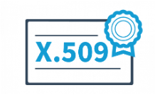
Federal PKI
Identity
Authentication
Secure Communication
U.S. Department of the Treasury
U.S. Department of State
Traditional Standard FIPS 186-5
(RSA, ECDSA)
U.S. Department of Transportation
U.S. Department of Education
Notes:
The core technical component inside Federal PKI: digital signature used to generate the certificate in X.509 format.
Because Federal PKI is a government trust infrastructure, it cannot adopt arbitrary cryptographic algorithms. Any digital signature algorithm used in this system must follow NIST standards.
In the current classical setting, Federal PKI relies on FIPS 186-5, which specifies approved digital signature algorithms such as RSA and ECDSA.

Slide 4


Federal PKI
FCP CA
⋯
U.S. Treasury CA​
⋯
⋯
NASA Operational CA
Notes:
What does the FPKI looks like? Federal PKI is organized as a certificate hierarchy, starting from highly trusted root Certificate Authority, Federal Common Policy-CA down to other CAs like US treasury CA.

Slide 5


Threats to the Current FPKI
I am a Quantum Adversary
FCP CA
Centralized Certificate Signing
Traditional Standard Signatures
  ECDSA and RSA
  Broken by Shor’s Algorithm [1]
⋯
U.S. Treasury CA​
⋯
⋯
NASA Operational CA
[1] Shor, Peter W. "Polynomial-time algorithms for prime factorization and discrete logarithms on a quantum computer." SIAM review 41, no. 2 (1999): 303-332.
Notes:
The current FPKI faces two key threats: centralized certificate signing and reliance on traditional standard signatures, such as ECDSA and RSA. In the post-quantum setting, a quantum adversary may break these classical signature schemes. If the CA is compromised, it will be a disaster.
In this example, if the Treasury CA is affected, then the certificate and entities below it in the hierarchy may also become untrusted. This creates a cascading failure in the Federal PKI trust chain.

Slide 6
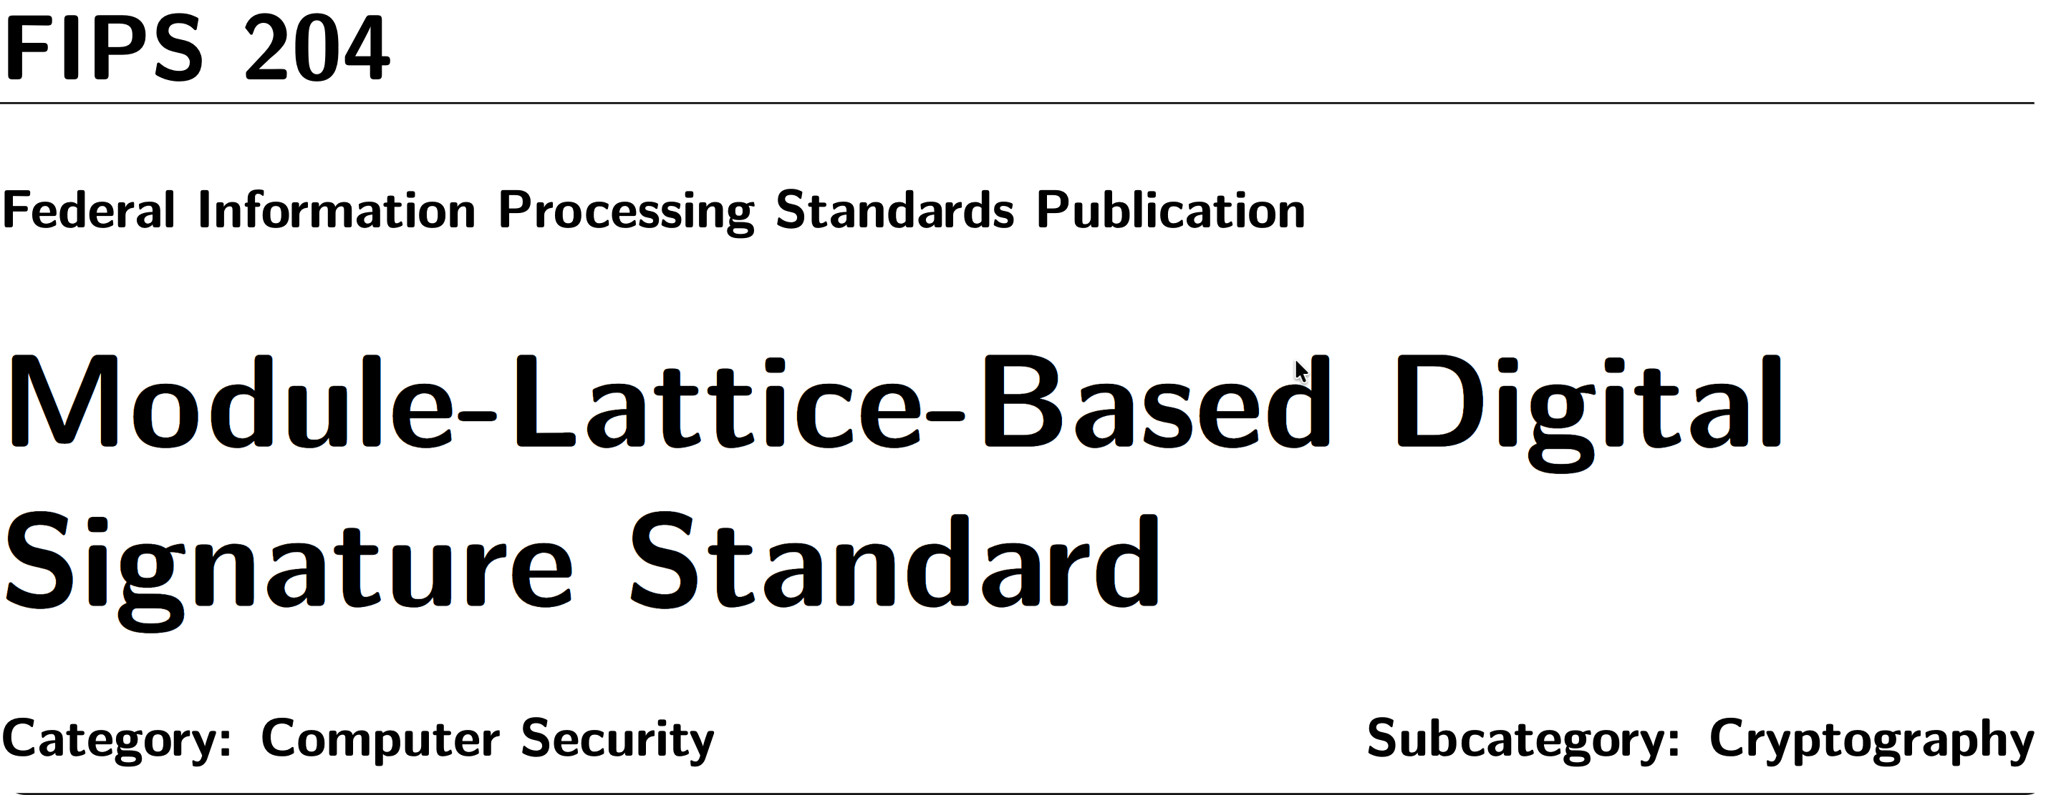
Research Gap
Non-Standard
Threshold non-NIST Post-quantum Signatures
(e.g., Ringtail [1])
NIST Post-quantum Signature Standards
(e.g., FIPS 204 / ML-DSA)
Threshold Modified FIPS 204
(Noise addition, Message-independent sampling)
-----------------------------
Bienstock et al. [2]
Dufka et al. [3] Borin et al. [4]
[1] Boschini, Cecilia, et al. "Ringtail: practical two-round threshold signatures from learning with errors." 2025 IEEE Symposium on Security and Privacy (SP). IEEE, 2025.
[2] Bienstock, Alexander, et al. "Quorus: Efficient, scalable threshold ML-DSA signatures from MPC." IACR ePrint 1163 (2025): 2025.
[3] Dufka, Antonín, et al. "Trilithium: Efficient and universally composable distributed ML-DSA signing." Cryptology ePrint Archive (2025).
[4] Borin, Giacomo, et al. "Threshold signatures reloaded: ML-DSA and enhanced raccoon with identifiable aborts." Cryptology ePrint Archive (2025).
Notes:
Now the natural question is: If classical signatures are threatened, why not move Federal PKI directly to post-quantum signatures?
NIST has already standardized FIPS 204.
However, Federal PKI also needs threshold signing to avoid a single compromised CA key.
Existing work does not fully satisfy this requirement. One line uses non-NIST post-quantum signatures, such as Ringtail. Another line targets threshold FIPS 204, but modifies the signing procedure to gain the efficiency, which cannot achieve the algorithmic compliance of NIST standard.
This matters because Federal PKI is standards-driven. Algorithmic compliance means the threshold protocol follows the exact FIPS 204 signing algorithm, rather than only producing signatures that can be verified by a standard FIPS 204 verifier.

Slide 7
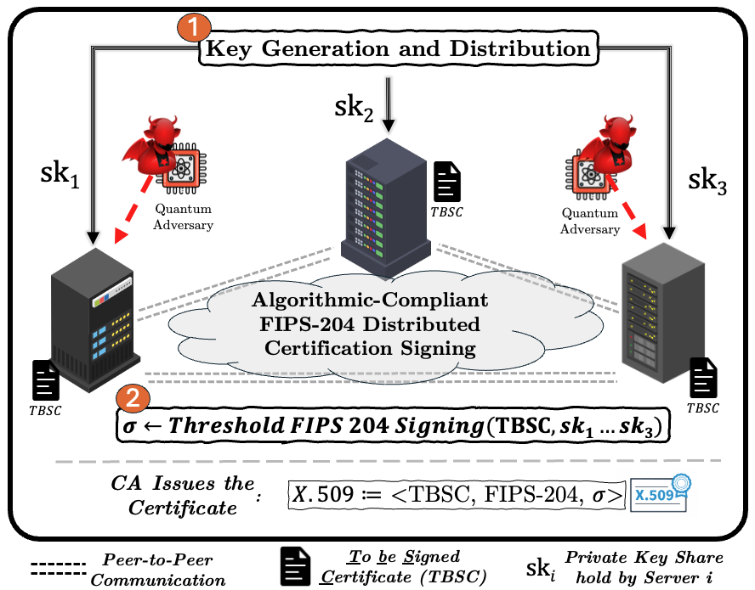






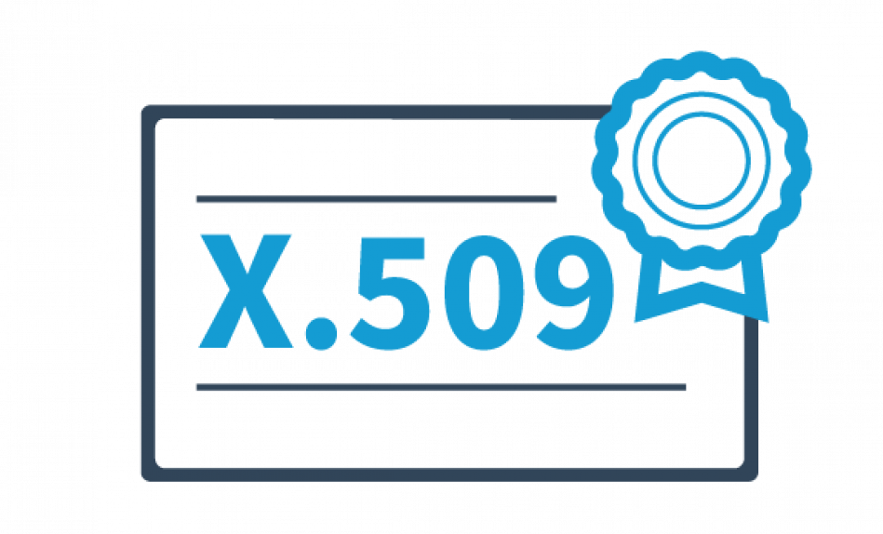





Solution: SHIELD Overview
Key Generation and Distribution
  CA Signing Key Distribution
Threshold Signing
  Algorithmic FIPS 204 Compliance
  Issue Certificate
    Content: TBSC
    Algorithm Identity: FIPS 204
    Signature Value: FIPS 204 Signature
We trust ABC
DoD, and IdenTrust
We trust IdenTrust and
digicert
But
DigiCert Federated ID CA G2
Other
CAs
ABC Corp
ABC Corp:
Our Policy is Caution
CA1
Trust:
1. ABC Corp
2. IdenTrust
Trust:
1. digicert
2. IdenTrust
IdenTrust Global
Common Root
CA 1
DoD
Interoperability
Root CA 2
Trust:
1. digicert
2. ABC Corp
No transitive
trust accepted
Other
CAs
FBCA G4
(FPKIMA)
Other
CAs
: Cross certification request
: Cross certification response
: CA Nodes
: Prohibited trust
: Fully allowed trust
: Partially conflicting trust
Quantum Adversary
Notes:
To address this research gap, we propose SHIELD, which consists of two procedures: key-generation distribution and threshold signing.
The key-generation distribution procedure splits the CA signing key into shares and distributes them across multiple servers, avoiding a single point of compromise.
The threshold signing procedure allows these servers to jointly sign the TBSC, or to-be-signed certificate, while preserving algorithmic compliance with the FIPS 204 signing process.
The output remains a standard FIPS 204 signature, so it fits directly into the existing X.509 certificate structure: the TBSC, the FIPS 204 algorithm identifier, and the signature value.

Slide 8
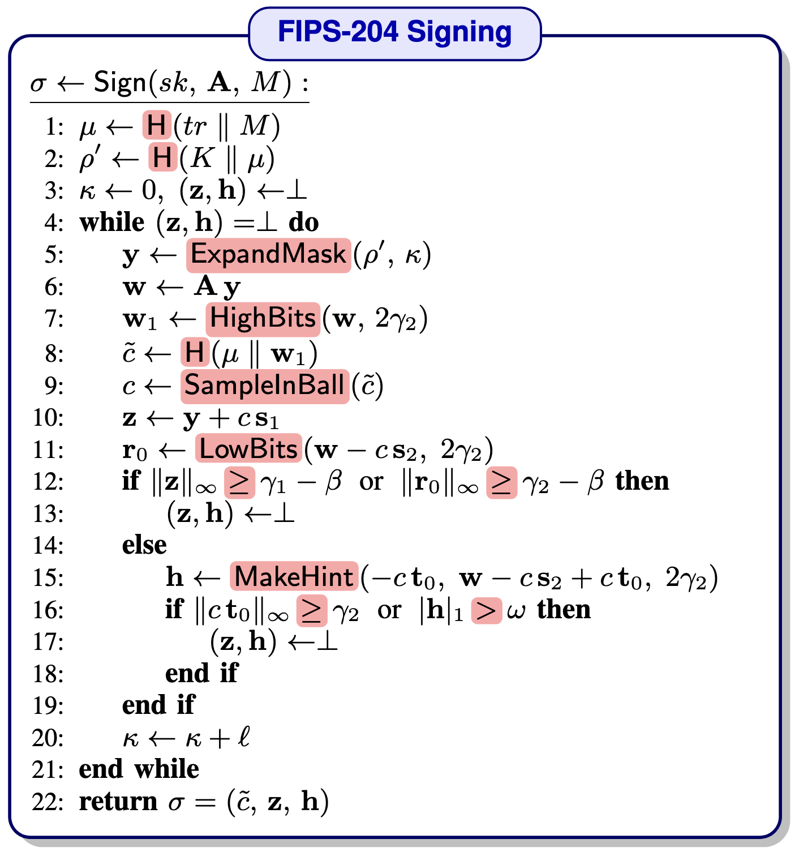
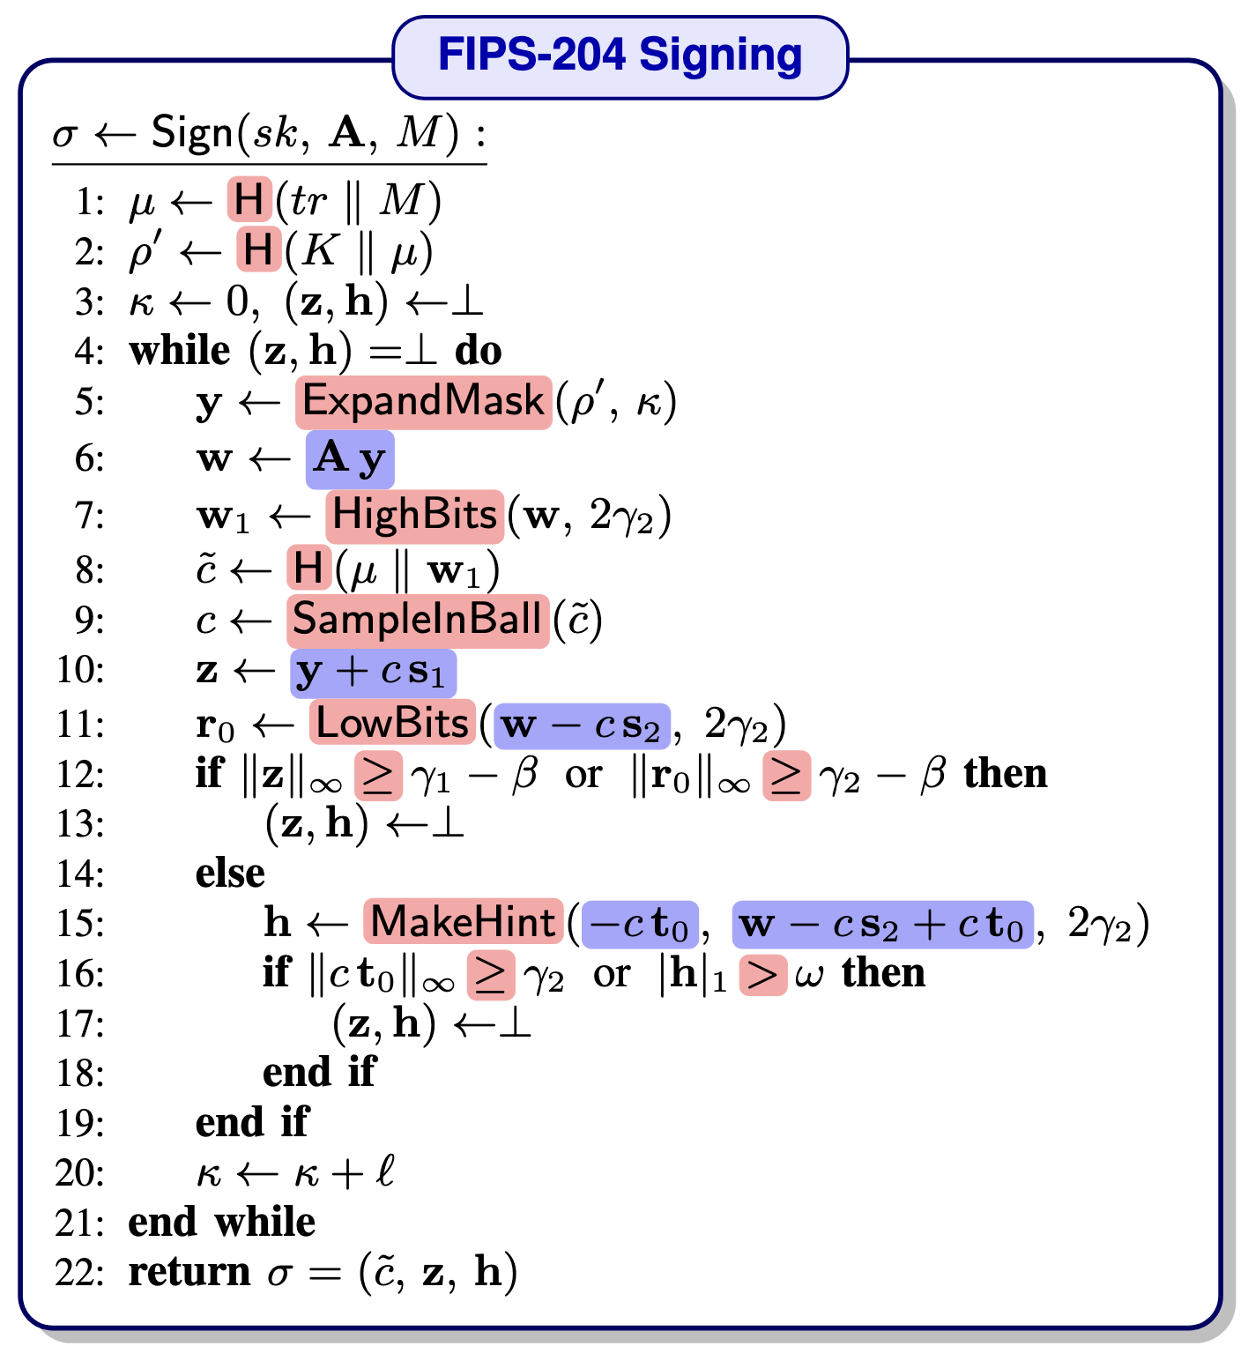
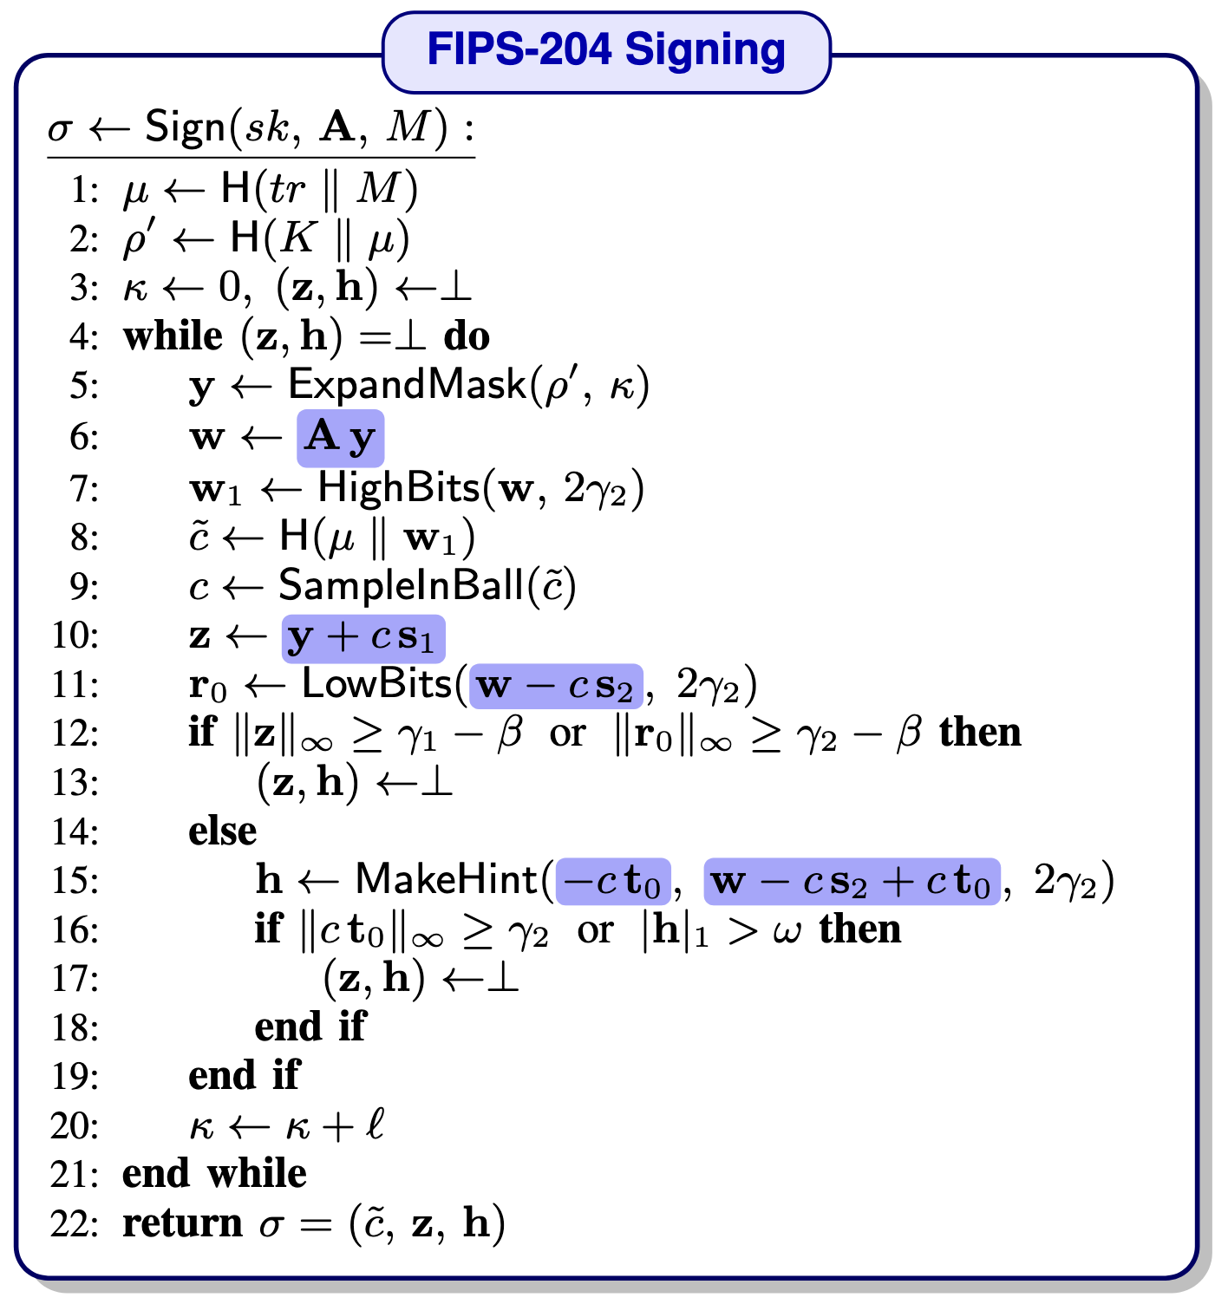
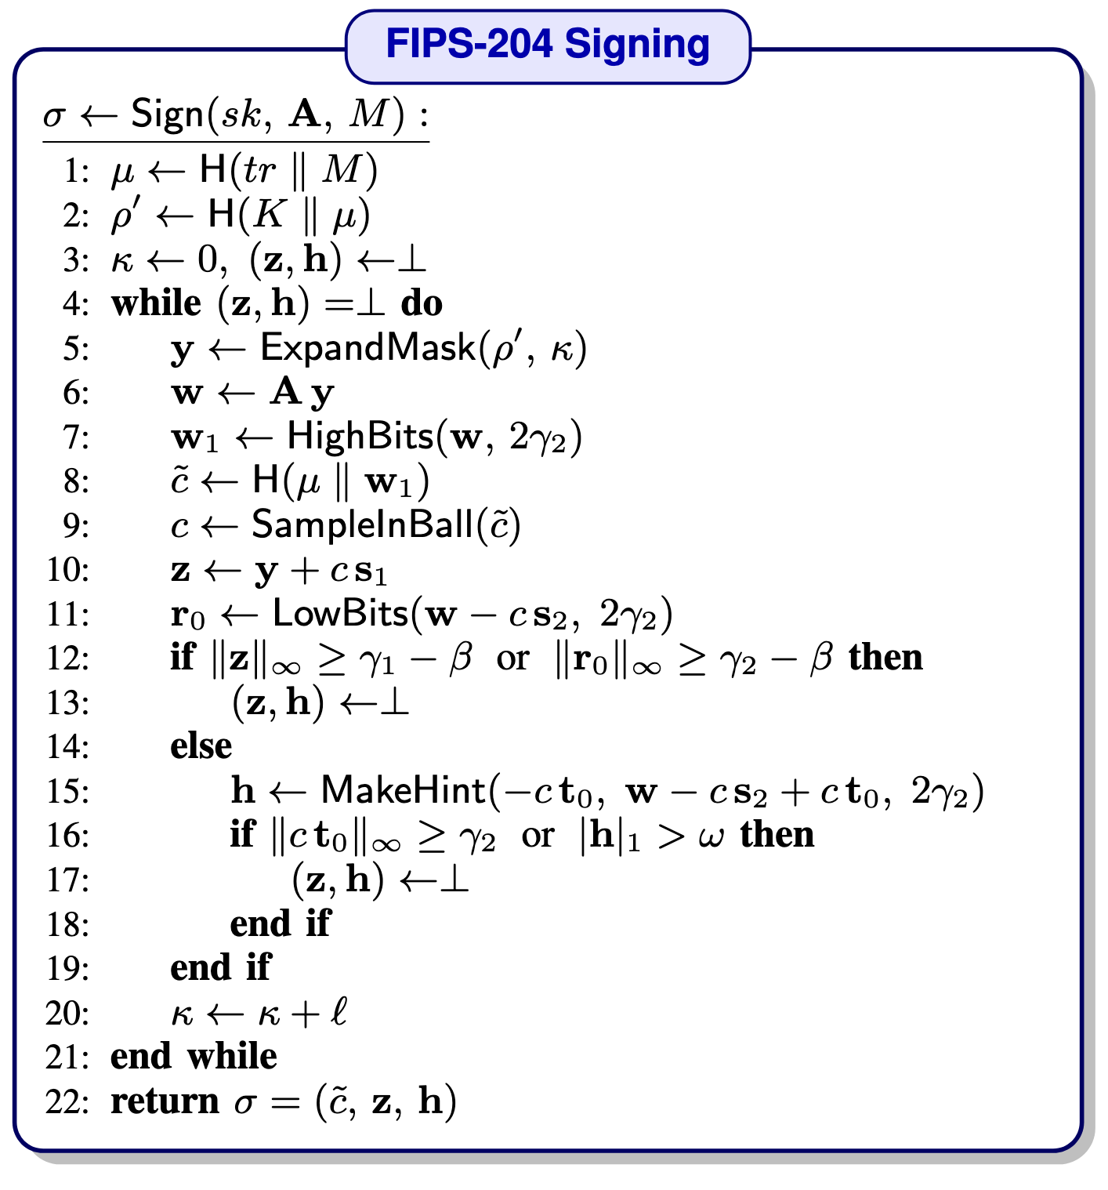
Algorithmic FIPS 204 Compliance
Arithmetic Friendly
NTT-based multiplication
(e.g., Ay, cs₁)
Polynomial addition/subtraction
(e.g., y + cs₁)
Mode Conversion
Boolean Friendly
Hash functions
(e.g., ExpandMask, H)
Decomposition operations
(e.g., HighBits, LowBits)
FisherYates algorithm
(e.g., SampleInBall)
Norm Comparison operations
Notes:
Refer to paper that other algorithms have been presented in the paper.

Slide 9
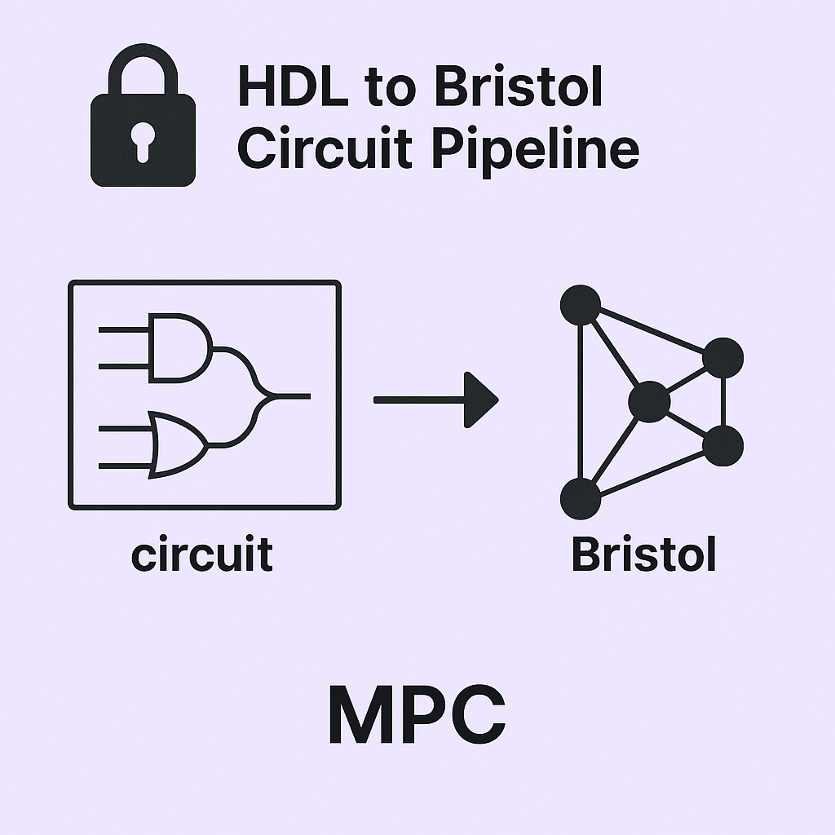




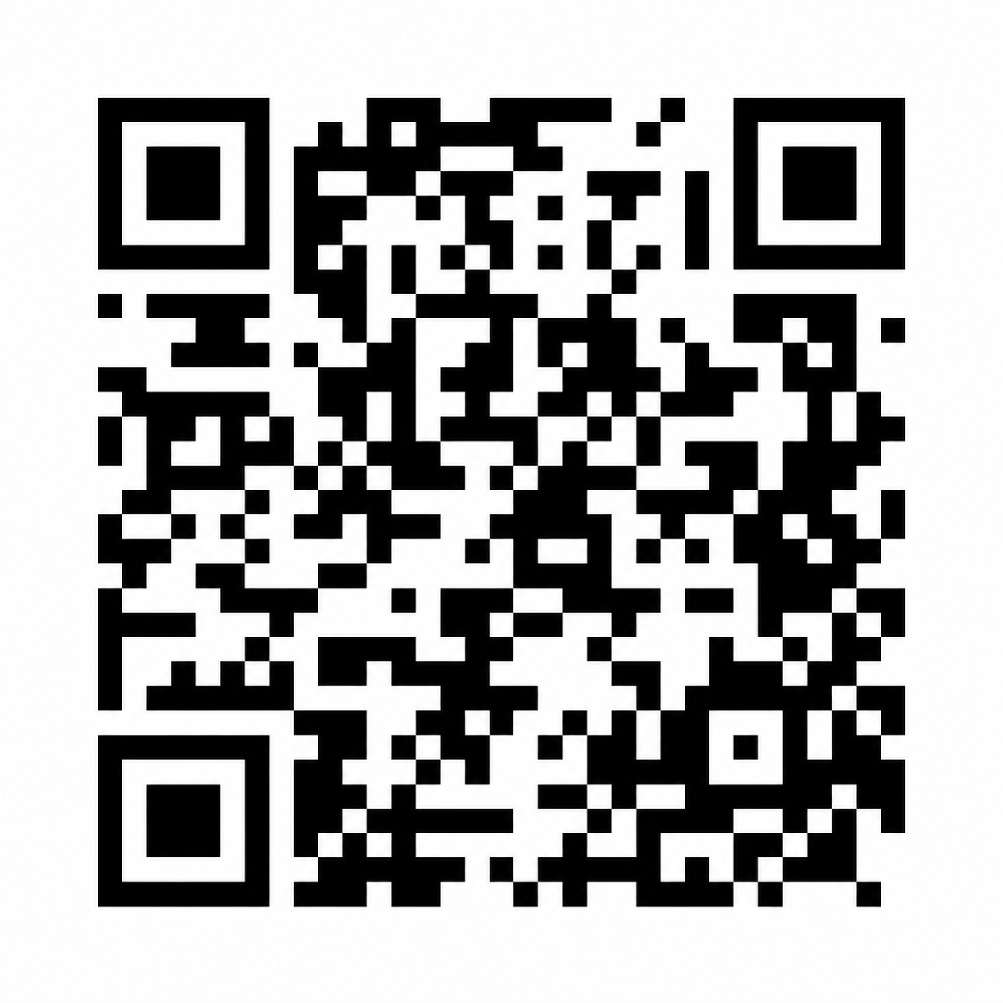

Implementation
SyntYoCirc
Full implementation in C++
  Arithmetic Operations: From-scratch SPDZ
  Boolean Operations: WRK17 [1] by EMP-Toolkit [2]
HDL
FIPS-204 Components
Addition Circuits (32-bit adder) 27% gate reduction
  Ours: 294 gates, 358 wires
  SOTA: 375 gates, 439 wires
FisherYates Optimizations ~890K gates to ~355K
  Representation of {-1, 0, 1} with 2 bits instead of 23 bits
Yosys RTL Synthesis
Circuit Optimization
YosysHQ
A generic tool for Boolean Circuits
  SOTA Limited Functionalities (no FIPS 204)
    Scale-Mamba
    OpenFHE
    Emp-Toolkit
  How can we have a generic solution?
Bristol Format
AND/XOR/INV gates
2 1 3 4 5 XOR
2 1 5 6 7 AND
[1] https://github.com/open-threshold-pqc/SHIELD
[2] Wang, Xiao, Samuel Ranellucci, and Jonathan Katz. "Global-scale secure multiparty computation.” In Proceedings of the 2017 ACM SIGSAC conference on computer and communications security
[3] https://github.com/emp-toolkitx

Slide 10
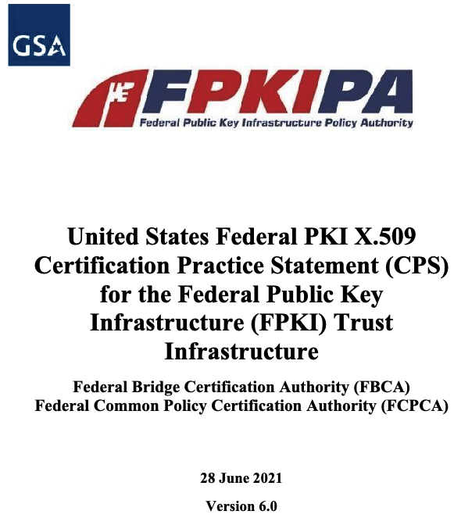
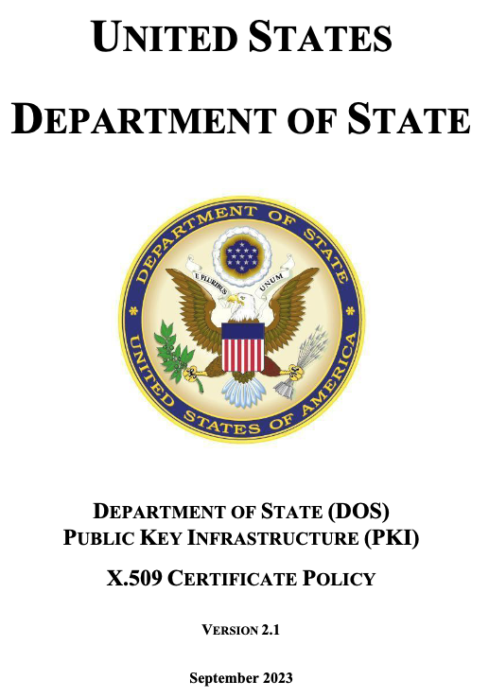
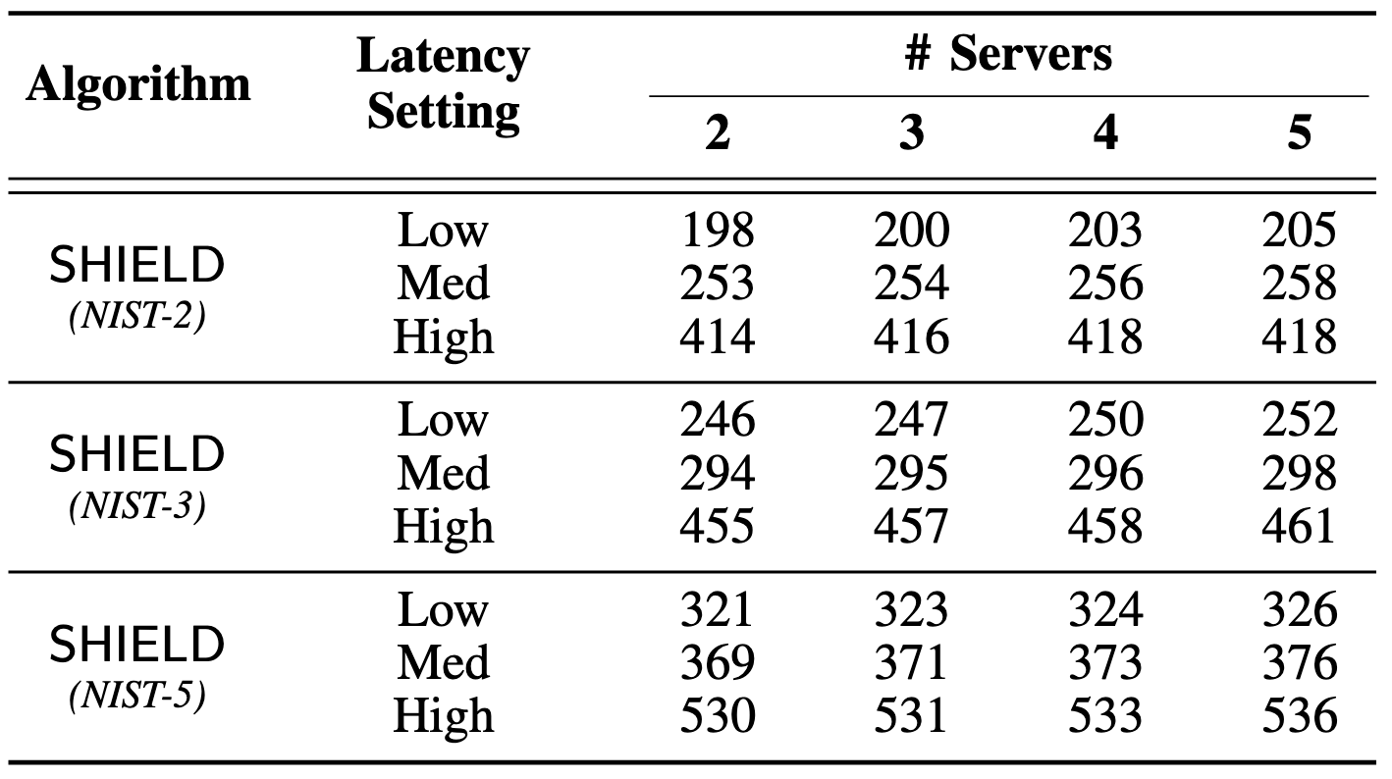
Performance
Evaluation Setup
  Servers (2-5)
  Networks (Latency: 1-10 ms, BW: 10Gbps)
  Security levels (NIST 2 – NIST 5)
Threshold Signing Latency
  Single Iteration FIPS 204
  Leveraging multi-core to run in parallel
  Throughput: 20 in low latency and 6 in high latency
Communication
  Round complexity: 23
  Major Contributors:
    Computing Domain Conversions
    Circuit Authenticity Checks
FPKI Operational Model
Onboarding, re-keying, policy updates by FPKIPA
  DOS requires 2+ weeks notice
  DOS artifact distribution in 24 hours
Key Takeaways
Fully Algorithmic-compliant Threshold FIPS 204
Transparent Thresholding with No Assumption
Implementation and Integration for FPKI
Notes:
Not only FPKI but it can also be applied to other applications that require NIST compliance (TLS) (will be addressed)
Security levels -> Underlying MPC should be adjusted in the security level (will be addressed)
Sub-second performance in various configurations

Slide 11

Conclusion
SHIELD: Algorithmically NIST-compliant Threshold FIPS 204 Signature
Practical performance within FPKI operational tolerance
Open-source implementation with optimized Verilog circuits
Thank you!
https://github.com/open-threshold-pqc/SHIELD

